Slide 2
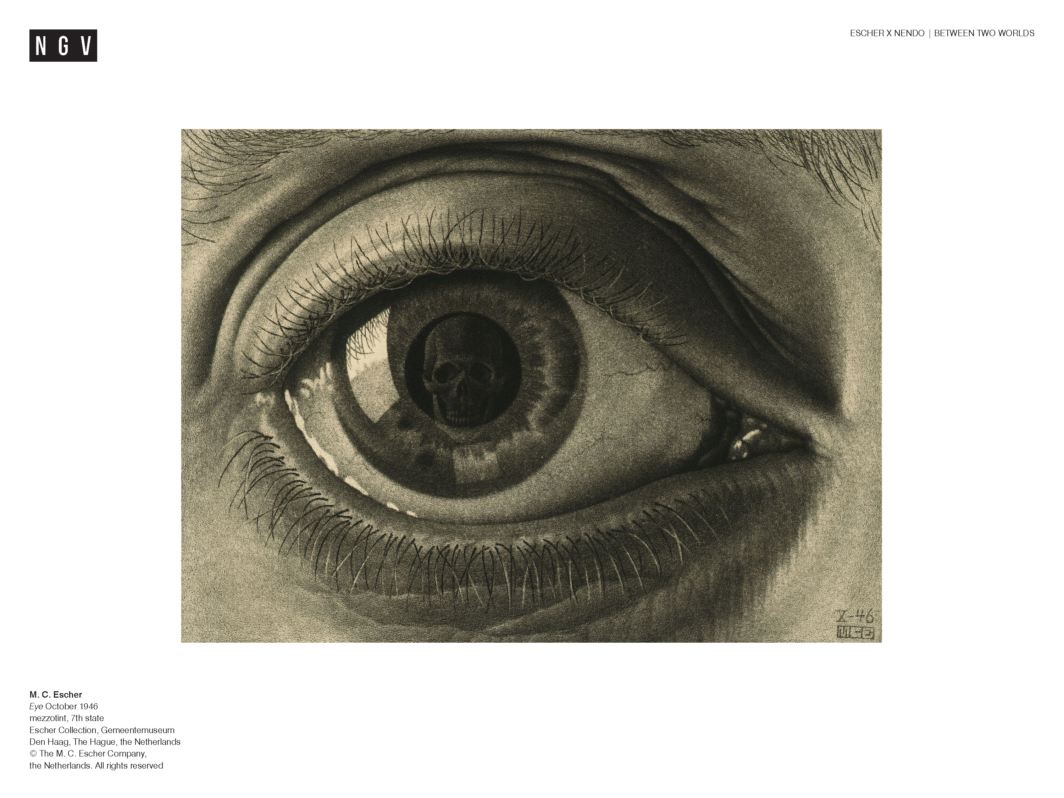
Notes:
Share this information with your students:
Visual perception refers to how we make sense of the complex visual world around us. It refers to how we meaningfully sort and interpret the shapes, forms and patterns we see.
We use different types of perceptual cues to create meaning. We can broadly group them into two groups: Gestalt cues and depth/distance cues
Gestalt principles are a set of principles described by German psychologists (Max Wertheimer, Wolfgang Kohler, and Kurt Koffka) at the start of the 20th Century to describe how we group and order visual information. The term ‘Gestalt’ refers to the complete form or the total effect – the idea that our understanding of a thing is based on more than the sum of its parts.
Depth cues are the cues that give us information about depth and distances. Biological depth cues come from the movement of the parts of the eye. Pictorial depth cues refer to how the illusion of depth is created in pictorial (2D) representations of three dimensional space.
Dutch artist Maurits Cornelis Escher created works of art that utilise both gestalt principles and pictorial depth cues to great effect.

Slide 3
FIGURE/GROUND
SIMILARITY
PROXIMITY
CLOSURE
Notes:
Share this information with your students:
GESTALT PRINCIPLES
To make sense of the world, our visual system has developed a number of shortcuts. One of these is the grouping together of stimuli into simple coherent patterns, or wholes, known as gestalts. Pattern recognition (which includes psychological concepts of spatial proximity, similarity and completeness) allows for the rapid assimilation of information through a process called figure-ground organisation.
Figure/Ground
This refers to how we distinguish between an object and its surroundings. Objects are usually distinct from their background due to sharp outlines and edges, and colour or tonal contrasts. In the past, this would have helped our ancestors detect predators. Notice how at the top of this image it is more difficult to discern the individual leaves from the water? This is in part because the shape and colour of the leaves is more similar to the background than those in the foreground, which have very defined shapes and contrast strongly with the dark water.
Similarity
We tend to group things together that are similar. For example, in this image, titled Three Worlds, we group the trees, and the leaves and the fish. On closer inspection, we might group types of leaves that are the same – oak leaves and elm leaves, for example.
Proximity
We tend to group or associate things that are close to each other, for example the three trees reflected in the water or the groups of leaves that have floated together
Closure
Even if we cannot see the entirety of a thing, because its outline is broken or obscured, we still perceive it as being complete. Our brain fills in the gaps. In the image here, we can’t see the outline of the fish because the leaves are in the way, but we still ‘read’ the whole fish. We can’t see the whole of the tree reflected, but we fill in the missing parts of the branches.
Ask students:
What are the three worlds referred to in the title?
The world above, reflected in the water - the trees and sky.
The world on the surface of the water - the floating leaves.
The world beneath the surface of the water – the fish.

Slide 4
Notes:
Ask students:
Which Gestalt principle is evident here?
Share this information with your students:
This image is a tessellation - a pattern of repeating shapes with no gaps in between. Escher loved to devise tessellation patterns to totally fill a surface or plane. He called it ‘regular division of the plane’.
Ask students:
Which do you see: blue geese or white geese?
Share this information with your students:
In this image Escher plays with how we perceive Figure/Ground.
We can either look at the blue geese against a white background, or the white geese against a blue background – but not both at the same time. One of them has to be the object (the figure) and the other the background for our brains to make sense of what we are seeing.

Slide 5
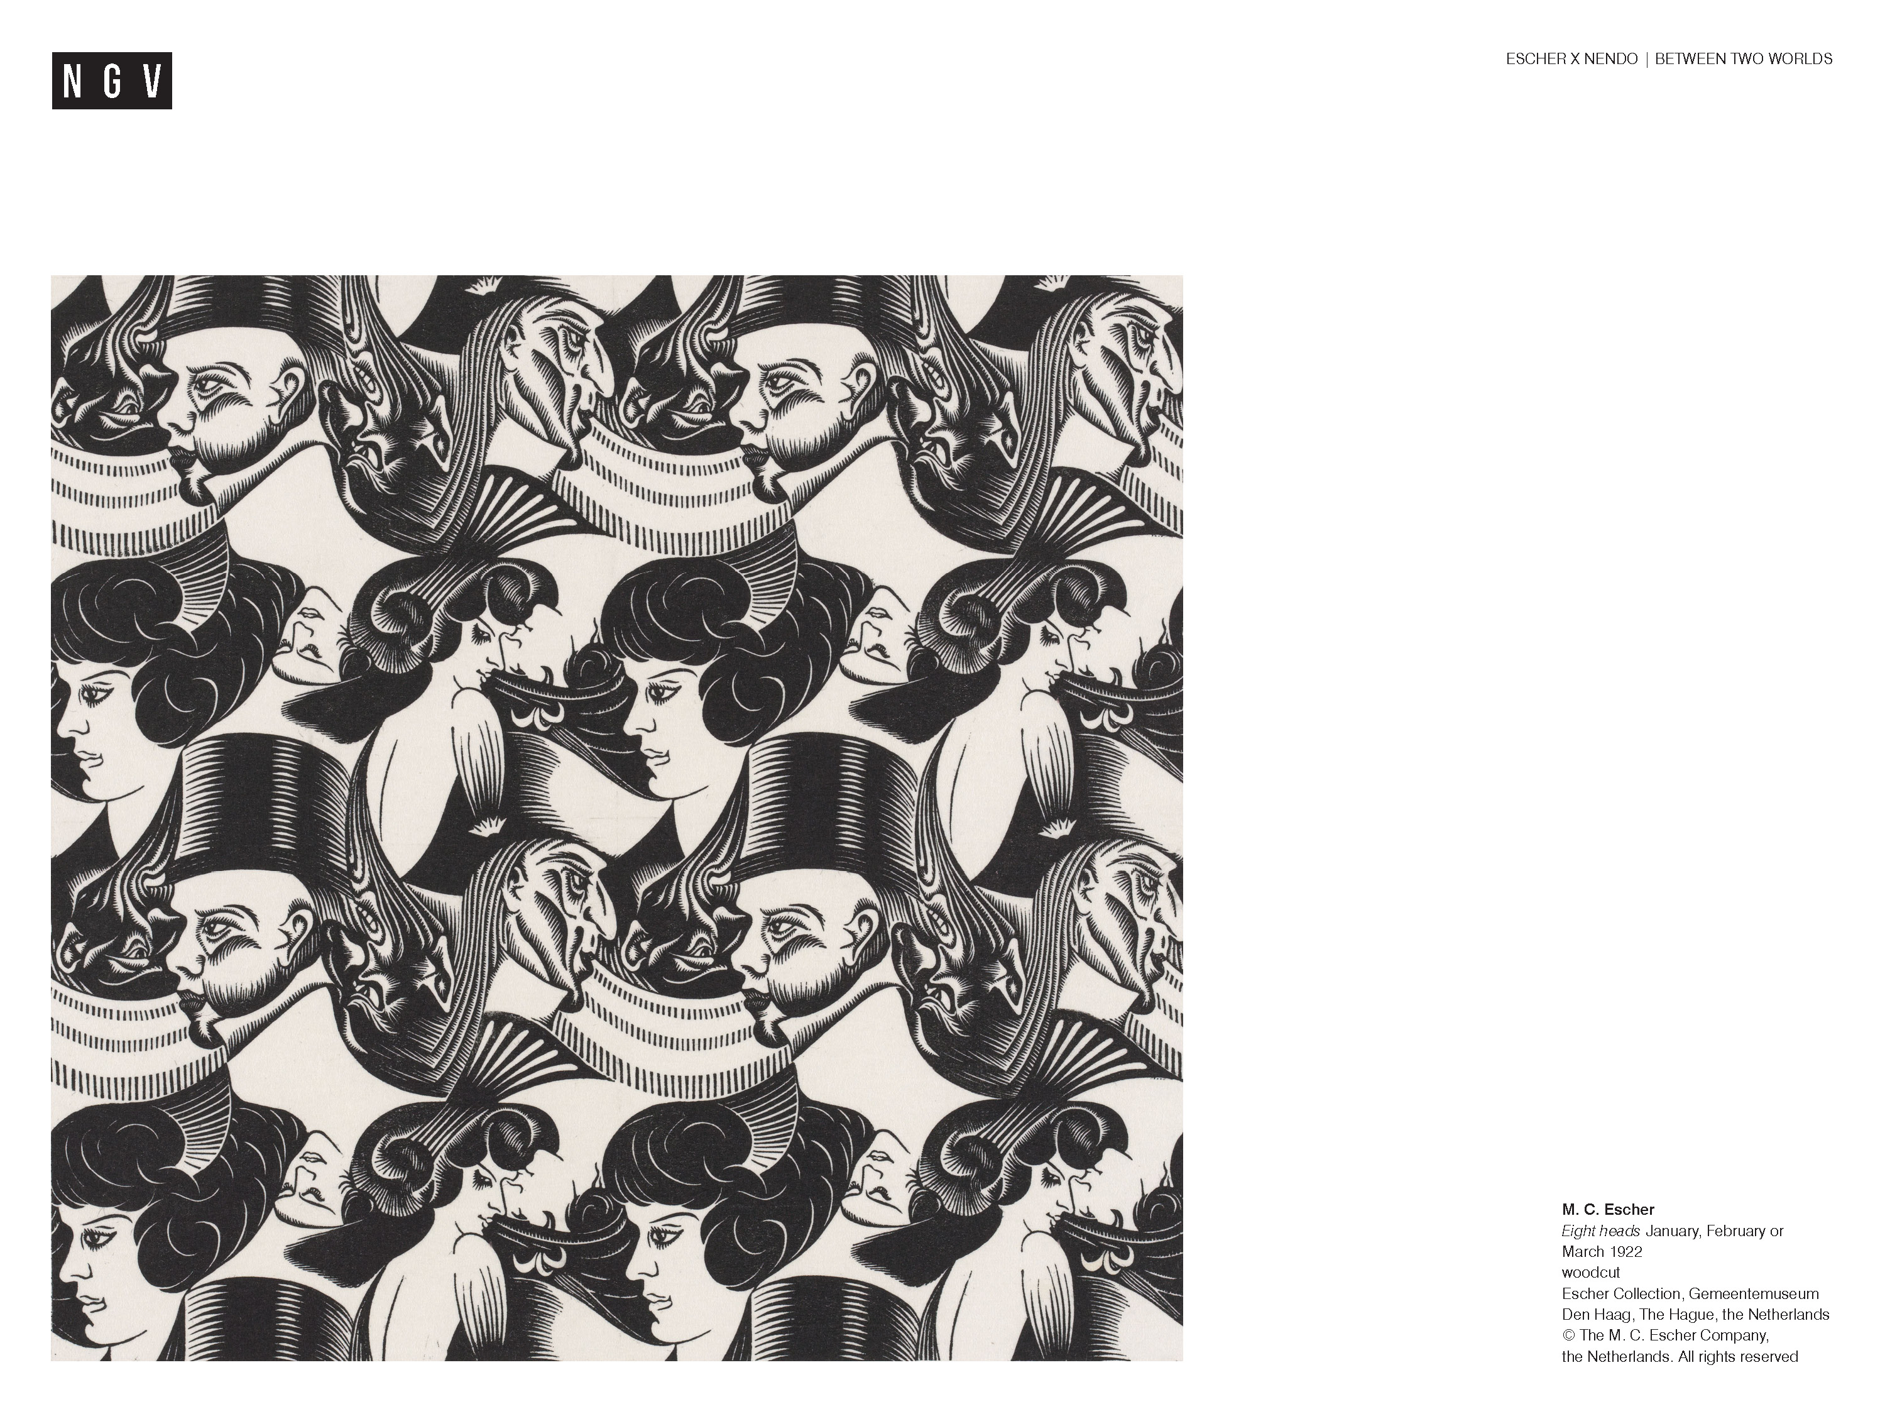
Notes:
Ask students:
Can you find the eight different heads M.C. Escher refers to in his title?
How many heads can you count in total?
Share this information with your students:
This work made in 1922 shows Escher’s early interest in tessellation and figure/ ground. The image is confusing because our brains struggle to make sense of the visual information, and we are constantly re evaluating figure vs ground and the orientation of the different faces.

Slide 6
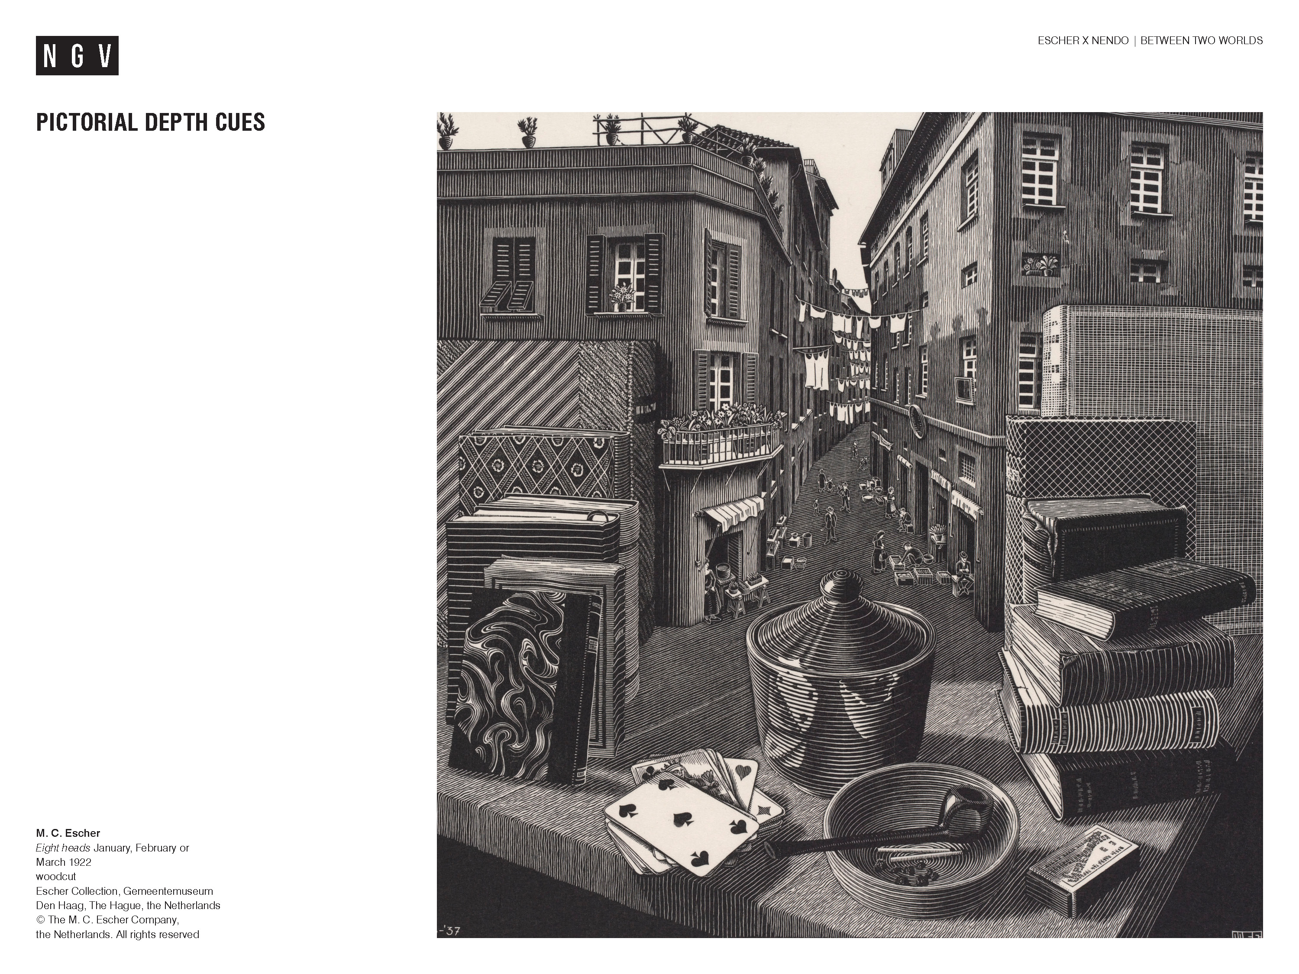
TEXTURE GRADIENT
HEIGHT IN THE VISUAL FIELD
RELATIVE SIZE
INTERPOSITION
LINEAR PERSPECTIVE
Notes:
Share this information with your students:
Escher was aware that drawing is an optical illusion that challenges the brain to construct a picture of reality. In his work, a flat two-dimensional plane is converted into a three- dimensional space which, according to Escher, is the only true reality we know. He said ‘something that is flat does not exist for us any more than something that is more than volumetric.’
M.C. Escher, Escher on Escher: Exploring the Infinite, Harry N. Abrahams, Inc., NY, 1989, p. 115.
His meticulous drawings and woodcuts are a lesson in depth perception, which is the ability of the human eye to see in three dimensions and to judge our distance from objects. Escher creates the illusion of three-dimensional depth by using a range of techniques.
Pictorial depth cues describe the techniques artists use to create the illusion of depth on a two-dimensional surface.
Texture Gradient
One way the illusion of depth is created is by rendering objects that are closer to the viewer with greater detail, and those further away with less detail. This is referred to as ‘Texture Gradient’. Objects that are rendered with greater detail appear closer to the viewer.
Ask students:
Can you find an example?
We can see the details of the print on the matchbox and the cards in the foreground, whereas further away we can’t any detail on the figures down the street, so they appear further away.
Share this information with your students:
Height in the visual field
Things placed closer to the horizon line (the line where the earth and sky meet) appear further away. Things based further away from the horizon line appear closer to us.
Ask students:
Can you describe an example in this picture?
The ashtray with the pipe resting in it looks very close to us because it is drawn very far from the horizon line, whereas the clothes hanging in the street are very close to the horizon line and therefore appear far away.
Share this information with your students:
Relative size
How big or small something appears affects our perception of how close or far away it is.
Things close to us look bigger than things that are further away. The cards on the table in the picture are shown as much bigger than the people, even though we know that in real life, people are bigger than cards. We ‘read’ this to mean the people are far away. The size of objects relative to each other affects our understanding of how close or far away they are.
Interposition
If one object partly hides another, we understand that the one in front overlapping the other is closer, and the obscured object is behind and further away. This overlapping is referred to as ‘Interposition’.
This image is based on a view of a street in Savona, Italy.
Ask students:
Is this a realistic scene?
Which elements are not realistic?
Which of the depth cues does Escher manipulate in this picture?

Slide 7
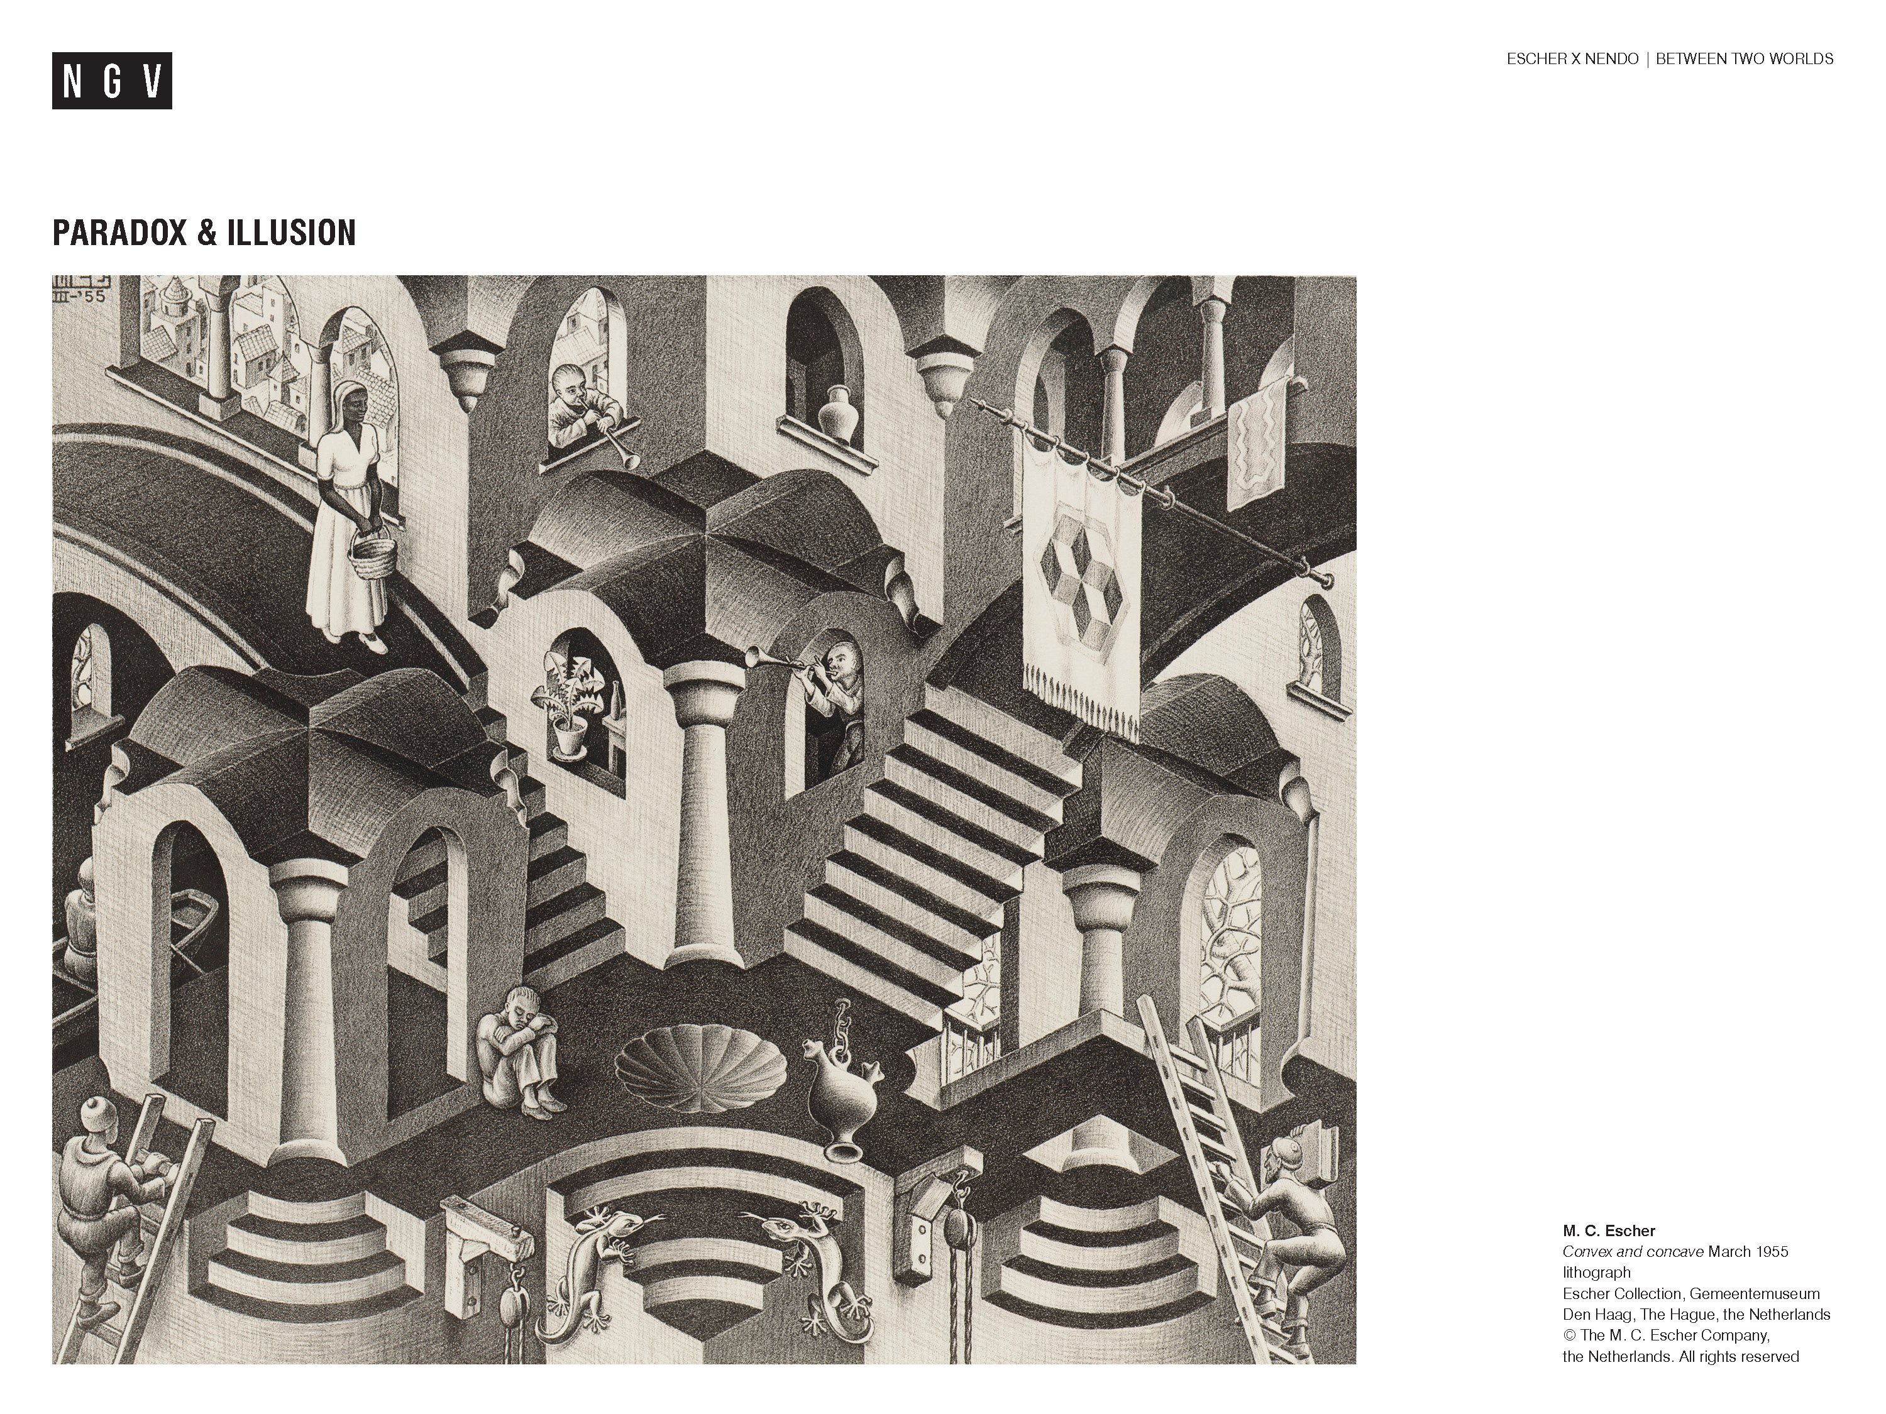
Notes:
Ask students:
Look closely at this image. What surprising things do you notice?
In some parts of the image we seem to be looking down and in others, looking up.
Share this information with your students:
Illusion, paradox and visual tricks
Artists often play with the ways that our brains process visual information to create illusions and visual tricks. Escher loved to combine multiple perspectives and viewpoints to create impossible images. Our brains struggle to comprehend this conflicting visual information, because it doesn’t fit in with our expected pattern of understanding the world. While it seems at first to make sense, opposing realities exist that would logically negate each other.
Ask students:
Use the pictorial depth cues to discuss this picture.
Further activity:
Visit the exhibition Escher X nendo | Between Two Worlds. Find examples to illustrate and describe the ways in which the exhibition design by nendo utilises gestalt principles, depth cues or visual tricks to play with our visual perception.

