Slide 2
Notes:
Share this information with your students:
Nendo is the Japanese design studio behind the exhibition design for Escher X nendo | Between Two Worlds.
Nendo (nendo is the Japanese word for ‘clay’) was founded in Tokyo in 2002 by designer Oki Sato.
Oki Sato was born in Toronto in 1977 to Japanese parents and graduated with a M.A. in Architecture from Waseda University, Tokyo in 2002.
Oki Sato is described as ‘one of the most prolific and dedicated designers working today... a skilled storyteller demonstrating intense imaginative prowess and a curious fascination with the manipulation of space, shifting perspectives, playful visual effects. [His] pared back super-precise designs … achieve a fascinating level of presence through a beguiling economy of means.’
Ewan McEoin, A house for Escher, Escher X nendo, Between Two Worlds, National Gallery of Victoria, Melbourne, 2018 p.98.
Sato’s work has been described as imaginative, whimsical and playful.
Nendo was invited to design an exhibition space to display and extend upon Escher’s works of art. The brief was to create spaces, installations or environments in response to thematic clusters of work and to add new aspects to the audience’s experience and understanding of Escher’s practice.
Oki Sato:
Although it is a privilege to collaborate with Escher, I won’t necessarily say it was about the specific connections between our work that has drawn me to this project.
More the fact that it is a completely new idea to design a collaboration between two creators – especially one being a graphic artist and the other a designer. To design an exhibition, create new contents and respectfully present another artist’s story is a great challenge.
Oki Sato quoted by Ewan McEoin, A house for Escher, Escher X nendo, Between Two Worlds, National Gallery of Victoria, Melbourne, 2018 p.98.

Slide 3
Notes:
Share this information with your students:
Oki Sato wanted his design to extend the themes and inspirations found in Escher’s work.
Sato noticed that Escher’s work demonstrated a fascination with the representation of space. Sato devised the house motif as a recognizable symbol of space, that could be used as a basic module of the design.
Ask students:
What are some of the ideas we associate with ‘house’? What are the parallels between nendo’s iterations of the house and Escher’s image above?

Slide 4
Notes:
Share this statement from Oki Sato with your students:
Oki Sato:
This simple shape can convey various concepts such as inside and outside, two-dimensional and three-dimensional, perspective and scale, as well as evoke emotions and feelings such as longing and nostalgia. When I thought about the invitation to design a space for Escher, I thought about a shape that can contain and convey all the layers and complexities of this exhibition and will serve as a ‘house’ for Escher.
Oki Sato quoted by Ewan McEoin, A house for Escher, Escher X nendo, Between Two Worlds, National Gallery of Victoria, Melbourne, 2018 p.101.

Slide 5
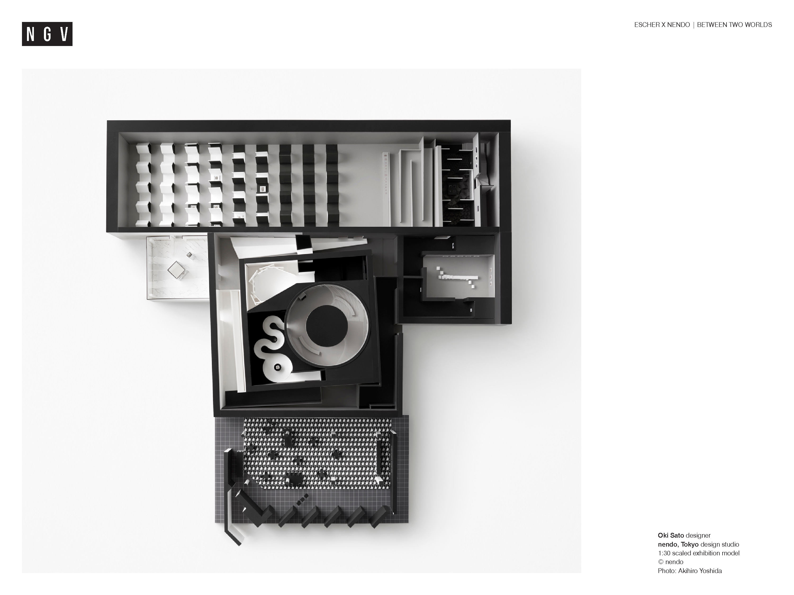
Notes:
Share this information with your students:
This is a scale (1:30) model of the Escher X nendo | Between Two Worlds exhibition design, including the Gallery Kitchen café on the right of the model.
Share this information with your students:
Oki Sato’s design is a series of interconnected spaces that follow the different themes of Escher’s work. Each space has its own iteration (version) of the house icon, and draws the audience into the exhibition experience using the layering of black and white, the ordering of space and the different methods of displaying Escher’s works of art.
The viewer is not a passive observer gazing at neatly framed prints on a gallery wall, but instead, having a physical experience with his work.
Ask students:
How might this design by nendo impact the way in which the viewer experiences Escher’s work?
How might it differ from a traditional presentation?
Why might nendo have chosen to limit the design to a monochromatic colour scheme?

Slide 6
Notes:
Share this information with your students:
Iterations are different versions or adaptations of an original idea or motif. nendo have made many iterations of the house motif throughout the exhibition. The iterations reflect the ideas that intrigued M.C. Escher:
tessellation and pattern filling
reflection
infinity
illusion
transformation
positive and negative space
Ask students:
Can you find examples in the exhibition design of the above ideas?
Share this information with your students:
Esher’s work is grouped in the exhibition in themes including
Early years
The Observed World
Regular Division of the Plane
Reflection
Infinity
Impossible structures
Ask students:
How does the exhibition design bring out these themes?
How is the design balanced with the work of M.C. Escher?
What measures are taken to present and protect Escher’s prints and drawings?

Slide 7
Notes:
Share this information with your students:
Escher’s last work was titled Snakes, 1969. Inspired by Snakes, 1969 the last room for Escher’s work is built as a waist-high, house-shaped corridor that leads the way to the work via an appropriately serpentine route.
Ask students:
How might this presentation of the work impact the viewer’s perception of it?

Slide 8
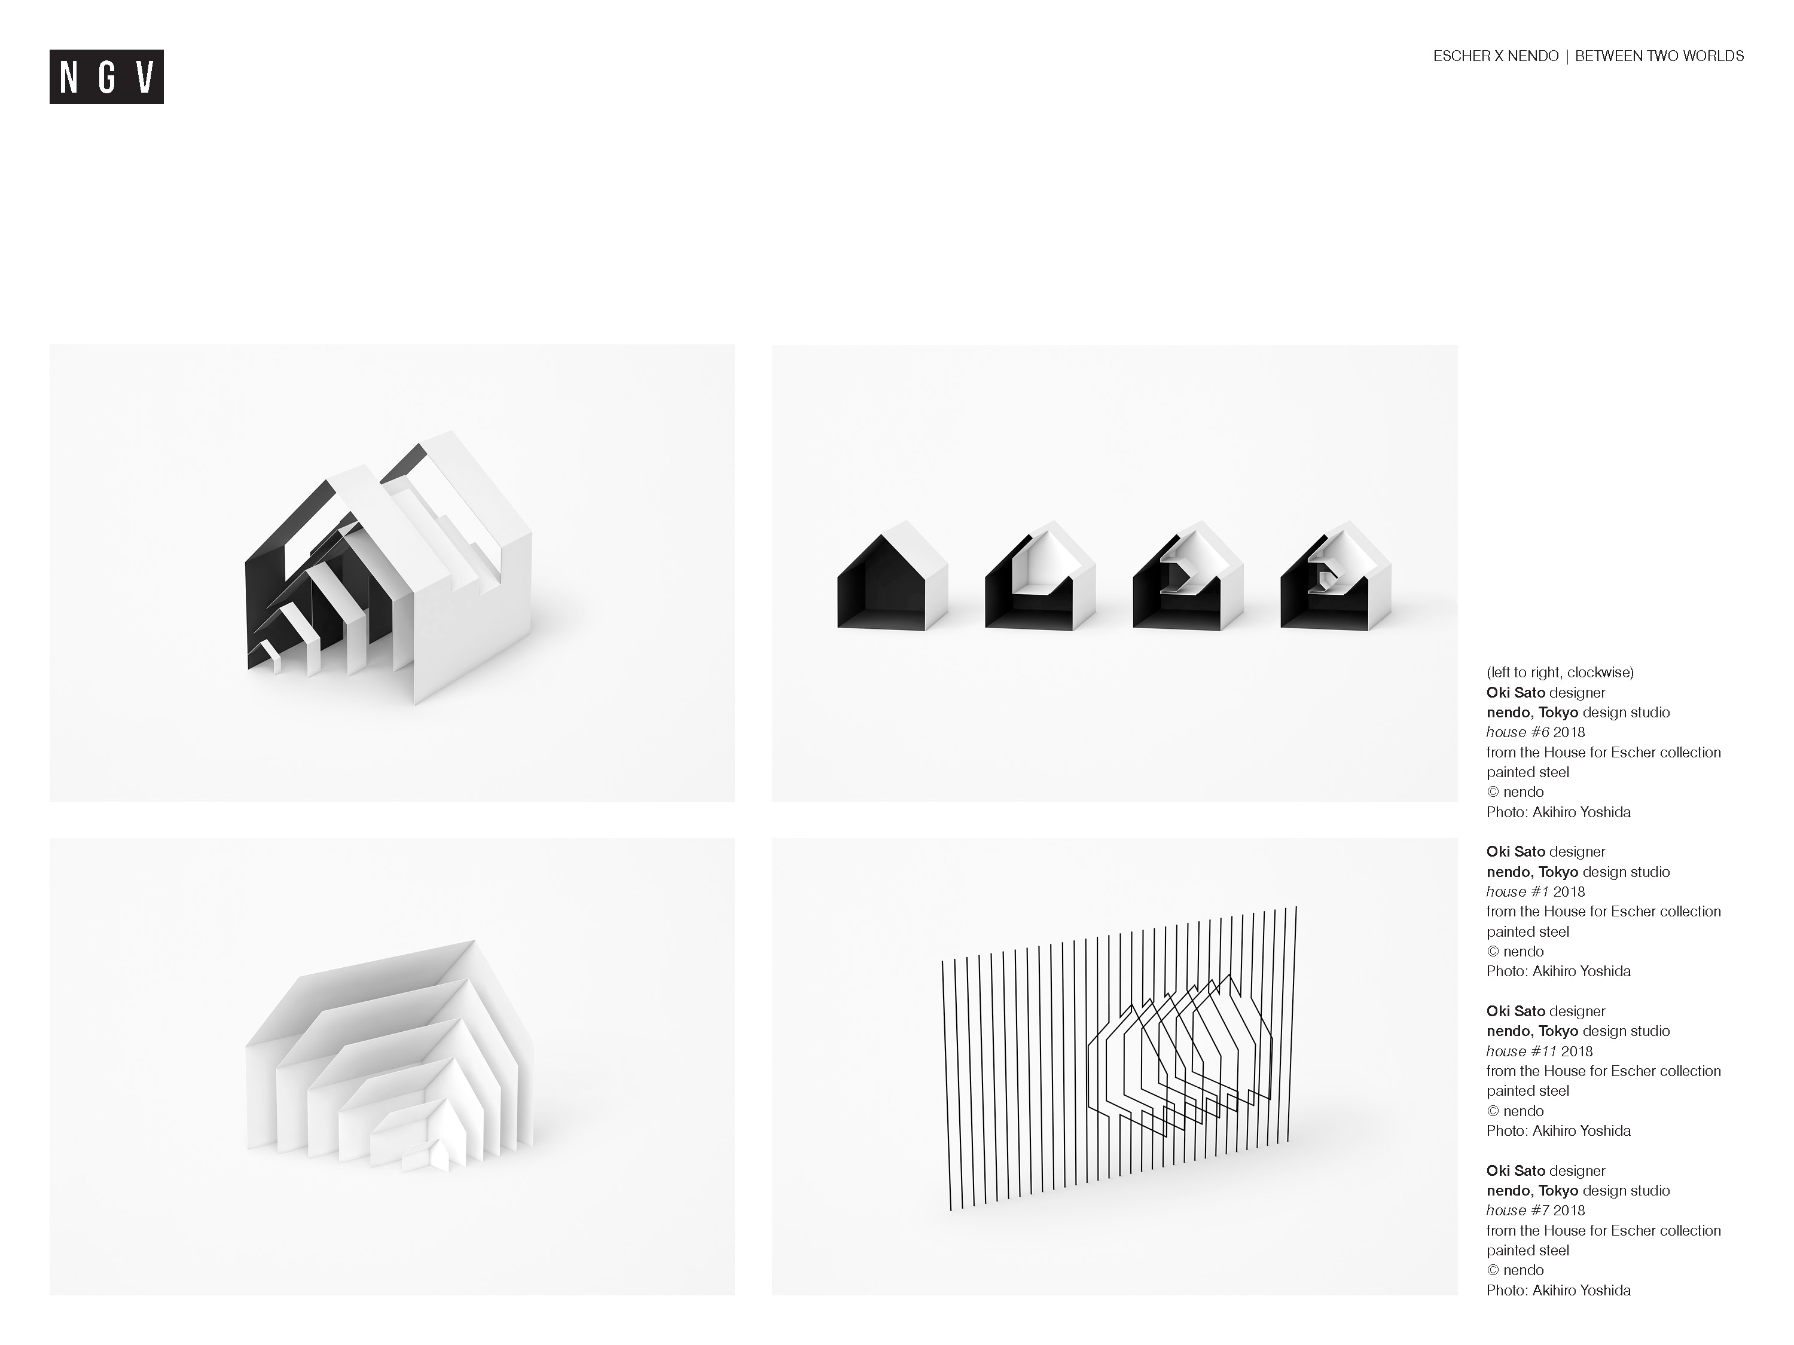
Notes:
Share this information with your students:
The final section of the exhibition is a room presenting a new nendo collection. These objects, commissioned by the NGV, started as sketches and developed as paper mock-ups. The have evolved into an eleven-piece collection made from black-and-white painted metal.
Ask students:
Describe how design elements and principles are evident in these objects. How do they reflect nendo’s style and Escher’s influence?

