Slide 1

Notes:
Who was Alexander Calder?
Why was he radical and what did he invent?
Let’s explore together and see what we can find out about this artist, his art and why the exhibition is called Alexander Calder: Radical Inventor.

Slide 2
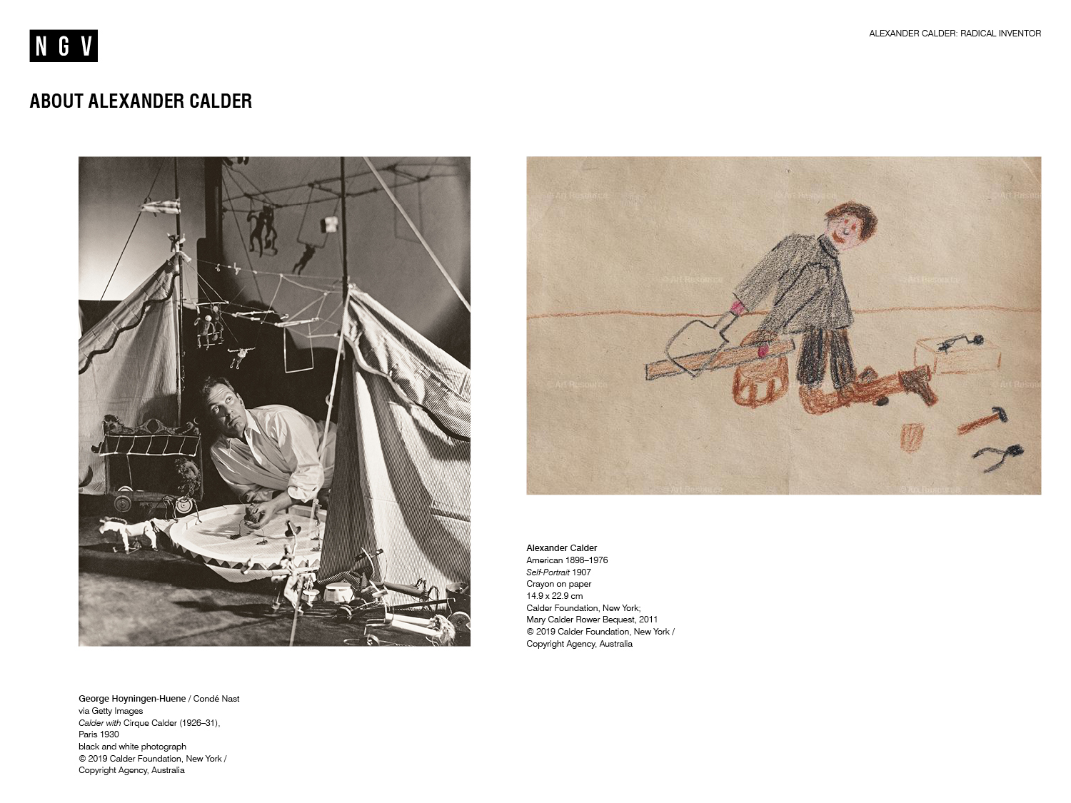
Notes:
Discussion prompt
Alexander Calder was born in 1898 and was thirty-two when this photo of him was taken. He was eight when he drew his self-portrait in 1907. What might we learn about Calder by looking at these two images?
Share this information with your students
Biography
Alexander Calder, also known as ‘Sandy’, was born in 1898, Pennsylvania. His parents were both artists: his father was a sculptor and his mother a painter. Growing up, Calder was always encouraged to express his creativity. He even had his own workshop from the age of eight, where he created toy sculptures for his family.
Calder decided to pursue a career as an artist after he graduated as a mechanical engineer in 1919. In 1923, he moved to New York where he attended the Art Students League and worked as an illustrator.
As an artist Calder made drawings and paintings, wire sculptures, bronzes, wood carvings, jewellery, assemblages, book illustrations, monumental sculptures and, as you’ll discover, even more.
In 1930, while living in Paris, Calder visited the French artist Piet Mondrian in his studio and was so impressed by Mondrian’s studio space, that it inspired a change in his art practice. He incorporated the element of movement within his sculpture. Calder is regarded as the artist who made sculpture move!
Calder was serious and focused in his practice and would spend his days in his studio, always working alone and in silence. He had an endless curiosity about the world around him and was very inquisitive.
Alexander Calder would become known as the most innovative sculptor of the twentieth century.
For more information on Calder’s biography, visit the Calder Foundation website: http://www.calder.org/life/biography

Slide 3
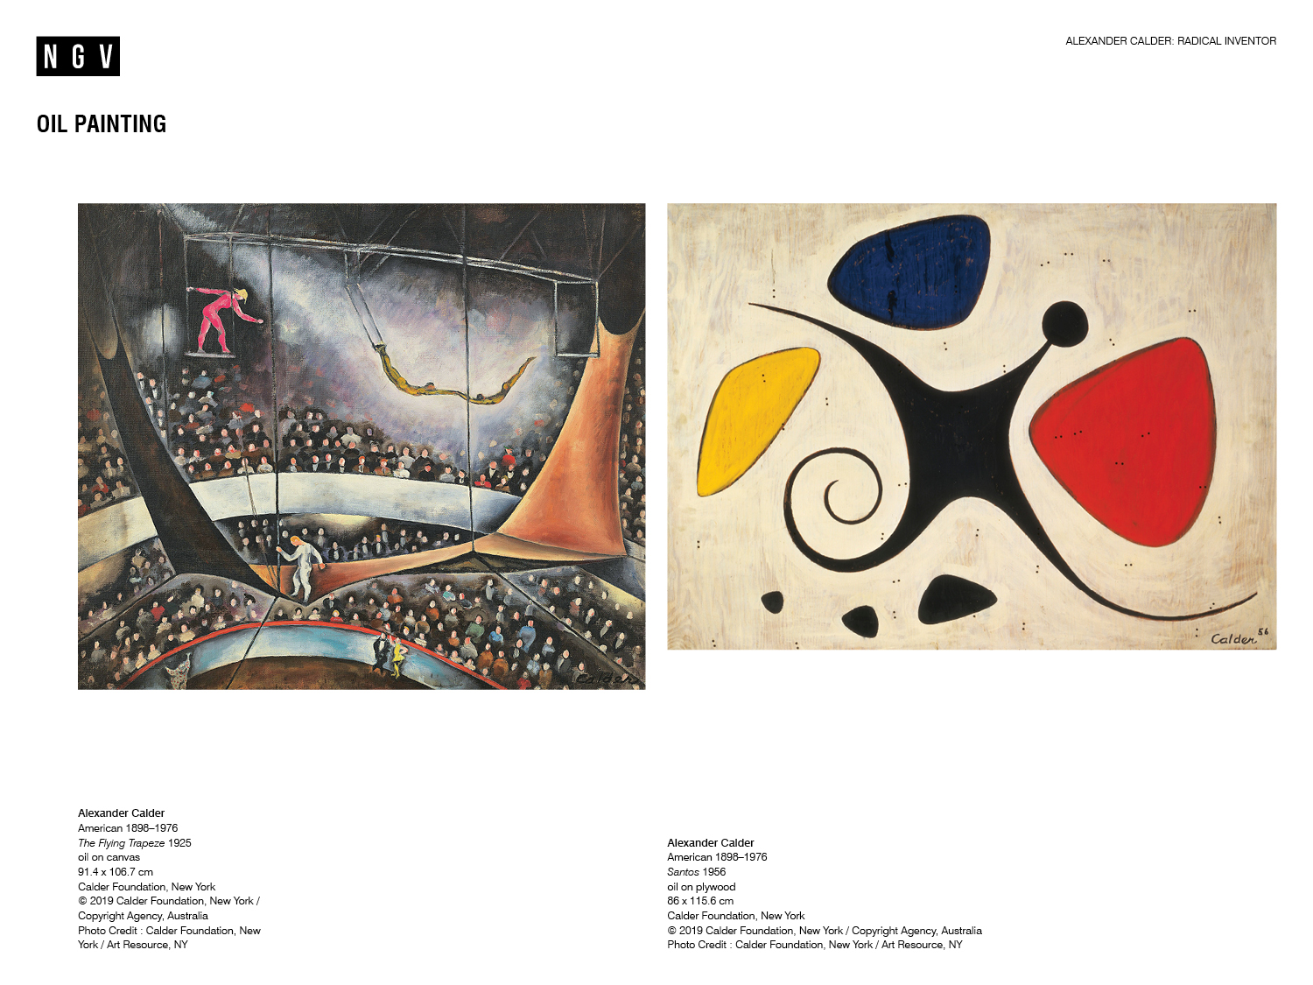
Notes:
Discussion prompts
In pairs, choose one of the Calder paintings shown here. Take turns to describe the painting. Use these questions as a guide:
What colours/shapes/lines has Calder used?
What mood and/or emotions are communicated by the painting?
What is the subject matter?
As a class, brainstorm similarities and differences between each of the works of art.
Share this information with students
In 1925, whilst working as an illustrator for the National Police Gazette, Calder was asked to sketch several circus scenes. The circus became a focus in his art, as shown in Calder’s painting, The Flying Trapeze. In 1926 Calder moved to Paris and created his Cirque Calder, a performance work of art made from wire, wood, cloth and other materials. Calder presented Cirque Calder throughout his life to many audiences with great success.
In 1954 and 1955, Calder travelled widely, visiting the Middle East, India and South America, with trips to Paris in between. Santos was created in 1956, shortly after this period and almost thirty years after The Flying Trapeze.
Further discussion prompt
Look closely at these two paintings, created thirty years apart. What can we learn about Calder’s changing style?
To view images of Cirque Calder, visit the following link: http://www.calder.org/life/photobiography

Slide 4
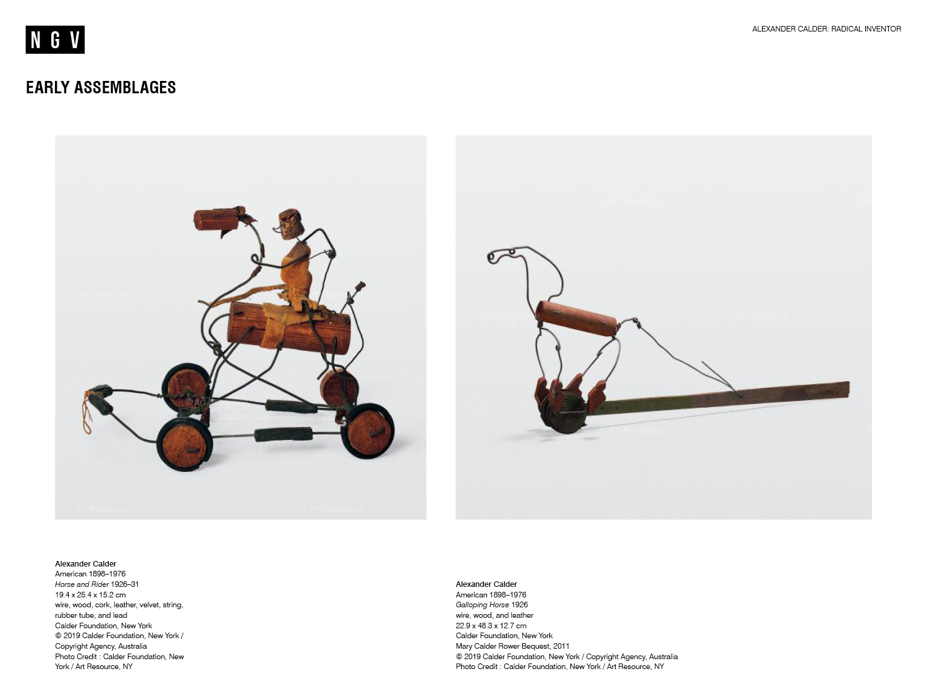
Notes:
Discussion prompts
Sculpture is a type of art in three-dimensional form, made by either carving, modelling, casting or constructing. Think about any sculptures you have seen before - what materials were they made from?
What materials has Calder used to create these sculptures?
How do you think Calder made these sculptures?
How does Calder create a sense of movement in his work?
If these sculptures ‘came to life’, what sounds would they make?
Think of a story where Horse and Rider or Galloping Horse are key characters. Share your story with a partner.
Share the quote below with your students
‘…I went to New York, and then to Paris, where I started making wire toys—caricatures of people and animals, some of them articulated. Then I made things in wood, taking a lump of wood and making very little alteration in its shape- just enough to turn it into something different. Then I made a circus with elephants, horses, a lion, Roman chariots and so on: basically of wire, but with cork and wood and bright colours added. Most of these objects were articulated, so that they made characteristic gestures. The material for this was based on my observation at the circus, and on drawings of it. I was always interested in circuses.’¹
Further discussion prompt
Why do you think Calder had a keen interest in the circus?

Slide 5
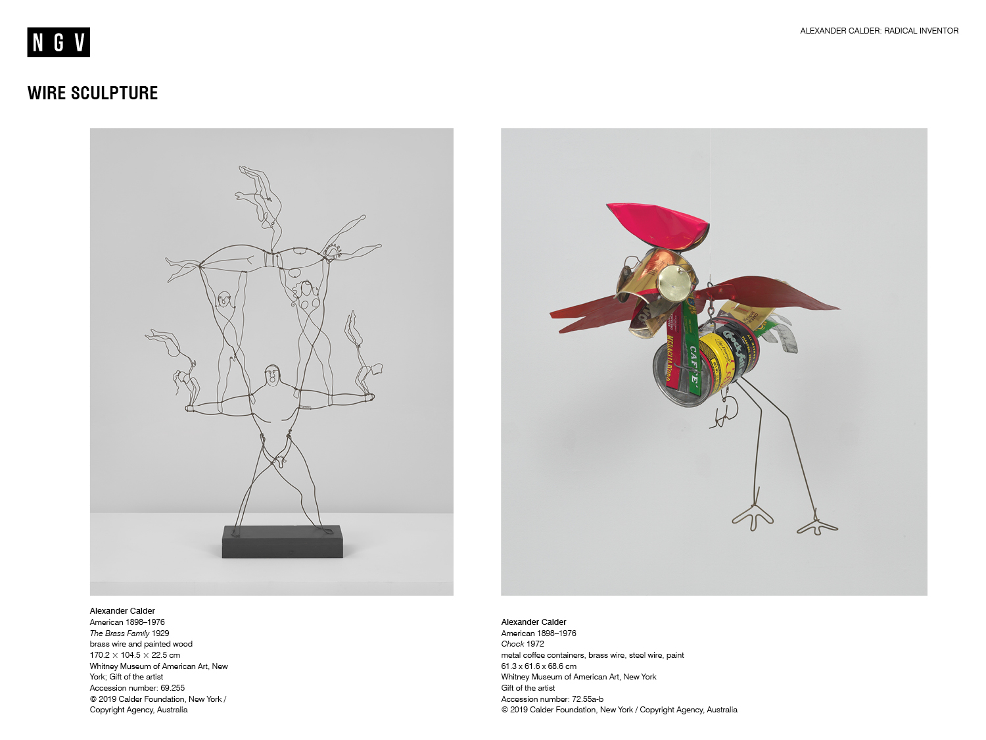
Notes:
Share this information with students
Calder loved to draw with wire, and create three-dimensional line drawings. He manipulated wire to create a range of shapes, spaces and forms. Often he would draw his friends, animals, the circus and personalities of the day.
Calder’s fascination with wire and sculpture continued throughout his life and career. The Brass Family and Chock are wonderful examples of this.
He also gave his works of art very memorable titles to keep track of them all (Calder made more than 22,000 works in his lifetime).
Discussion prompts
Calder once said of wire that it was ‘something to twist, or tear, or bend’. He also said it was ‘an easier medium for me to think in’.² Do you think it would be harder or easier to draw with wire instead of paper and pencil? Explain why.
Calder was very clever in his use of materials and methods of making. In The Brass Family, 1929, Calder has mainly used brass wire to create his sculpture which stands on a wooden base. Look closely at the materials Calder has used to make Chock, 1972. Chock is more than just wire. Why do think Calder used a mixture of different materials for Chock?
For a range of selected texts about the artist and his work, visit the Calder Foundation: http://www.calder.org/life/selected-texts

Slide 6
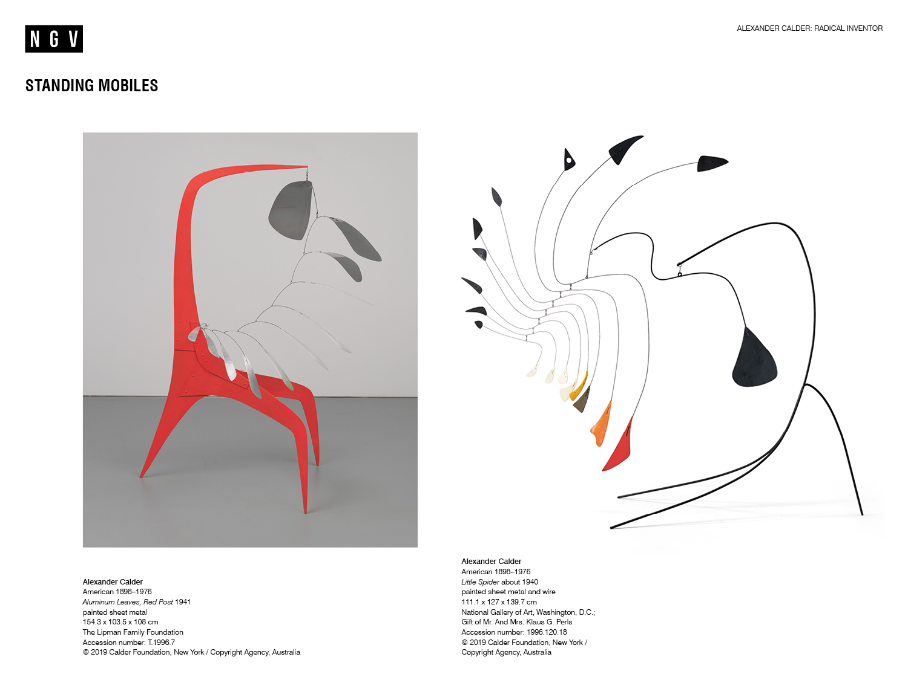
Notes:
Share this information with students
Calder made his first wholly abstract works of art in the early 1930s.
He also invented the kinetic sculpture now known as the mobile, a term conceived by the French artist Marcel Duchamp in 1931 to describe Calder’s early suspended wire sculptures.
In French the word mobile refers to both motion and motive.
Kinetic art is a form of art that depends on movement for its effect.
Both Little Spider, about 1940, and Aluminium Leaves, Red Post, 1941, are wonderful examples of how Calder integrated movement into his works of art. These works of art - referred to as standing mobiles - have moving components attached to a static base.
Discussion prompts
In pairs, choose one of Calder’s standing mobiles shown here. Take turns to describe the standing mobile. Use these questions as a guide:
What colours/shapes/lines has Calder used?
How has Calder created balance in the standing mobile?
What does the standing mobile remind you of?
Both of these standing mobiles are very large, and have a component that moves, attached to a static base. How do you imagine this part of each work of art might move? Quickly or slowly? Gracefully or abruptly? Create a list of at least three adjectives.
Can you think of a metaphor or simile to describe either of these standing mobiles? Use some of the descriptive words you came up with earlier to help with this task.

Slide 7
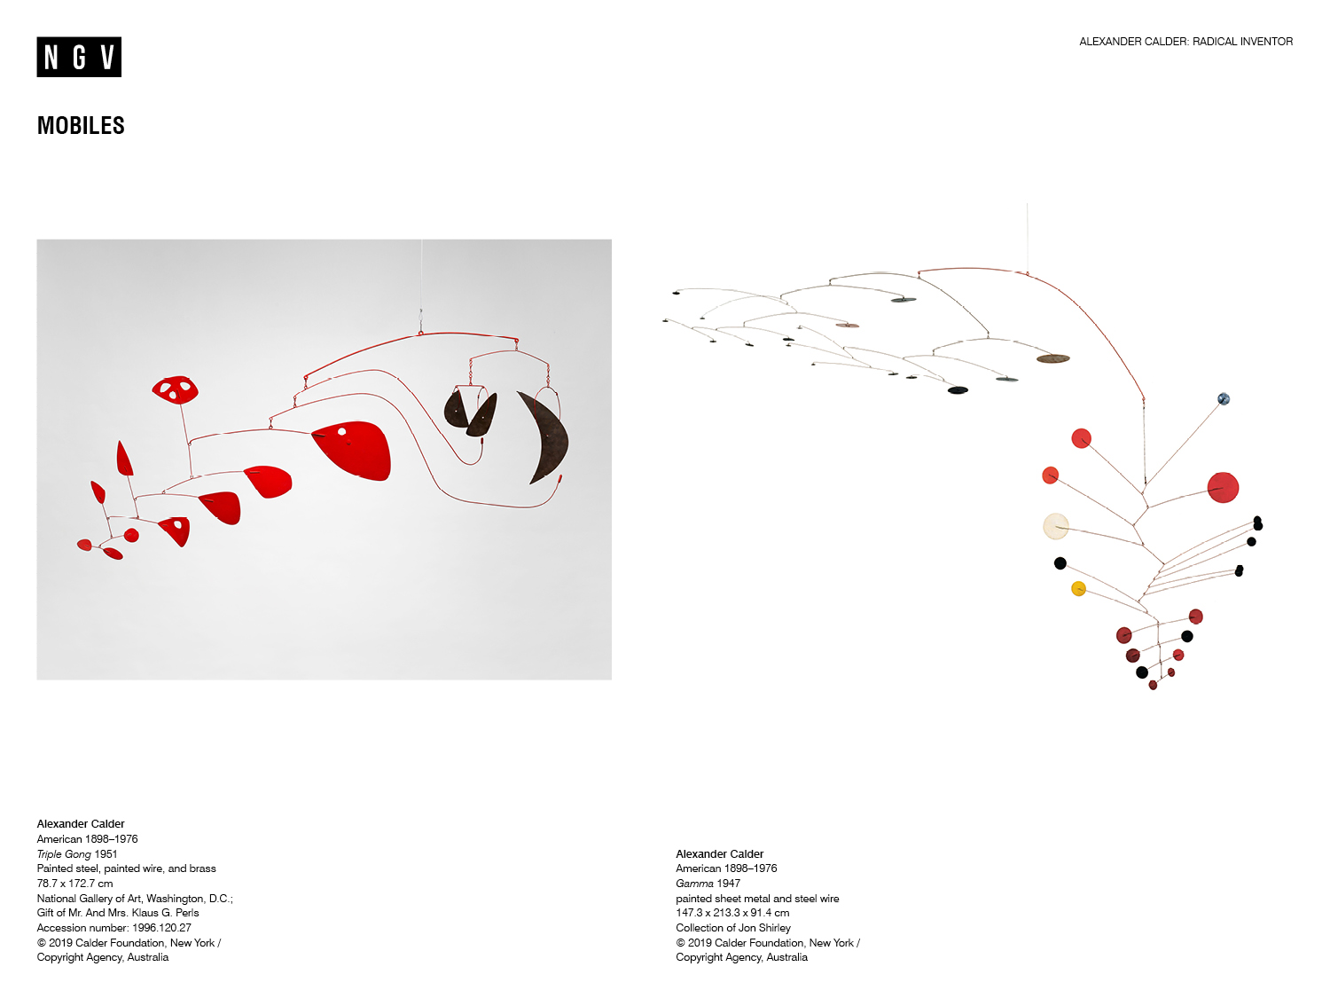
Notes:
Share this information with students
Calder’s mobiles, like Triple Gong, 1951, and Gamma, 1947, hang from the ceiling rather than standing on the floor.
Calder was very inventive in the way he initially transported these works of art. They were essentially flat packed, which meant they could easily be sent overseas for exhibitions. Of course, Calder would send very specific instructions on how the works of art were to be displayed, and would often travel with the works to see them installed.
Discussion prompts
Gamma is a large sculpture which features colourful discs made using paint and sheet metal. From a single wire, hang two more wires, each supporting these colourful discs. The discs on the left sit parallel with the floor, while the discs on the right hang vertically. This part looks like a downward arrow in the photo. How has Calder created balance in Gamma? Consider shape, form and colour in your answer.
How do you think Triple Gong might move? What does it remind you of? Explain why.

Slide 8
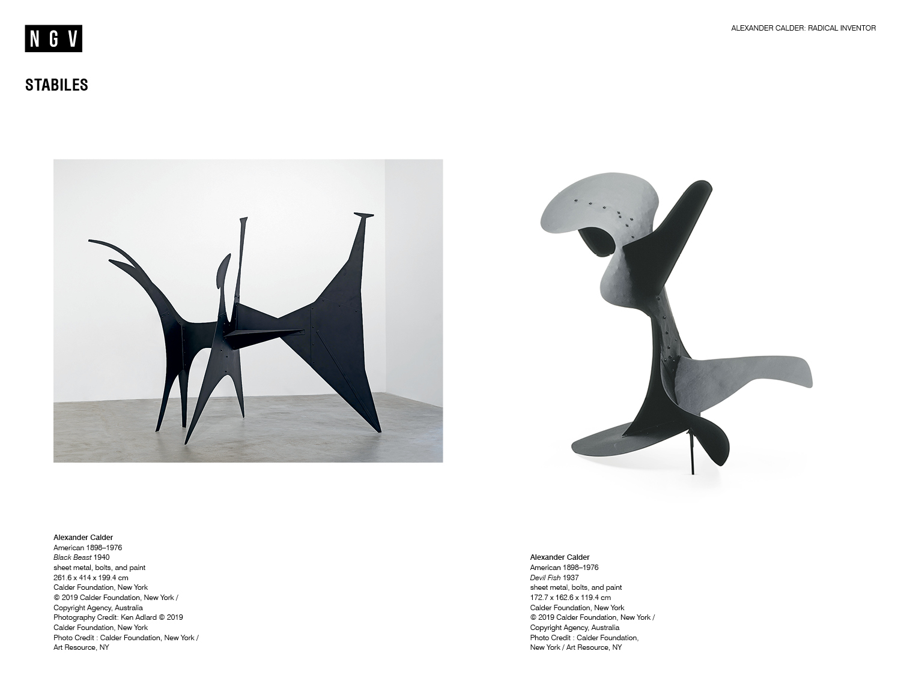
Notes:
Share this information with students
In the 1930s Calder began to make much larger sculptures called stabiles. Calder’s friend, the artist Jean Arp, invented the term stabile in 1932 to describe his grounded sculptures.
In 1937, Calder created his first large bolted stabile fashioned entirely from sheet metal, which he called Devil Fish.
Black Beast, another stabile in the exhibition, is even larger than Devil Fish, and was created only a few years later in 1940.
Discussion prompts
Use a ruler, measuring tape or perhaps even your body to create and imagine the space that Black Beast or Devil Fish might occupy.
Do you think that the size of a work of art changes the way we might interpret it? Why or why not?
Reflection
Why do you think this exhibition is titled Radical Inventor? What does this mean?
What do you think makes Calder a radical inventor?
Resources
Further information and classroom activities can be found in the Calder Foundation teaching guide: http://www.calder.org/contact/teaching-guide
Notes
1. Alexander Calder, ‘Mobiles’, in Myfanwy Evans (ed.), The Painter’s Object, Gerold Howe, London, 1937, p. 62.
2. Alexander Calder, ‘Mobiles’, in Myfanwy Evans (ed.), The Painter’s Object, Gerold Howe, London, 1937, p. 62.

