Slide 1
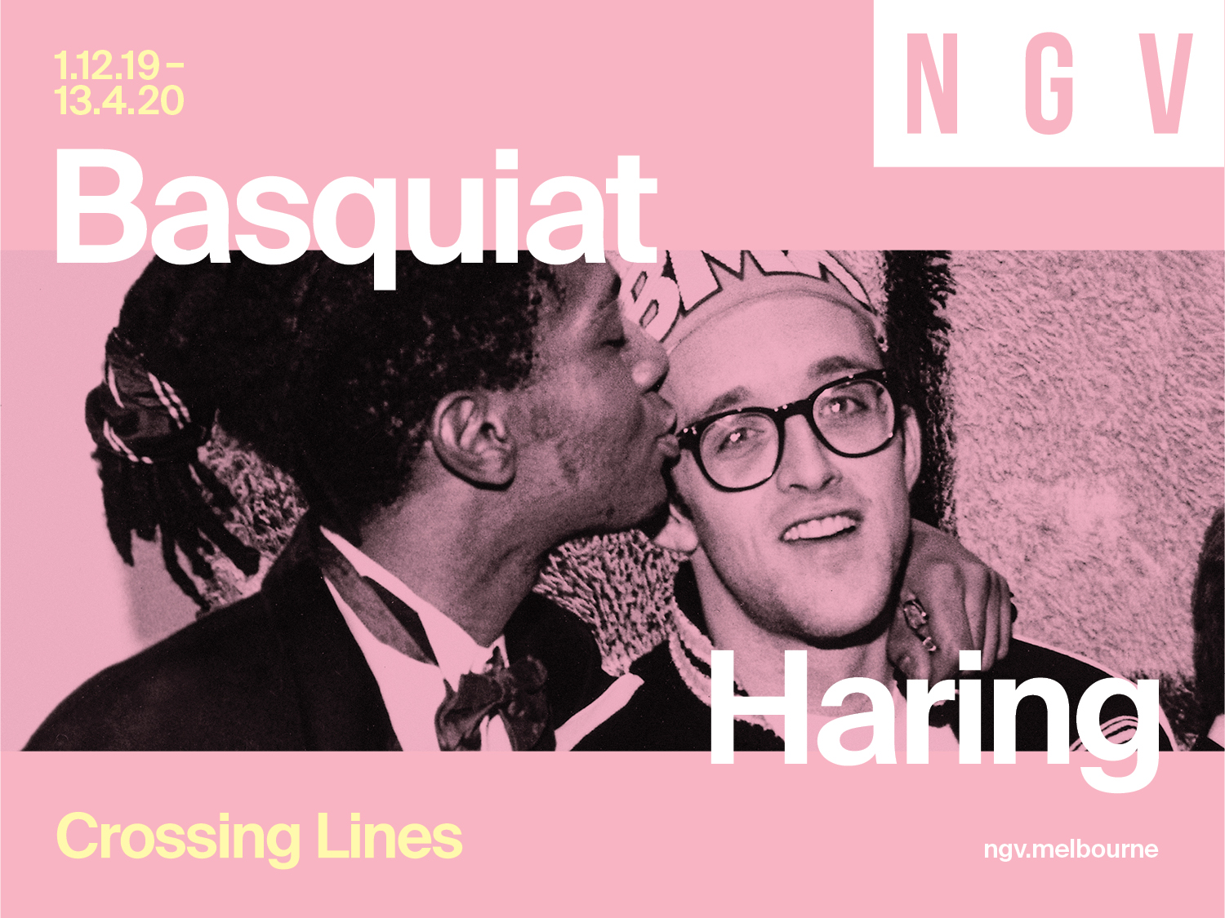
Notes:
Introduction to Keith Haring | Jean-Michel Basquiat: Crossing Lines
Keith Haring | Jean-Michel Basquiat: Crossing Lines includes over 200 works from Keith Haring and Jean-Michel Basquiat’s short yet prolific careers. The exhibition features works from the streets and subways of New York City, as well as paintings, drawings and sculptures. Following chronological and thematic sections, the exhibition highlights intersections between Keith Haring and Jean-Michel Basquiat’s lives and work.
Learning Objectives
Analyse and interpret themes, concepts and ideas in Haring and Basquiat’s work and discuss how they are expressed.
Identify and discuss important influences on Haring and Basquiat’s style and choices in art making.
Explore how Haring and Basquiat use materials, techniques, technologies and processes to realise their intentions in their artworks.
Identify and connect specific features of Haring and Basquiat’s work to a wider historical, cultural and social context.
Compare and contrast the work Haring and Basquiat and explore the parallels in their careers.

Slide 2
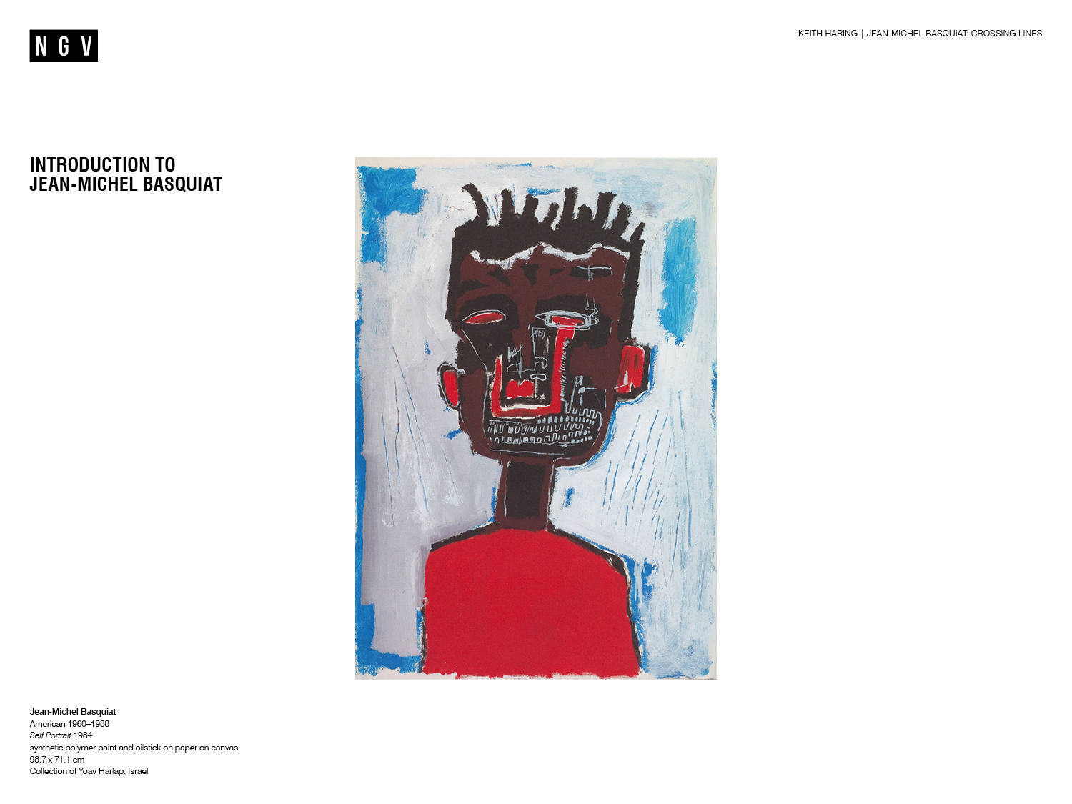
Notes:
Discussion prompts
What do you already know about Jean-Michel Basquiat?
What information does the work on the slide provide about the artist? Why do you think this?
Introduction to Jean-Michel Basquiat
Jean-Michel Basquiat (1960-1988) was a self-taught artist whose practice included paintings, drawings and sculptures.￼ His distinctive visual language of signs, symbols and words referenced art history, graffiti, music and popular culture. Through layers of paint and textual references his work engaged with complex topics such as race and racism, and communicated his experience as a man of Puerto Rican and Haitian descent living in America.
Growing up
Basquiat grew up in Brooklyn, New York and showed a talent for drawing from an early age, dreaming of one day becoming a comic book artist. His mother often drew with him and took him on visits to New York museums like The Museum of Modern Art, the Metropolitan Museum of Art and the Brooklyn Museum. ​
At the age of seven, Basquiat was hospitalised after being hit by a car while playing in the street. While recovering he leafed through pages of Gray's Anatomy, the famous anatomical encyclopedia, which his mother gave him as a gift. He later formed a band named Gray, after the book, and adapted many of its anatomical illustrations in his art.​
For more information on Jean-Michel Basquiat’s biography, visit The Estate of Jean-Michel Basquiat’s website: http://www.basquiat.com/
Discussion prompts
How does this background information influence how you think about the artist?
What do you think Basquiat found interesting about human anatomy? Which other artists use anatomical illustrations in their work?

Slide 3
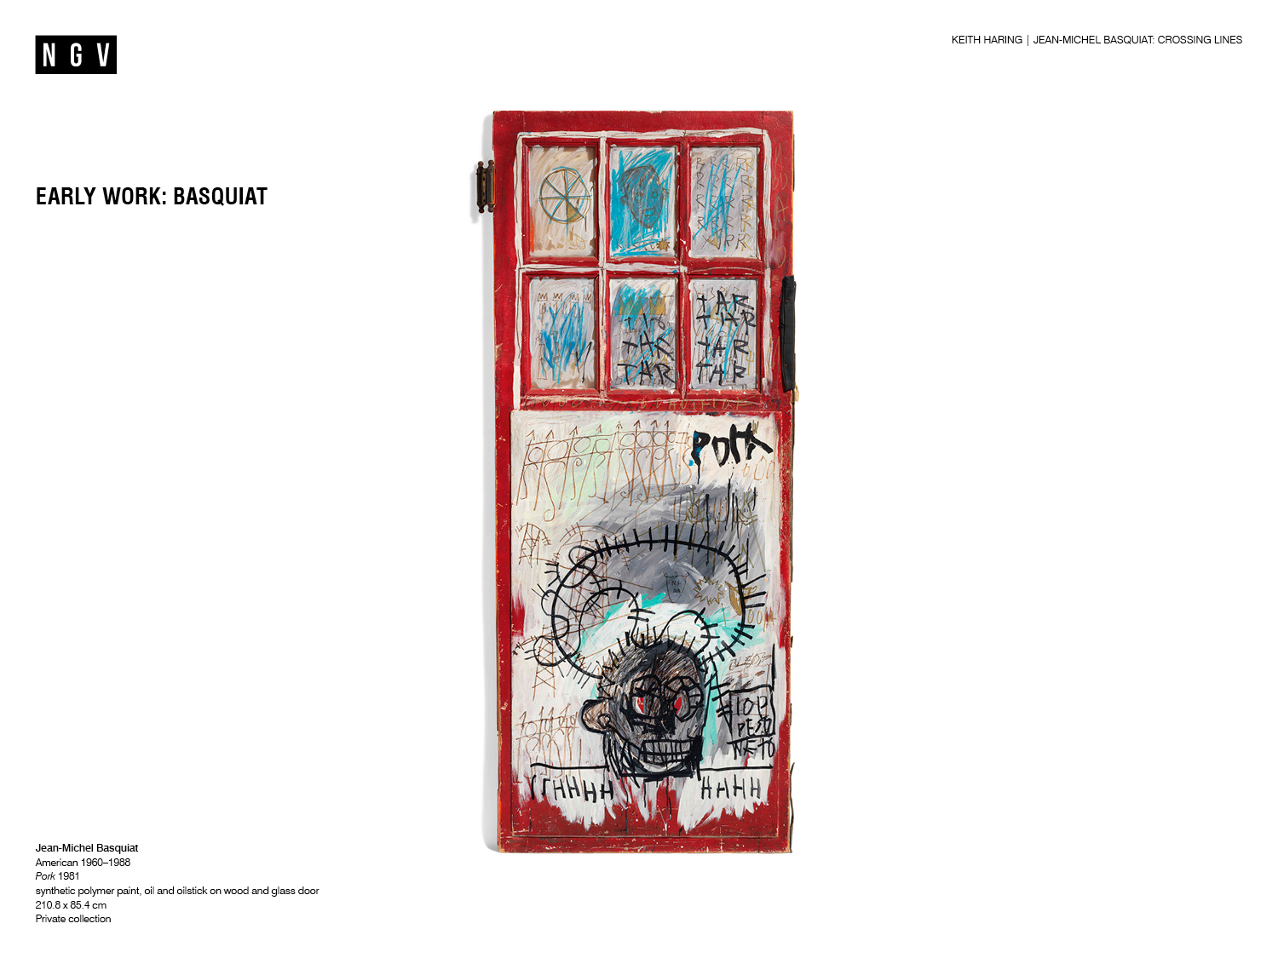
Notes:
Basquiat’s Early Work
From 1978-1980, Basquiat and his friend Al Diaz, sprayed words and phrases on public surfaces around New York City under the moniker SAMO©. Although he eventually transitioned away from the street art scene, Basquiat continued to salvage everyday materials from the street and paint on them throughout his career. For example PORK, 1981, is painted on a wooden and glass door.
Other examples of Basquiat’s developing visual language can also be seen in PORK. The work combines images and text; he has scratched letters into white paint and written in marker on the surface of the door. The images of the crown and halo reappear continuously as motifs throughout his art.
Discussion prompts
What might the materials used for these works tell us about the artist’s life and interests at the time?
What practical reasons might Basquiat have had for choosing to paint on everyday surfaces?
How is art made on the street different to art you would see in a gallery? How is it similar? Consider the art-making process, materials used, subject matter, artist intentions and the audience.

Slide 4
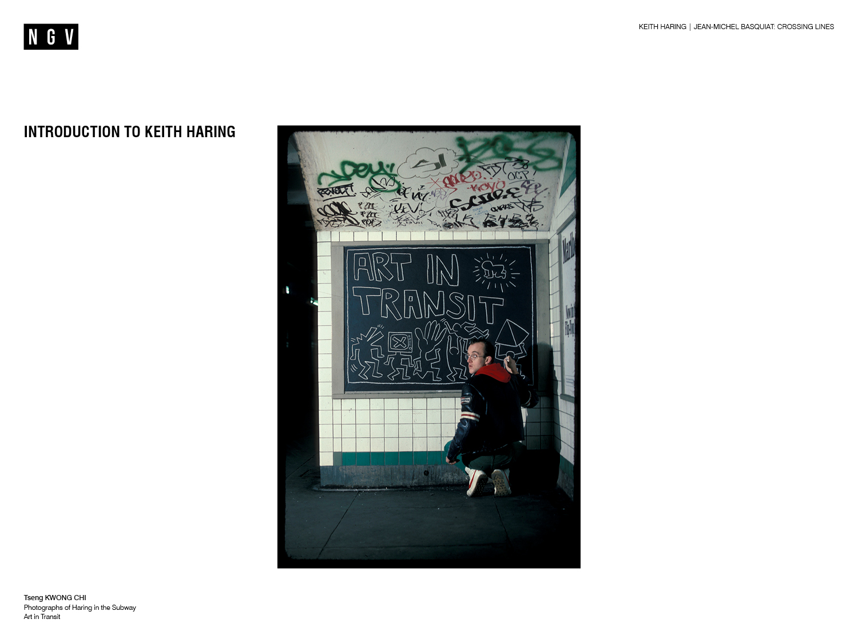
Notes:
Discussion prompts
What do you already know about Keith Haring?
What information does the photo on the slide provide about the artist? Why do you think this?
Introduction to Keith Haring
Keith Haring (1958-1990) was an American artist based in New York in the 1970s and 80s. His paintings, drawings and large-scale public works were immediately recognisable for their bold and energetic linear style. Driven by the goal of making art as accessible as possible, Haring worked prolifically throughout his life and often created art in public places, attracting interest around the world. His work celebrated sexual diversity, rallied against racism, drug addiction, and corporate greed.
Growing up
Haring’s earliest introduction to art came from his father, who drew cartoons. His father taught him techniques such as drawing with his eyes closed, which led to a strong interest the physical movement of drawing.​ Dr Seuss, Walt Disney and Charles M. Schultz’s Peanuts comic strip were all inspirations for Haring whose earliest aspiration was to work for Walt Disney.
Haring and Basquiat first met in 1978 at the School of Visual Arts, New York, where Haring studied. They became good friends and found a sense of belonging in the graffiti, music and art scene of New York’s Lower East Side.
Discussion prompts
Keith Haring used art to raise awareness about social issues of his time. Why might art be an effective platform for this?

Slide 5
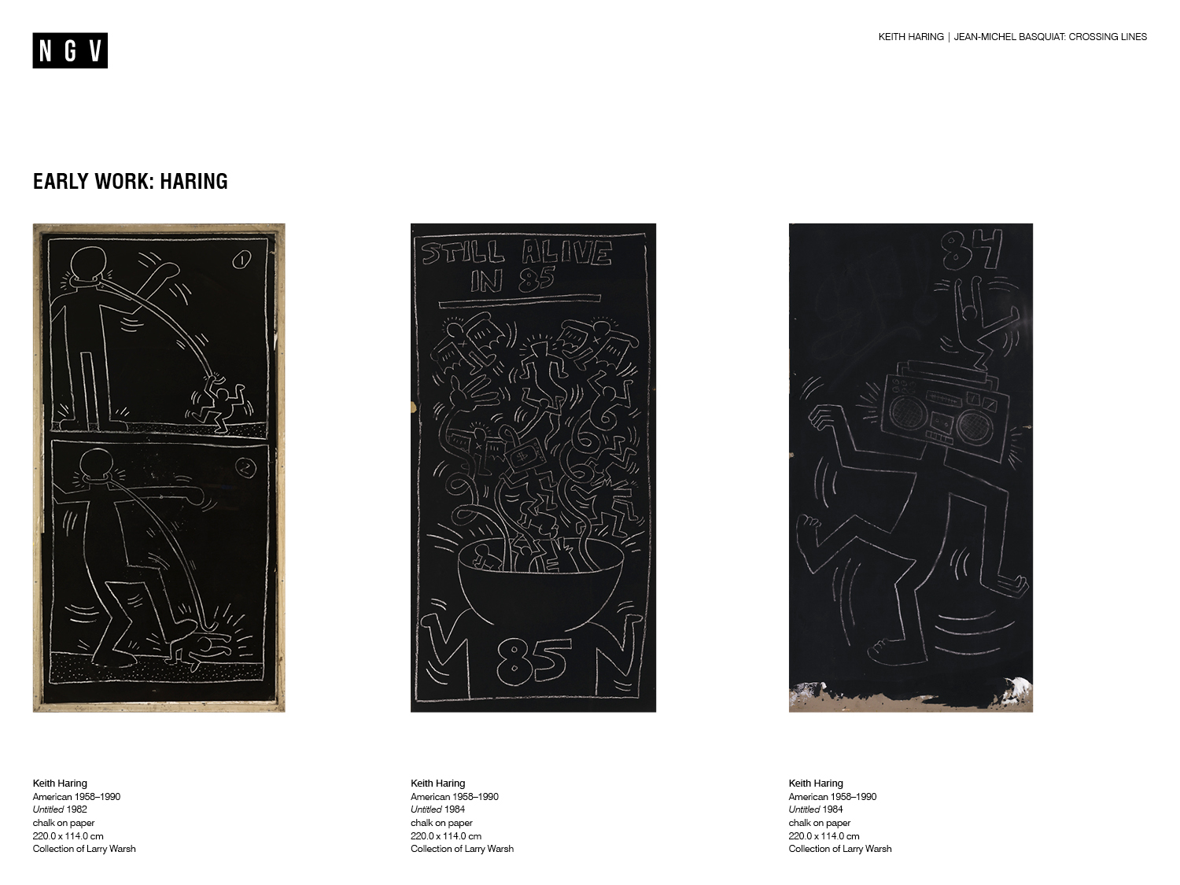
Notes:
Haring’s early work
Haring was inspired by the colourful graffiti that spread over New York City’s trains and building walls in the late 1970s. He loved the idea that art could break out of the galleries and museums and become a part of the city landscape, where it could be seen and accessed by everyday people. He began to draw with white chalk on the black matt paper which covered New York City subway’s blank advertising spaces.
Commuting New Yorkers would often see Haring at work, sometimes quickly executing the drawings between getting off one train and boarding the next. Haring was arrested numerous times in the process of drawing these works, which were considered vandalism under state law. Despite the threat of arrest, Haring persevered and is estimated to have completed between 5,000 and 10,000 chalk drawings from 1980 to 1985.
For more information on Keith Haring’s biography, visit the Keith Haring Foundation website: http://www.haring.com/
Discussion prompts
How do Haring’s subway drawings represent his desire to bring art to everybody?
When drawing in the subway, Haring had to contend with busy commuter crowds and the risk of being arrested. How might these factors have affected the way he approached art making?
How has Haring represented movement in the drawings on this slide? Consider use of art elements and principles such as line, rhythm and repetition.

Slide 6
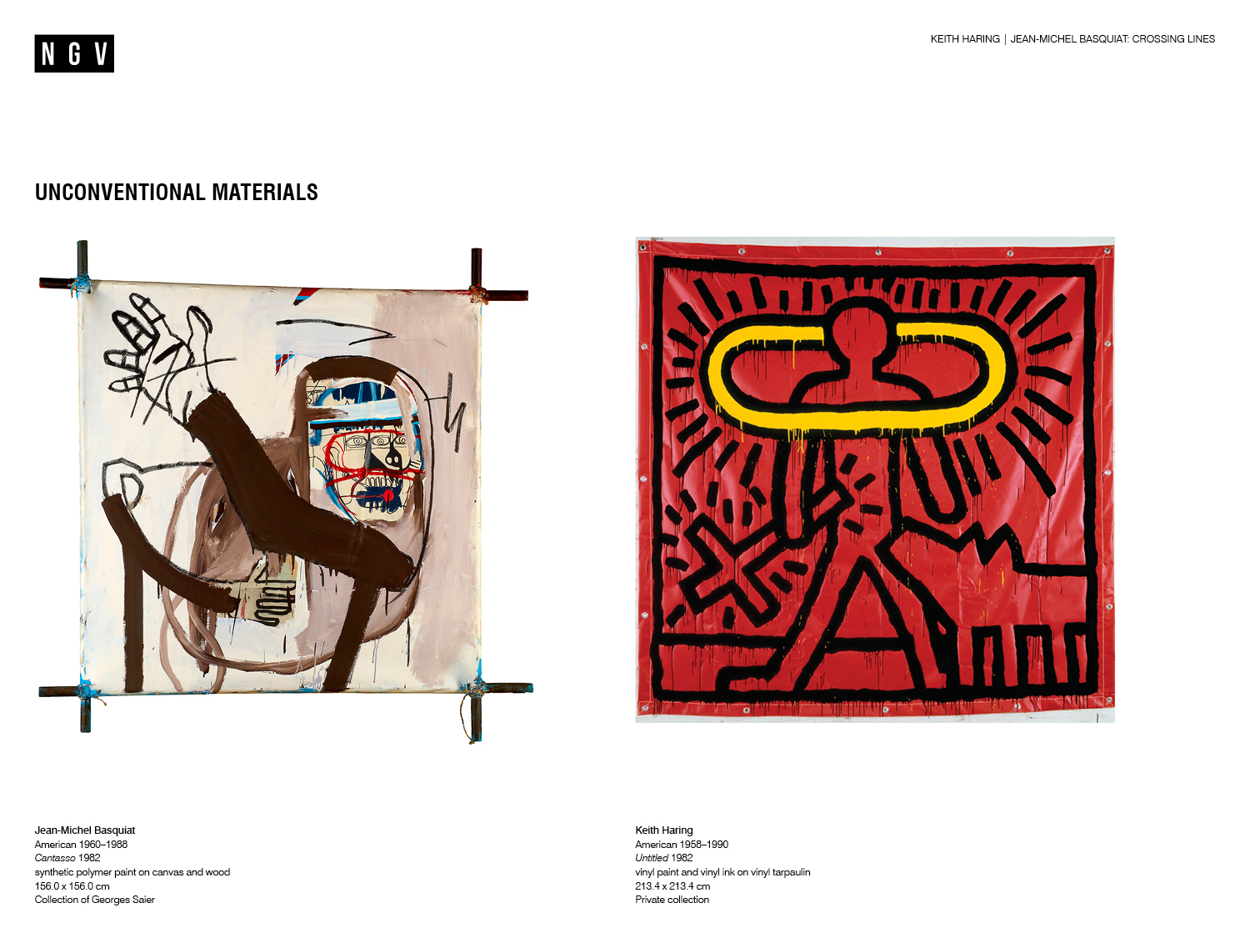
Notes:
Unconventional materials
Basquiat often experimented with different painting supports and built many from found materials. From 1982, he began to stretch his canvases over wooden frames either nailed or lashed together with twine. In Cantasso, 1982, the crossed corners of the frame defy the traditional method of hiding the support behind the canvas, and add a sculptural dimension to the work.
Haring also used unconventional supports in his practice. With Untitled, 1982, he has painted on the lightweight, portable and affordable surface of red tarpaulin, rather than canvas, which is much more expensive and is associated with traditional painting. The tarpaulin work is then hung from the wall by metal grommets.
Discussion prompts
In Cantasso, Basquiat has painted the intersecting pieces of wood supporting the canvas black. Why do you think he has done this? What effect does this have on the presentation of the work?
What might Haring’s choice to use tarpaulin as a painting surface say about his interests and values?
How do the materials used in these works add to the meanings or messages in the work?
Which other artists use unconventional surfaces in their art? Which materials do they use and why?

Slide 7
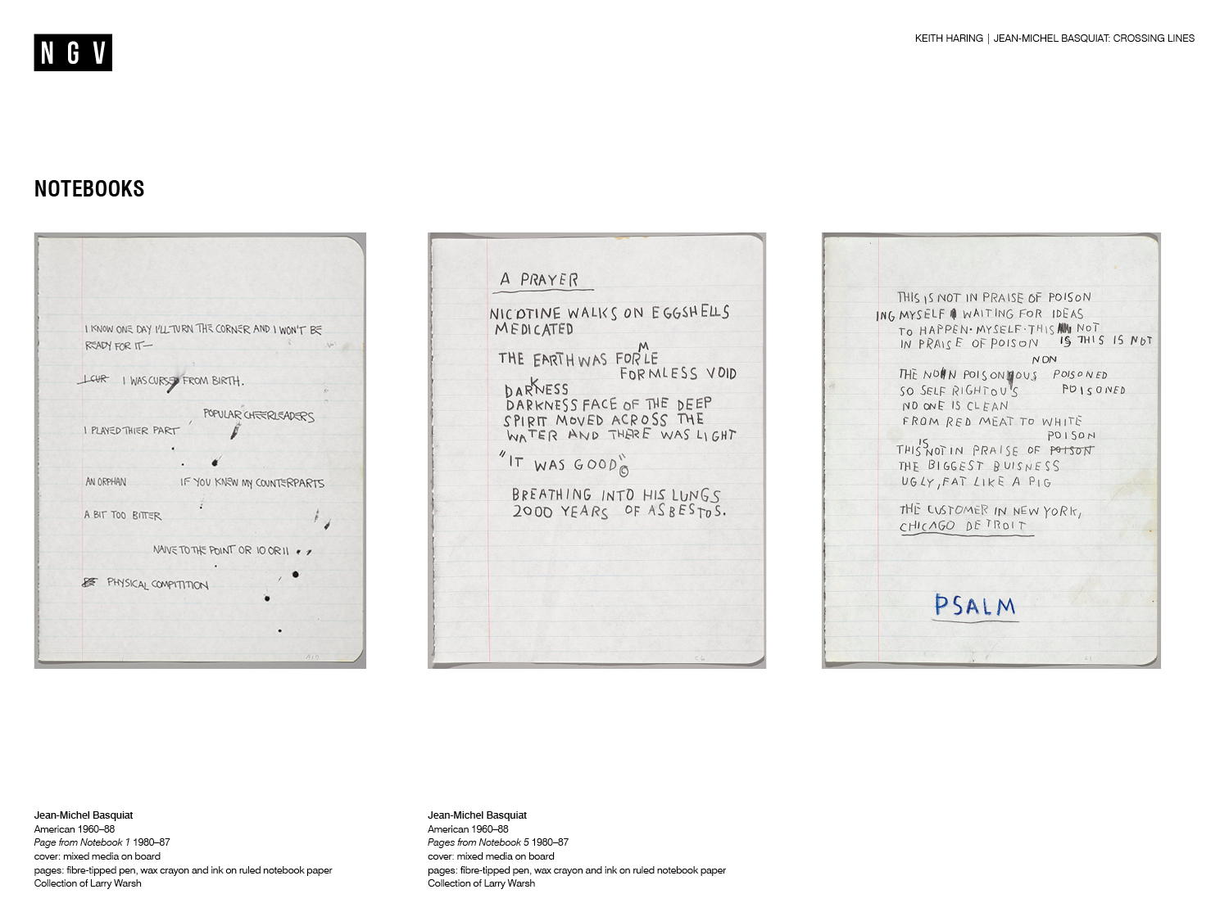
Notes:
Discussion prompt
Why do you think an artist might keep a notebook?
Notebooks
Basquiat recorded letters, words and phrases from songs, TV shows and the streets in his notebooks. The pages above show phrases and words which read as if they are a stream of consciousness, continuously flowing without structure or order. Basquiat would use words and phrases in his paintings too, where they would sometimes be misspelled, crossed out, or included for the way they looked or sounded.
Though Haring’s paintings and drawings conveyed messages in a mostly pictorial way, Haring also experimented with words and phrases and documented his creative processes in notebooks.
Discussion prompts
Look at the content of Basquiat’s notebooks. What cultural and historical sources do you think he has been inspired by?
Why do you think Basquiat has misspelled words and crossed out letters in his notebooks? What effect does this have on the meaning of the words?
Think of a favourite lyric from a song, line from a movie or book, or phrase from an advertisement or meme. Stitch you and your partner’s phrases together to make a continuous piece of prose. Share with the class.

Slide 8
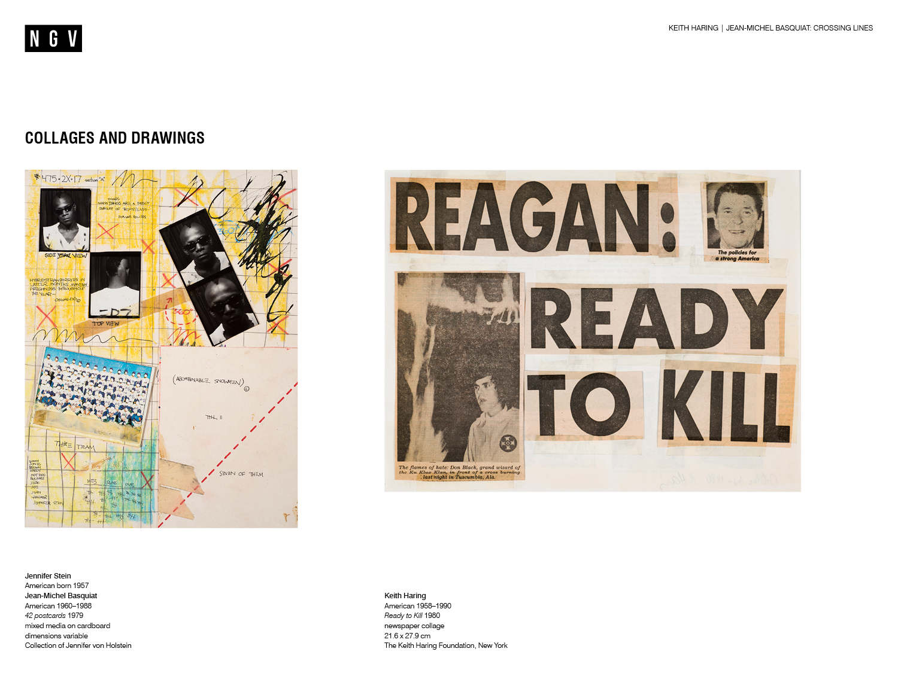
Notes:
Mixing and matching
Haring and Basquiat created their unique visual languages by mixing and matching a wide range of source material. Their experiments with collage, pictured on this slide, are early examples of this approach.
Postcards
Basquiat’s earliest collages were postcards which he created in collaboration with artist Jennifer Stein in the late 1970s. Everyday materials such as newspaper clippings, cigarette butts and photo-booth portraits were layered to form compositions, such as the example shown above. They then colour photocopied the collages to sell as postcards on the streets of New York. Basquiat famously sold a postcard for $1 to American artist Andy Warhol, who would later become his close friend and mentor.
Newspaper collage
In one of his first public art projects, Haring cut-up and rearranged newspaper articles to create alarming or absurd news headlines which commented on social issues from the time. He posted hundreds of copies on walls, lamp posts and newsstands throughout New York City. Ready to Kill, 1980, features USA’s then president Ronald Reagan, whose conservative, aggressively capitalistic policies marginalised some communities and angered Haring. He expresses his contempt for the president by placing his image alongside another of a Ku Klux Klan cross burning ritual.
Discussion prompts
Look at Basquiat and Stein’s postcard collage and identify the source of the different materials used. Why might the artists have chosen those materials? Which visual effects or ideas emerge from this combination of materials?
In the late 1970s when Basquiat made the postcards, colour photocopying machines were a new invention. Which everyday materials or technologies might he use if he was making these collages today?
Compare and contrast Ready to Kill with Basquiat’s postcard collage. How are they similar or different? Consider use of materials, visual elements, purpose and subject matter.

Slide 9
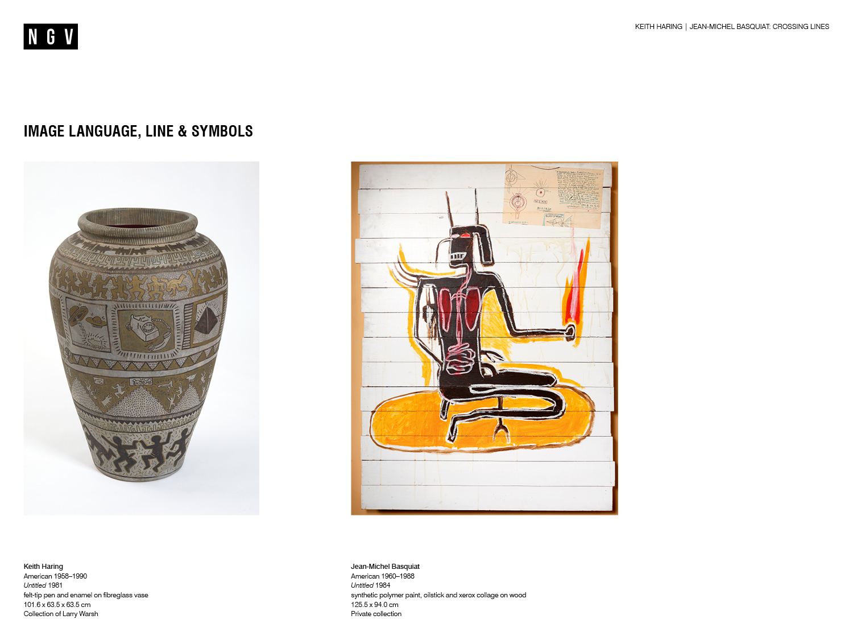
Notes:
Discussion prompts
Look at the works on the slide. Which cultural or historical materials do you think the artists are referencing?
Where might you find similar cultural or historical references in contemporary society?
Appropriation
Artists often borrow, copy and modify existing images or objects to highlight or subvert the original meaning and create new ideas. This process is called appropriation. Basquiat and Haring were both fascinated by art history and cultural traditions and often appropriated them in their art.
Image language, line and symbols
Both Haring and Basquiat loved to explore Ancient Egyptian, Greek and Roman art at New York’s Metropolitan Museum of Art.
Haring’s fascination with hieroglyphics and ancient vases, as well as his interest in semiotics or the language of signs at university, inspired him to develop his own symbolic visual language. For example, the flat, two-dimensional style of representation seen on Greek vases influenced Haring’s imagery on the above terracotta vase.
In Untitled, 1984, Basquiat appropriated the silhouette of an African queen depicted in ancient rock art found near the town of Rusape in modern-day Zimbabwe. He probably saw this reproduced in African Rock Art, 1970, a book by Buchard Brentjes. By painting on wooden slats in acrylic paint and oil stick, Basquiat used contemporary materials to point to his interest in exploring historical examples of black people appearing in art.
Discussion prompts
Why do you think Basquiat chose to appropriate images from African cultures? Consider his personal circumstances, cultural background and interests.
Basquiat once described his appropriation of images and styles of art as 'Someone's idea going through my new mind'. What new ideas are created in Haring and Basquiat’s appropriations pictured on the slide?
What might be sensitive or problematic about appropriating of images and styles originally belonging to other cultures, institutions or people?

Slide 10
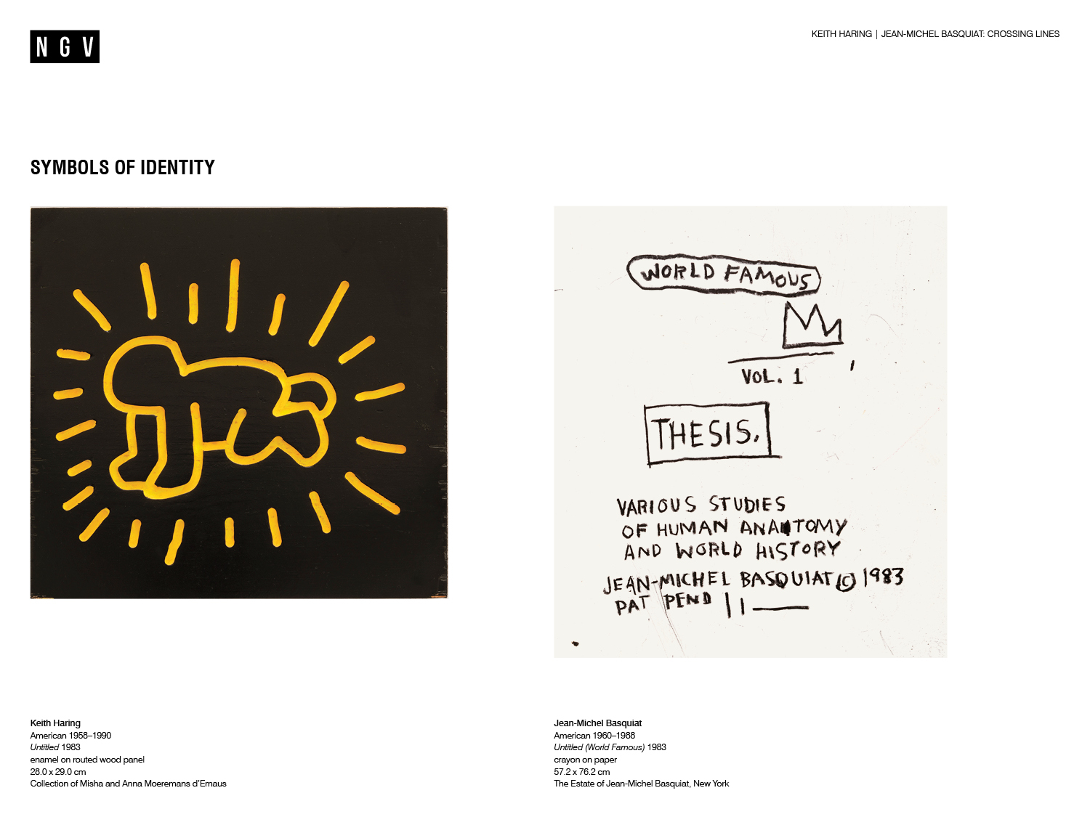
Notes:
Discussion prompt
Pictograms are simplified drawings, images or icons which communicate ideas through their resemblance to a physical object. Think of some examples of pictograms you might see and use each day. Why are they used? What do they represent?
Symbols of identity
Both Haring and Basquiat developed a vocabulary of pictograms which symbolised themes, ideas or aspects of their identity. These pictograms commonly recurred throughout both artist’s work, becoming signatures and closely resembling the practice of tagging in graffiti art.
One of Haring’s most recognisable pictograms is the crawling baby. To Haring, babies represented humanity in its perfect state with the potential and possibility of the future before them. The crawling baby, which Haring often made radiant with the addition of rays around its body, symbolises Haring’s love of play and reverence for the wisdom of children.
The crown is one of Basquiat’s most commonly repeated pictograms. The crown appeared as a symbol of his own great ambition as an artist, or was included by Basquiat alongside representations of people he respected and admired as a tribute.
Discussion prompts
Why do you think Basquiat used a crown to represent himself in his paintings? Consider the meanings and interpretations which are usually associated with crowns.
What do you think Haring was trying to communicate by including a baby in his work? Consider the meanings and interpretations which are usually associated with babies.
In what ways can a symbol or a pictogram be a self-portrait of an artist? How does it differ from a traditional self-portrait?

Slide 11
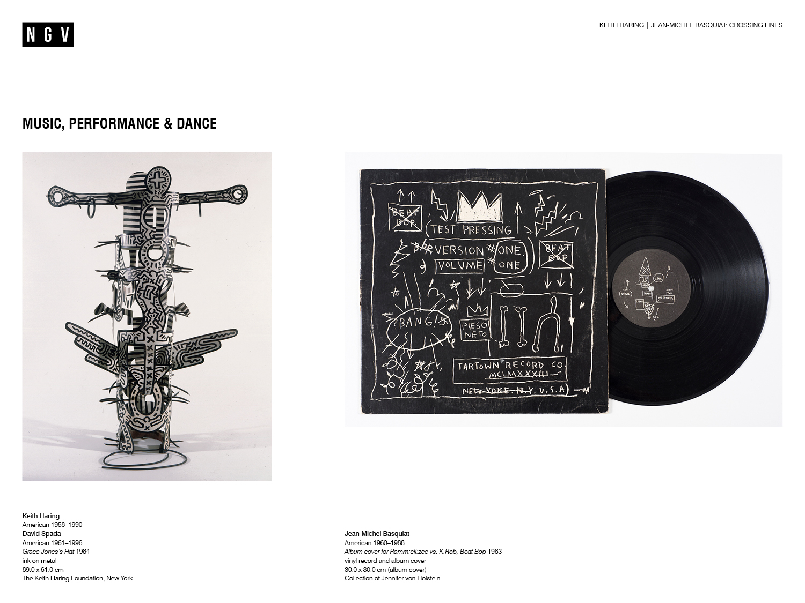
Notes:
Discussion prompts
Jazz and Hip Hop created entirely new musical forms by sampling and combining existing ones. How is this similar to Haring and Basquiat’s art making practices?
What do you think the relationship is between music and visual art? How are they similar or different?
Music, performance and dance
Music, performance and dance played a central role in Haring and Basquiat’s lives as part of New York’s downtown scene in the 1980s. The representation of movement in Haring’s works reflects the influence of breakdancing and electric boogie dance styles from the time: his figures are often positioned as if they are dancing.
Collaborations
Haring collaborated with musicians, dancers and fashion designers such as Madonna, Bill T. Jones and Vivienne Westwood. This collaborative art took many forms including videos, body art, theatre sets, and costumes. Grace Jones’ Hat, 1984, was a collaboration between Haring and jewellery designer David Spada, created for Grace Jones’ performance at the famous Paradise Garage nightclub in New York.
An avid music fan, Basquiat referenced jazz musicians like Charlie Parker and Miles Davis throughout his art, and made his own experimental, industrial music with his band Gray. Basquiat also collaborated with artists from many different fields. For example he produced the single Beat Bop by rappers Ramm:ell:zee and K.Rob and also designed the record sleeve artwork.
Discussion prompts
What evidence can you find in the works on the slide that the artists were inspired by music, performance and dance?
How has Haring created a sense of movement in Grace Jones' Hat, 1984?
How does art made for commercial purposes, like Basquiat’s album sleeve design above, differ from art made for exhibition in galleries?

Slide 12
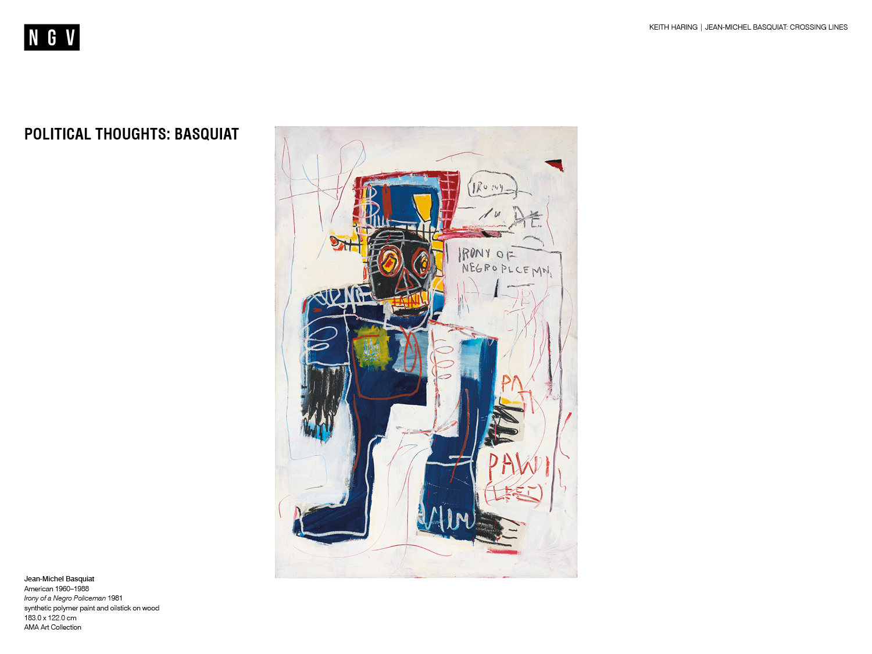
Notes:
Political Thoughts: Basquiat
Many of Basquiat’s works address his cultural heritage and experience as a black man in America, often commenting on racism and social injustice more broadly. Irony of a Negro Policeman, 1981, expresses Basquiat’s view that black people who became police officers were acting against their own interests or being hypocritical since law enforcement was widely associated with racial profiling and harassment.
Discussion prompts
What do you notice about Basquiat’s use of text in Irony of a Negro Policeman? What meaning does the text add to the work?
Which aspects of Irony of a Negro Policeman are characteristic of Basquiat’s visual language?
What connections to the artist’s personal history, identity and social and political concerns can you find in Irony of a Negro Policeman?

Slide 13
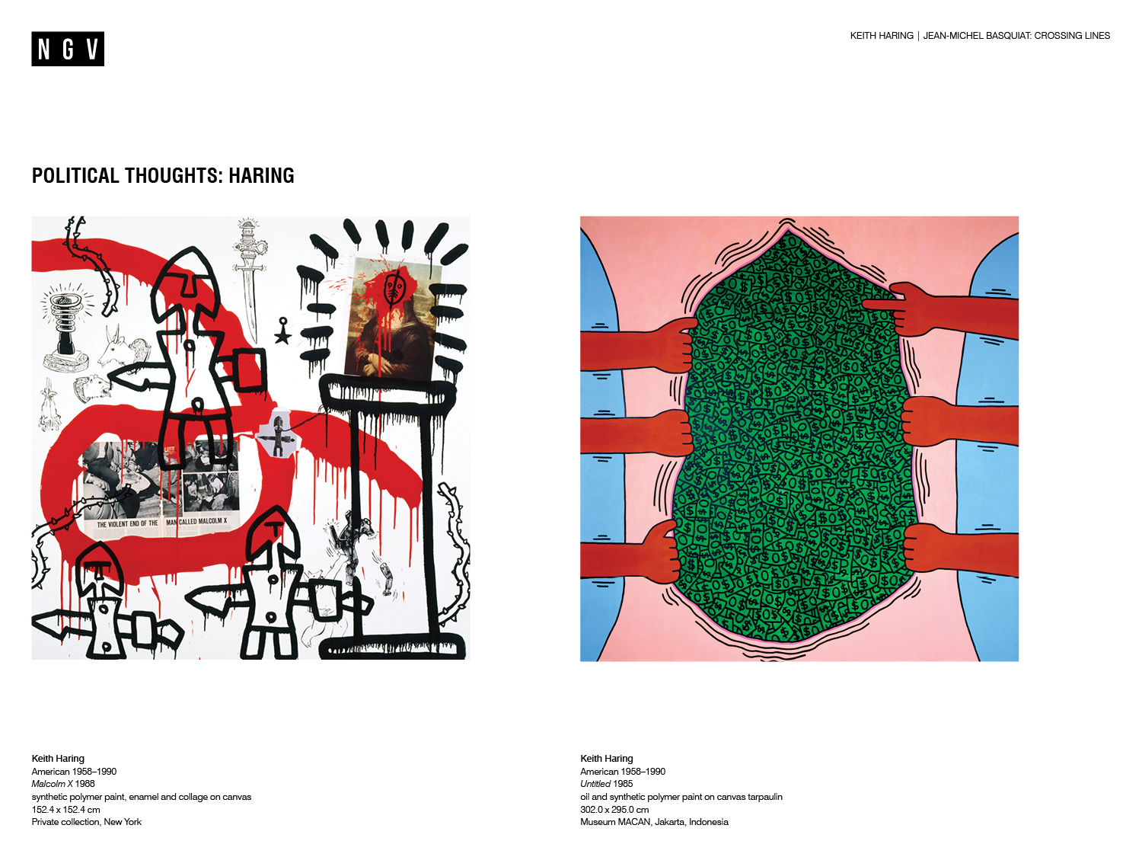
Notes:
Discussion prompts
What do you think these works are about? What do you notice about the works which leads you to think this?
Political Thoughts: Haring
Like Basquiat, Haring was an activist who used art to comment on social issues such as racism, the AIDS epidemic and capitalist greed. In Untitled, 1985, Haring makes a scathing criticism of capitalism by depicting a torso split open by hands to reveal ‘zero-dollar’ bills.
Malcolm X, 1988, is named after black activist and leading figure in the 1960s American civil rights movement, Malcolm X. The collage appropriates diverse imagery including Leonardo da Vinci’s famous painting Mona Lisa, 1503, images of African antiquity and a newspaper clipping about the 1965 assassination of Malcom X. The contrasting effect created by placing seemingly unconnected historical and cultural references near each other is called juxtaposition. Here Haring has used juxtaposition to comment on historical and contemporary racism in America.
Discussion prompts
What meanings or ideas does Haring’s appropriation of Mona Lisa suggest to you and why? Consider the use of visual elements such as the red tribal mask painted over her face, radiant black lines and the museum plinth.
What ideas emerge out of the juxtaposition of images from different cultures and times in Malcolm X?
How do the meanings and ideas in these works relate to Haring’s social activism?

Slide 14
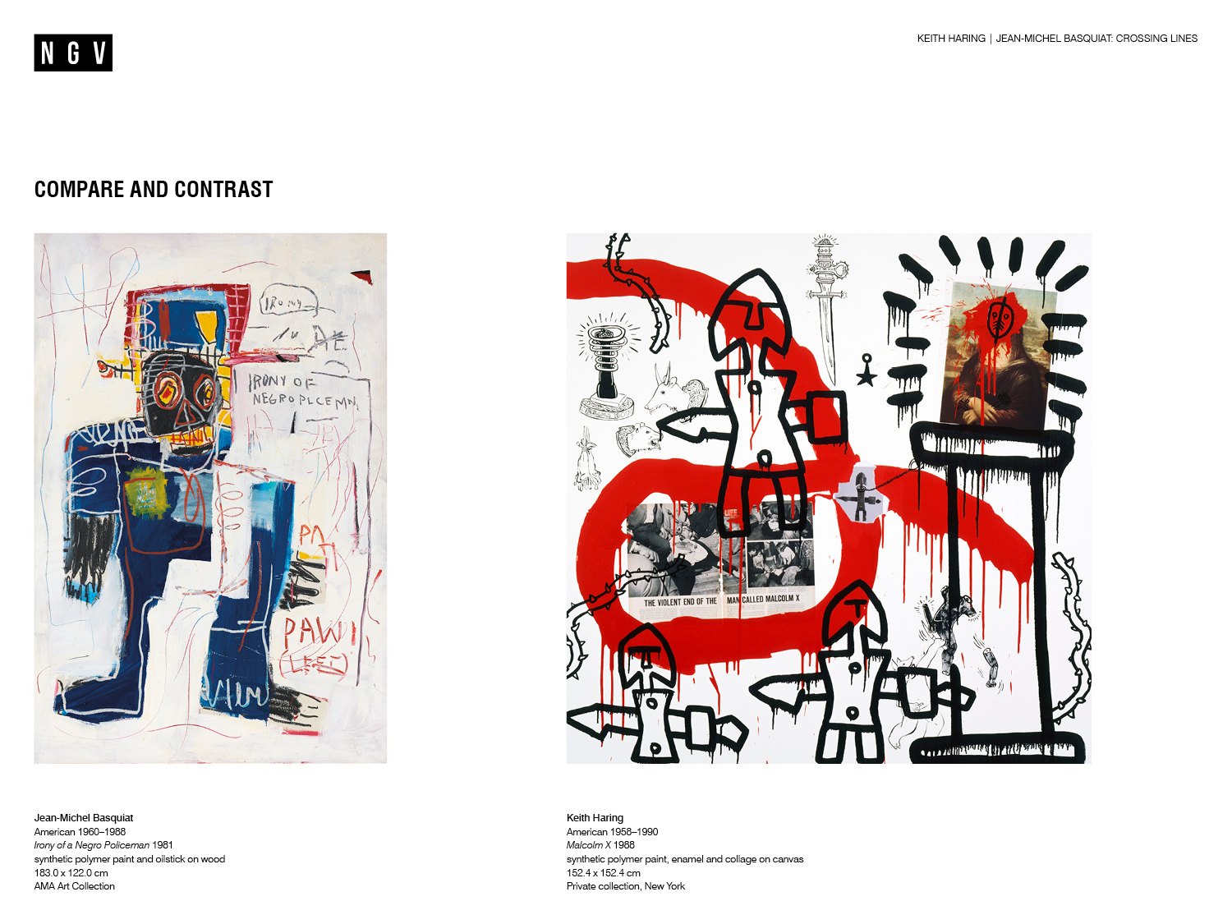
Notes:
Compare and contrast
Compare and contrast Haring’s Malcolm X, 1988, with Basquiat’s Irony of a Negro Policeman, 1981.
Which common themes arise from the paintings when read together? What evidence can you see in the works to support this?
Which techniques have the artists used? How is the effect similar or different?
Which art materials have the artists mixed and matched to create their works? Why do you think the artist chose those materials, and what effect does it have on the ideas and meanings in the work?

Slide 15
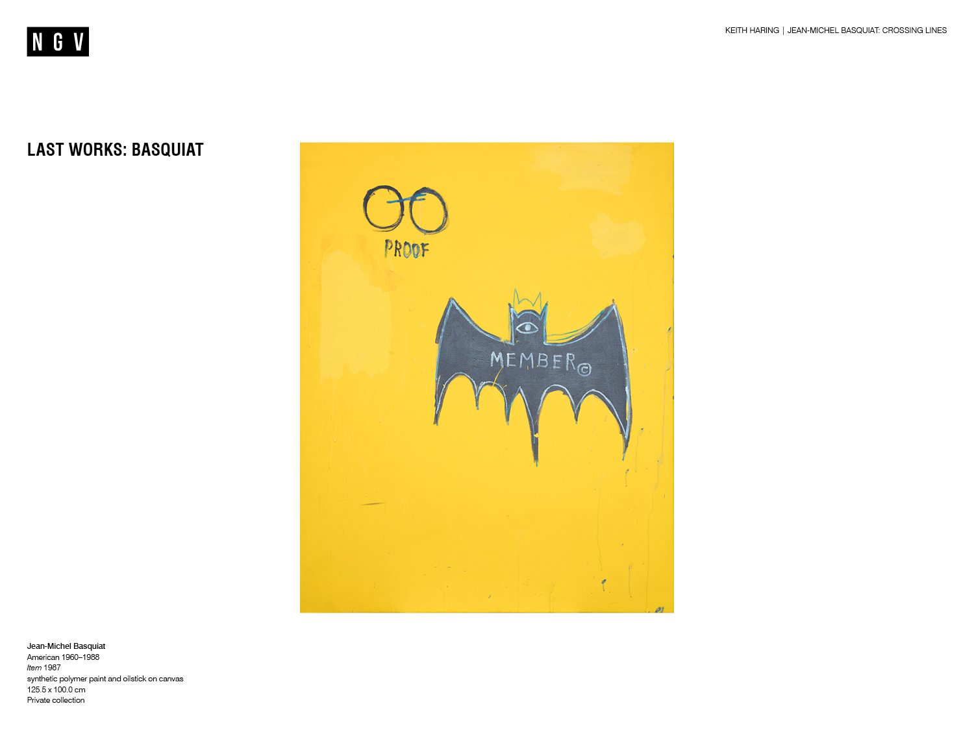
Notes:
Last Works: Basquiat
In 1987, Basquiat’s close friend and mentor Andy Warhol died from complications after gall bladder surgery. During the period of grief which followed, Basquiat’s work began to change. Instead of his earlier technique of filling the canvas with layered images and words, later works like Item, 1987 were contrastingly spare and minimal. The batman motif, which appeared on other works during this period, is emphasized in Item by a surrounding field of saturated yellow.
On August 12th 1988, Basquiat died unexpectedly in his Great Jones Street Studio in New York. He left a legacy of over 1000 prints and 1000 drawings.
Discussion prompts
How does Item make you feel emotionally? What is it about the work which evokes this response? Consider for example, the minimal composition.
How does Item differ from Basquiat’s earlier works? Which similarities can you identify? Consider use of text, colour and symbols.

Slide 16
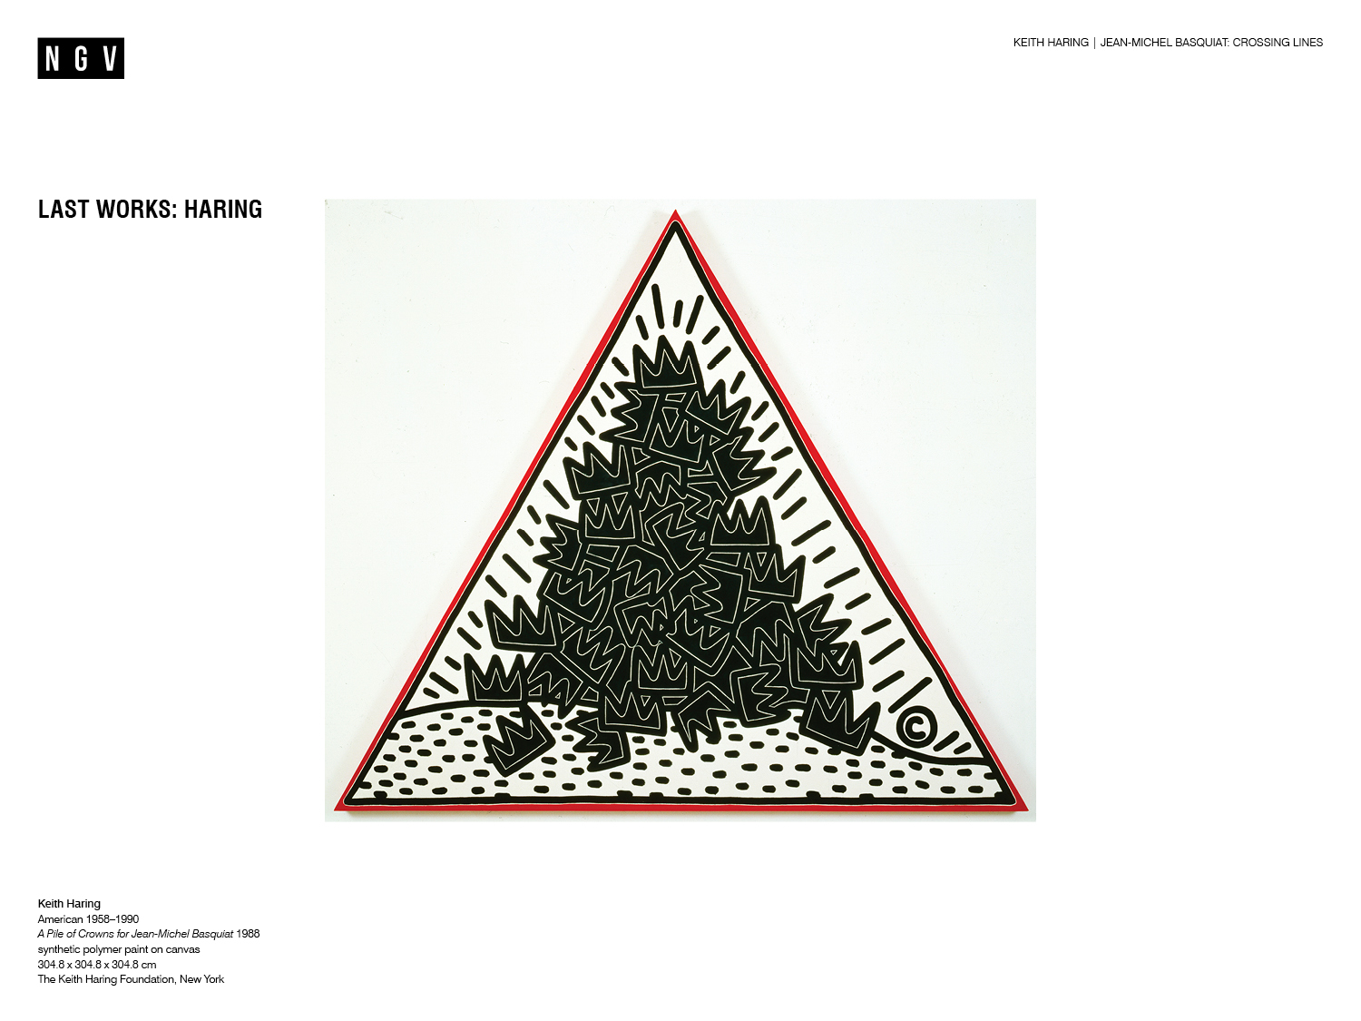
Notes:
Discussion prompt
Which visual references to symbols do you recognise in this image? If needed refer back to previous slides.
Last works: Haring
Keith Haring was devastated following the sudden death of his friend Basquiat and created Pile of Crowns for Jean-Michel Basquiat, 1988, as tribute. In this work, Haring merges elements of his own visual style with Basquiat's crown motif. Crowns are piled on top of each other like an offering to the late artist, with Haring’s signature radiant lines emphasising his powerful legacy.
The same year as the death of his close friend, Haring was diagnosed HIV positive. He worked tirelessly right up until his death at the age of thirty-one on February 16th, 1990 from AIDS-related complications.
Discussion prompts
Which aspects of this work are in keeping with Haring’s visual language? Which have been appropriated from Basquiat?
Why do you think that Haring chose to paint images from Basquiat’s visual language? Consider what you have learned so far about Haring and Basquiat’s art practices, symbolism, lives and their friendship.

Slide 17
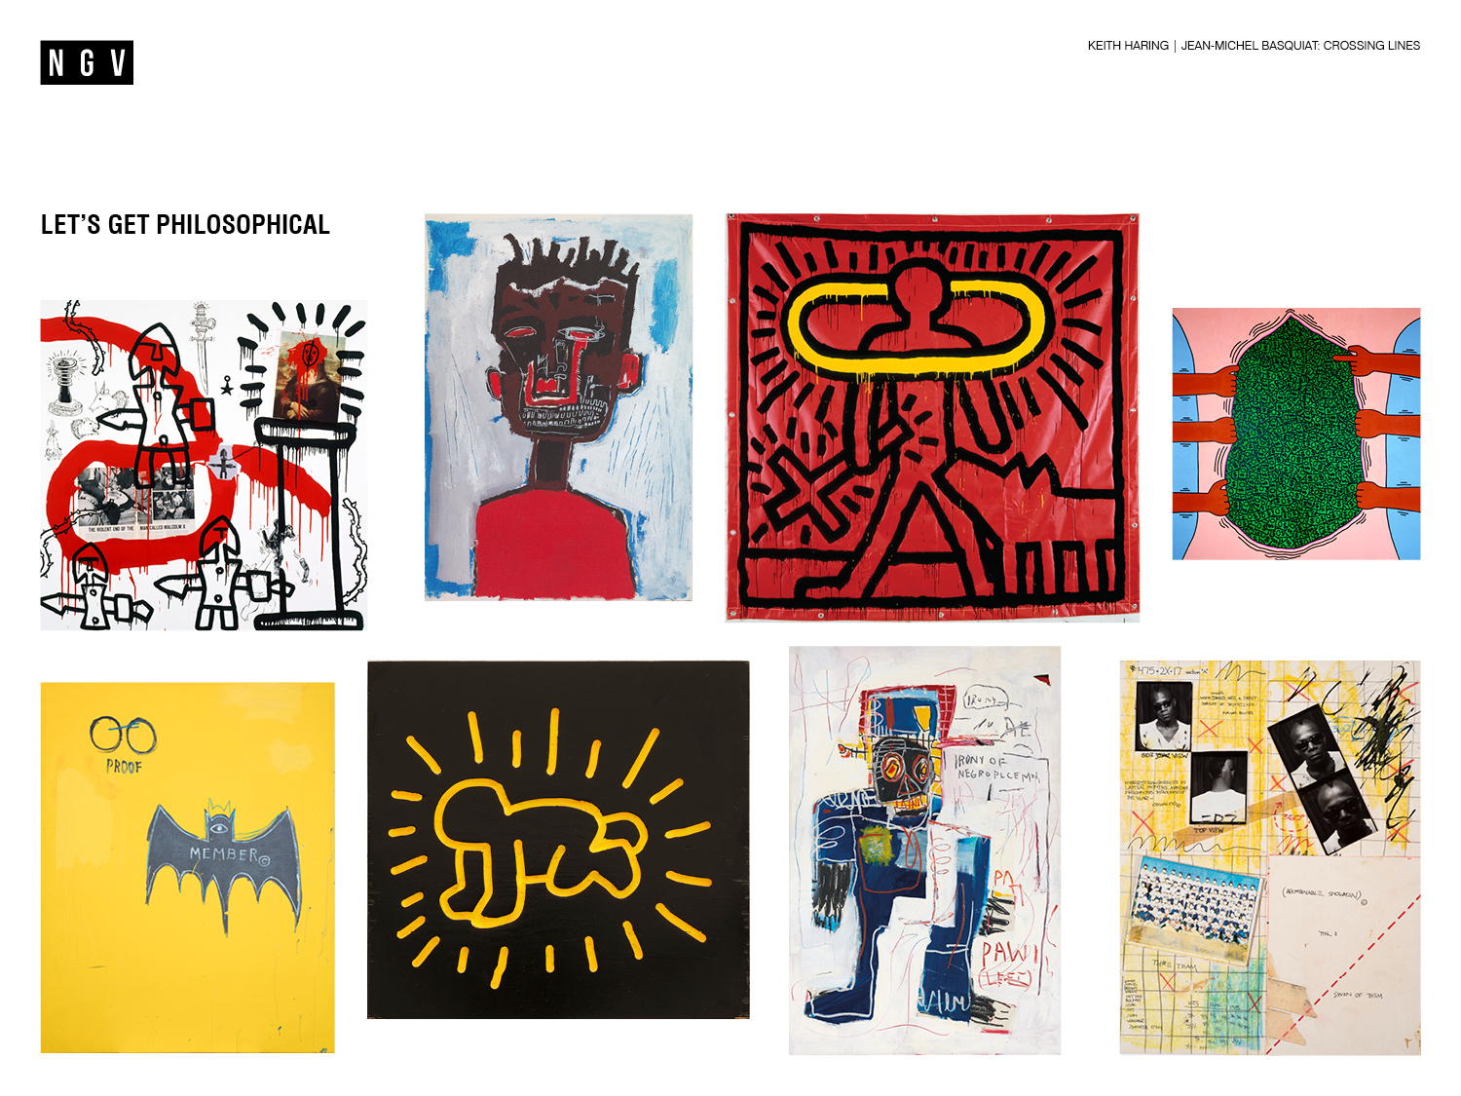
Notes:
Let’s get philosophical
What do you think is the role of art in society?
What does the work and lives of Keith Haring and Jean-Michel Basquiat teach us about the role of art in society?
What did Haring and Basquiat want you to think about when viewing their art? Consider their interests, influences, the social and political issues they commented on, and the materials and techniques used.
How successfully does their work communicate their intended messages and provoke thought?
What do you think art has the power to do? How can art change the world? Give reasons for your answer.

Slide 18


