Slide 1

Notes:
The following slides are recommended for use with the activities in NGV resource ‘Art and English | Descriptive writing inspired by John Brack's Collins St, 5p.m.’ It can be accessed at www.ngv.vic.gov.au/school_resource/art-and-english-descriptive-writing-inspired-by-john-bracks-collins-st-5p-m

Slide 2
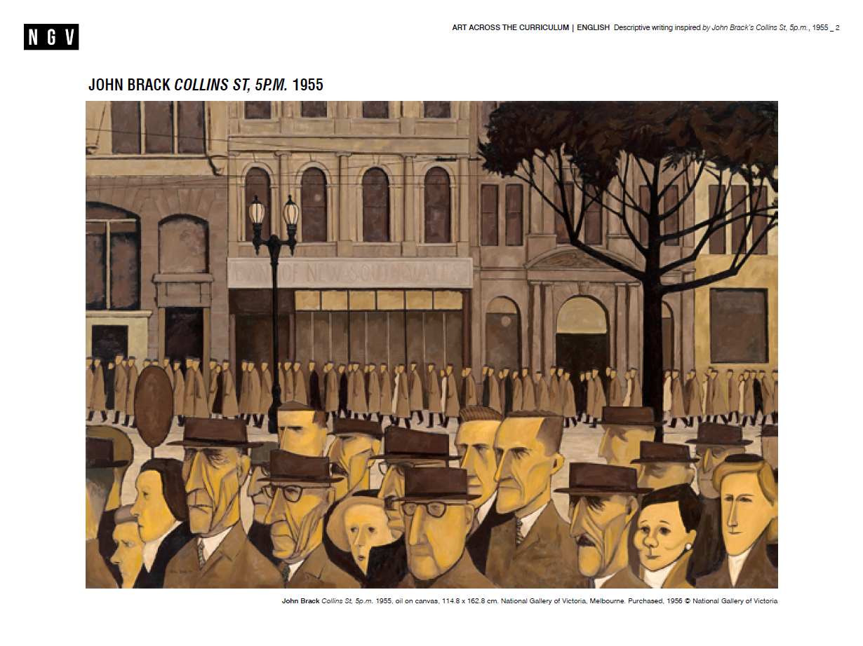
Notes:
John Brack (1920–99) was one of Australia’s leading modern artists. His iconic work, Collins St, 5p.m., 1955, offers a social commentary on everyday life in the 1950s. In 2011,the painting was voted the National Gallery of Victoria’s most popular work of art.
John Brack was interested in describing modern life and society and his subjects were everyday people. Collins St, 5p.m. was painted at a time when memories of the Depression and wartime austerity still lingered; however, there was also cause for celebration, as the Australian economy thrived with full employment and home building soared. To prepare for the painting, Brack stood in a doorway in Melbourne’s Collins Street between 4.45 pm and 5.15 pm for many weeks and sketched streams of rush hour workers on their way home from work. He also referenced photographs of buildings in Collins Street.
During this period in Melbourne, most of the population was of Anglo-Celtic origin. Brack has depicted the people in Collins St, 5p.m. monochromatically to reflect the similarity between them. The artist’s depiction of these emotionally closed, robotic figures, seemingly unaware of each other and their surroundings, may be read as a loss of individuality and sense of alienation in the masses. Brack noted, ‘As a matter of fact it used to strike me as most eerie, to be sketching within 3 feet of so many people, none of whom took the slightest notice’. Brack’s paintings, often sombre in tone, reveal insights into the human condition.

Slide 3
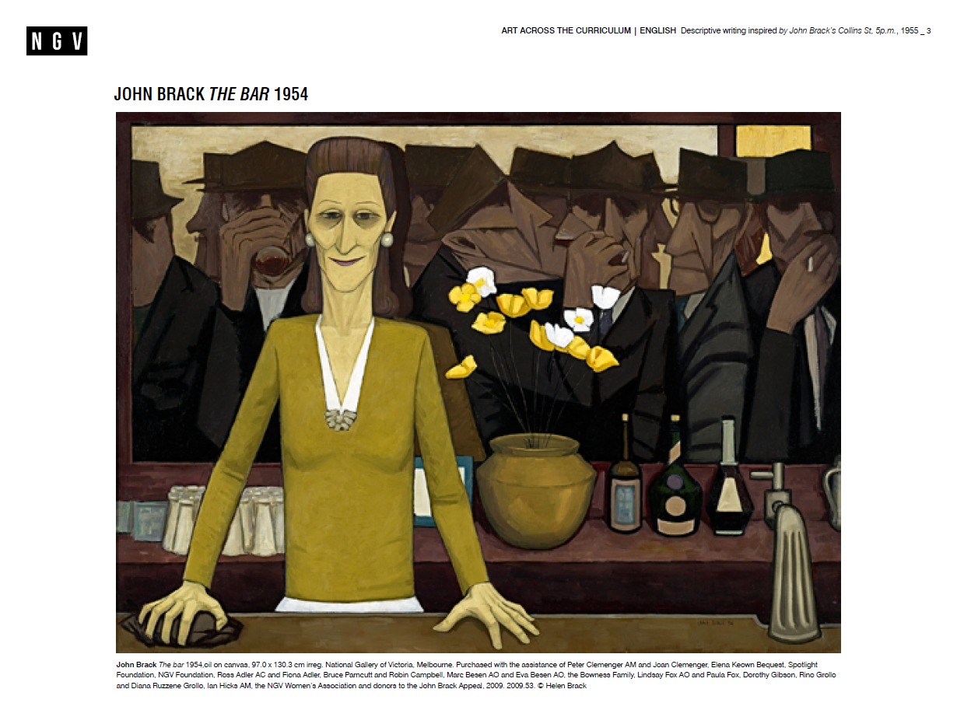
Notes:
John Brack’s work, The bar, 1954, is a companion to Collins St, 5p.m. Under the watchful eyes of a stern bartender, a band of near-identical workers urgently drink their fill before the six o’clock closing that was enforced in Melbourne pubs until 1966. As a pair, the two paintings offer an insight into city life during this decade in Australia’s history. In this work, Brack has appropriated Édouard Manet’s famous painting, A bar at the Folies-Bergère, 1882, and replaced the opulence of 1880s Paris with the dour austerity of 1950s Melbourne.

Slide 4


