Slide 1
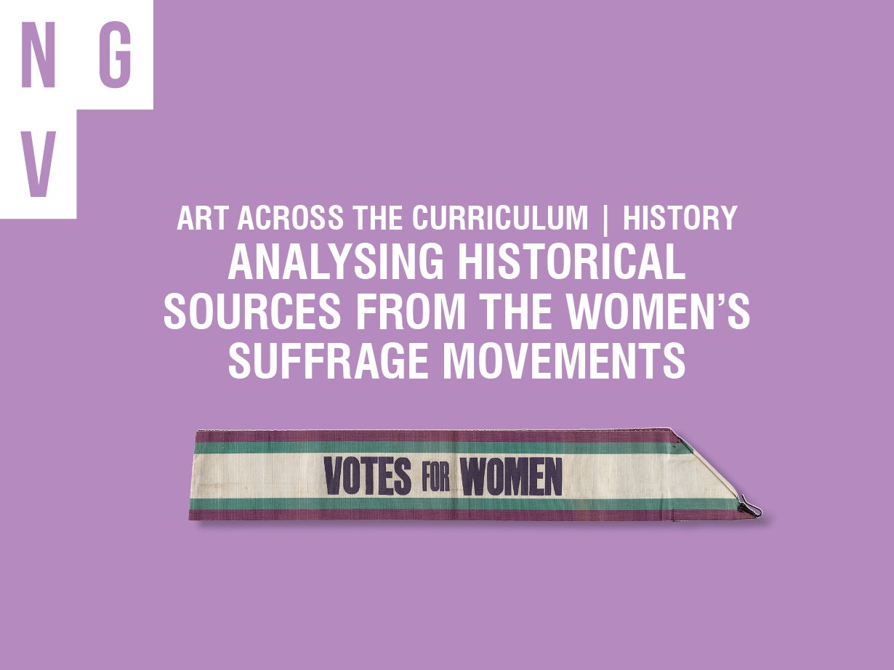
Notes:
The following examples of objects, clothing and documents in The Krystyna Campbell-Pretty AM and Family Suffrage Research Collection are recommended for use with the activities in the full resource ‘Art and History | Analysing historical sources from the women’s suffrage movements’.
To explore the Collection and find more sources to incorporate, visit NGV International or the NGV website https://www.ngv.vic.gov.au/exhibition/womens-suffrage-research-collection
You might think that women have always had the right to stand in elections and vote, but that isn’t the case. It wasn’t until the late 19th and early 20th century that women were given equal democratic freedoms to men, and only in certain countries, such as New Zealand and Australia. To create this change, women campaigned using both peaceful and confrontational tactics in organised societies known collectively as the women’s suffrage movement. In the United Kingdom, numerous women’s suffrage societies were established during the mid-19th century and women were eventually granted the same voting rights as men in England in 1928. This momentous event in social history was also a significant time in the history of popular design and fashion with the birth of modernism.
Designers and artists created jewellery, accessories, ceramics, banners, printed items and other artistic objects, which featured distinctive colour schemes and logos to promote the suffrage message and build their political advantage. Visual images defined the suffrage movement, from the purple, green and white sashes worn by the Women’s Social and Political Union, to the ‘Votes for Women’ posters designed by Hilda Dallas and distributed in their thousands around London and beyond.

Slide 2
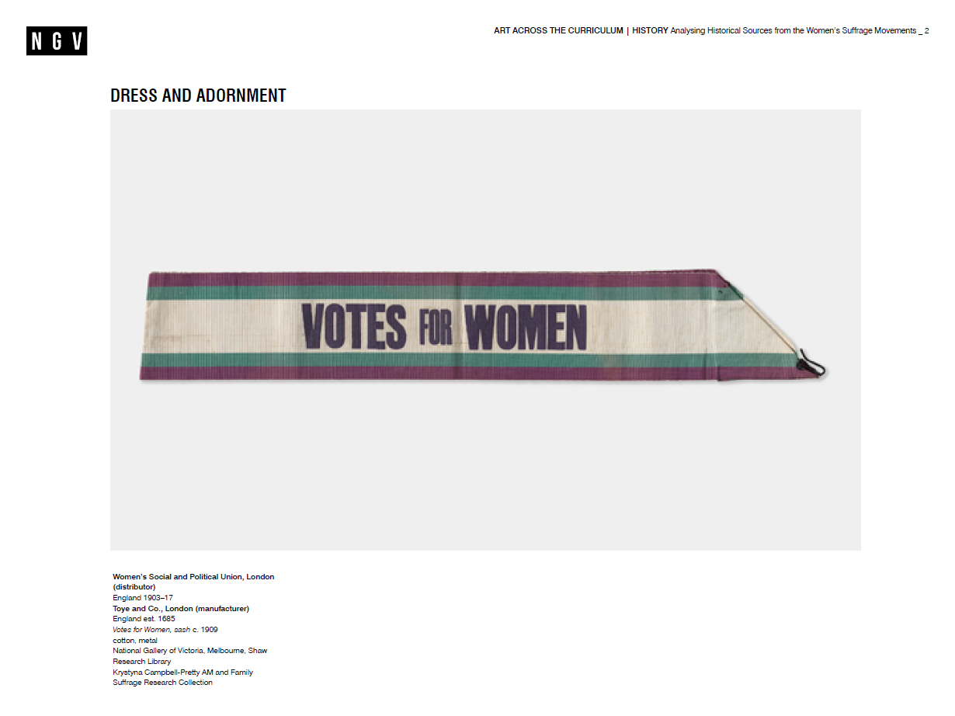
Notes:
Sashes were an essential part of the ‘suffrage uniform’ and were worn at demonstrations, processions and other public events to visually identify suffrage campaigners. This sash design was first seen at the Women’s Sunday march held on 21 June 1908. In the lead up to that event, the Women’s Social and Political Union treasurer, Emmeline Pethick-Lawrence selected the colours white (for purity), purple (for royalty, freedom and dignity), and green (for hope) to represent the WSPU. She impressed on women the importance of sporting the colours, rightly believing that the white, purple and green would become synonymous with the suffrage cause.

Slide 3
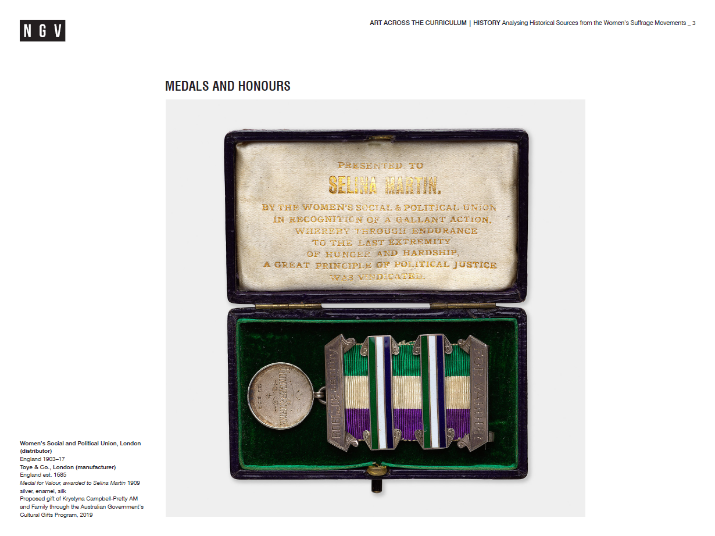
Notes:
Medals for Valour, such as this one and another in the Collection awarded to Grace Chappelow, were presented by the Women’s Social and Political Union to women who had endured a hunger strike while serving a prison sentence for an act of suffrage militancy. Few of these medals were awarded, making receiving one the crowning achievement for a suffragette. The significance of these medals is emphasised by their comparable design to military medals of bravery.

Slide 4
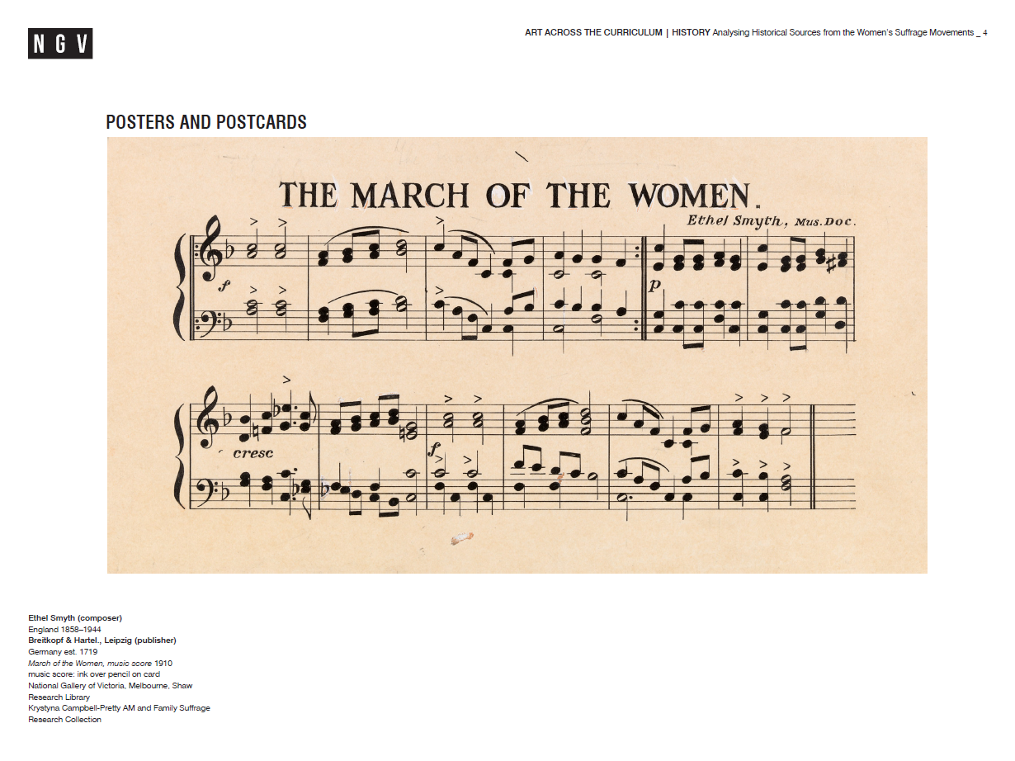
Notes:
In 1910, composer and suffrage campaigner Ethel Smyth composed March of the Women as the official anthem of the Women’s Social and Political Union, based on the rousing melody of a traditional Italian folk song. The lyrics were written by journalist and suffragist Cicely Hamilton. March of the Women was widely adopted around the world as a rallying cry for suffragists, and was sung at rallies, meetings and in prison. When composer Thomas Beecham visited Smyth in Holloway Prison in 1912, he reportedly found her conducting a group of women singing the anthem, keeping time with a toothbrush.

Slide 5
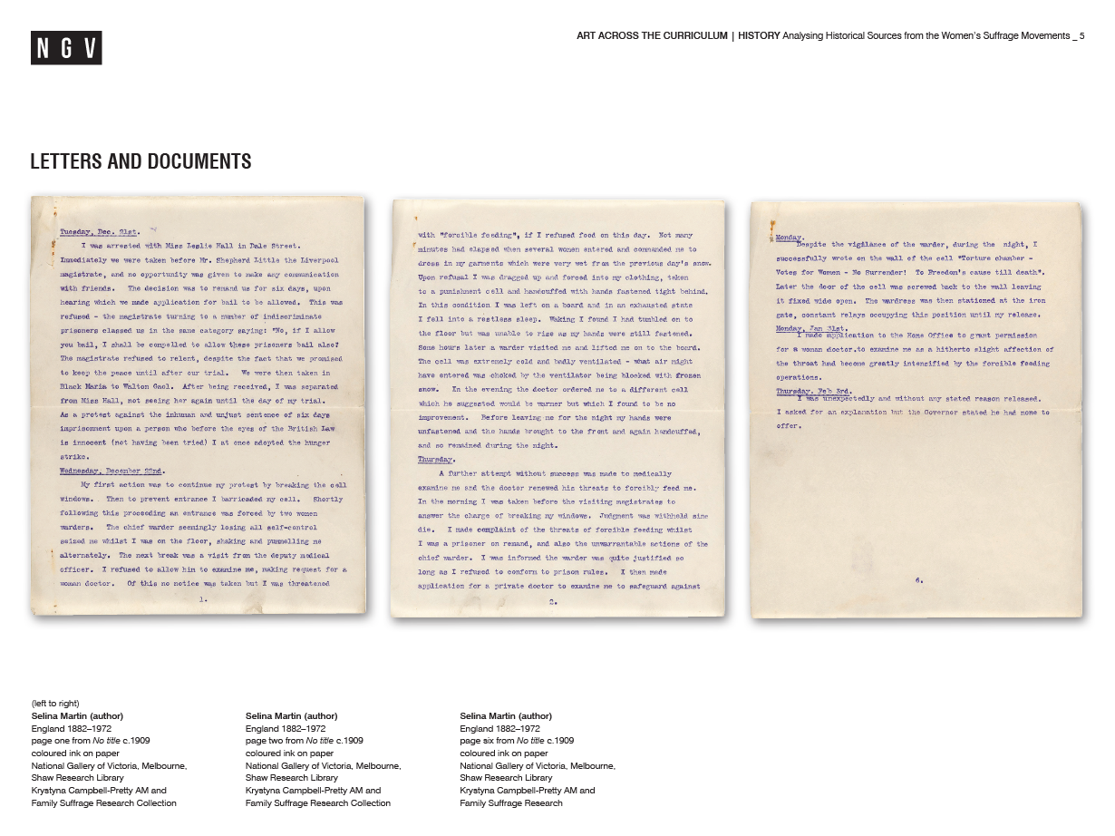
Notes:
Suffragette Selina Martin wrote this six-page typewritten account detailing the period from her arrest on 21 December 1909 to her release from Walton Gaol on 3 February 1910. In this first-person description, the reality and brutality of the suffrage hunger strikes and the subsequent force feeding of women who undertook them is graphically presented. Hunger strikes in gaol were seen by the leaders of the militant Women’s Social and Political Union as an important tool in publicising and arousing support for the suffrage movement, with accounts featured in Votes for Women.

Slide 6
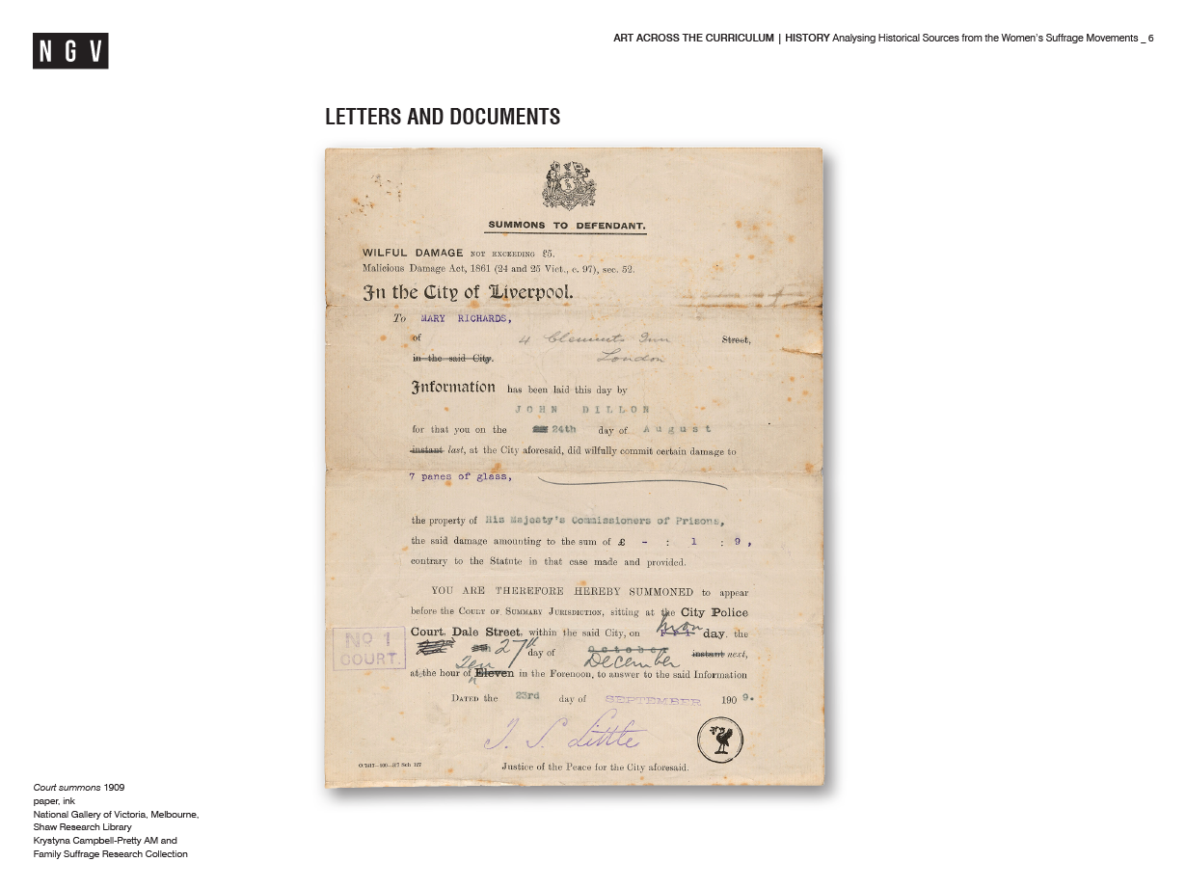
Notes:
This court summons was issued to suffragette Selina Martin (under her alias Mary Richards) in September 1909 when she was charged with wilful damage for smashing fourteen panes of glass. Martin was imprisoned many times and was effectively a ‘professional’ suffrage militant. She took part in five demonstrations that included militant incidents between May and September 1909 and spent much of the next year either in prison or recovering from hunger strikes. Only a relatively small group of women were willing to engage in militant activity, so activists like Martin were highly valued by the Pankhurst-led Women’s Social and Political Union.

Slide 7
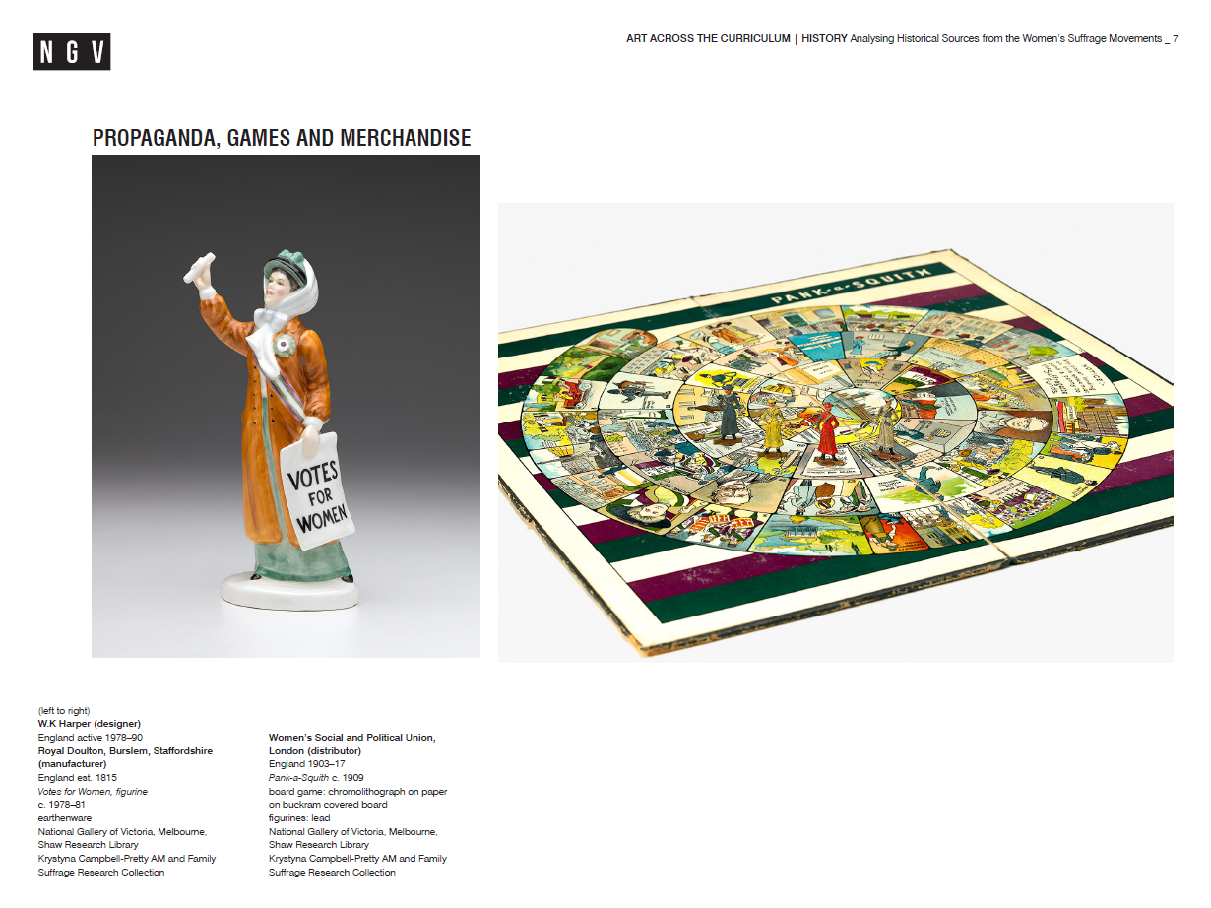
Notes:
This figurine was first made in 1978 to mark fifty years of universal female suffrage in England. The figure holds a pamphlet in one hand and a ‘votes for women’ poster in the other, and wears a sash and rosette in the purple, white and green colours of the Women’s Social and Political Union. Royal Doulton was the first established ceramic firm
to create products inspired by the suffrage movement. In 1909, it produced two ceramic inkwell figurines that alluded to the 1909 suffrage march on parliament. Both figures were squat and featured dour facial expressions. Although not explicitly anti-suffragist, the inkwells did not depict suffrage activists in a positive light.
Named for suffragette leader Emmeline Pankhurst and her political adversary, Prime Minister Herbert Asquith, ‘Pank-a-Squith’ was one of many toys and games sold by the Women’s Social and Political Union to raise funds for their campaign. Games were a vehicle for the suffrage message to reach a broad audience and inoffensively enter middle-class homes. Pank-a-Squith is similar to Snakes and Ladders: each player moves their suffragette game figure along a spiral of squares from their ‘home’ to the Houses of Parliament, navigating obstacles, prejudices and obstructions along the way. The first player to reach the final square of ‘universal suffrage’ is the winner.

Slide 8
