Slide 1
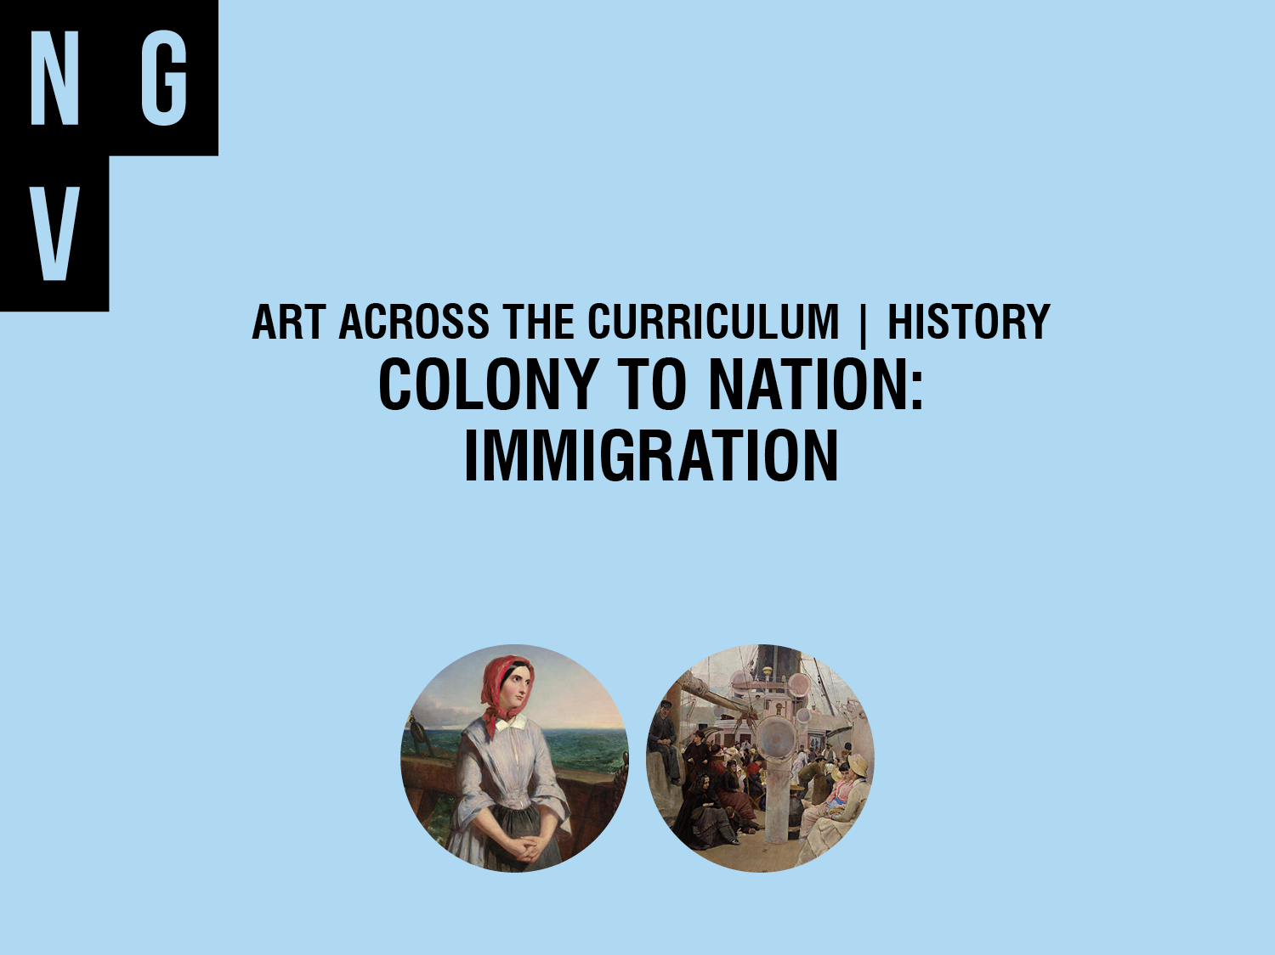
Notes:
The following slides have been designed for use in conjunction with NGV Education resource ‘Art and History: Colony to Nation Immigration’ available at http://www.ngv.vic.gov.au/school_resource/art-and-history-colony-to-nation-immigration

Slide 2
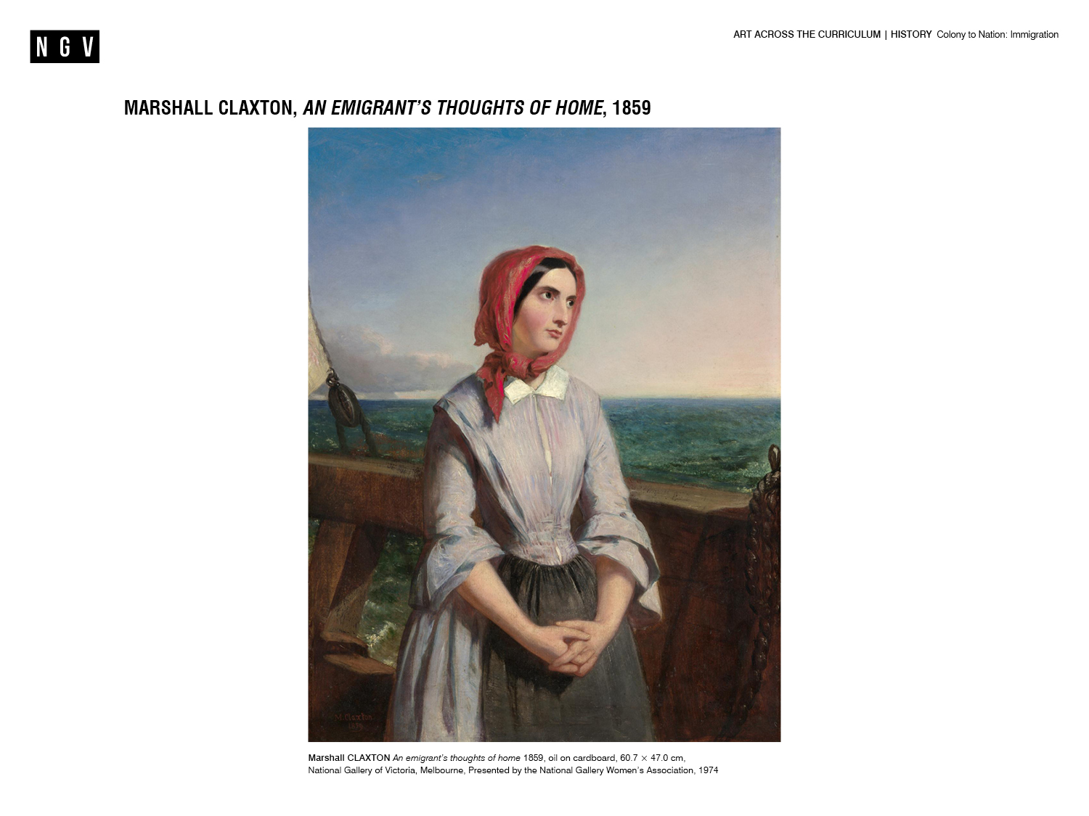

Slide 3
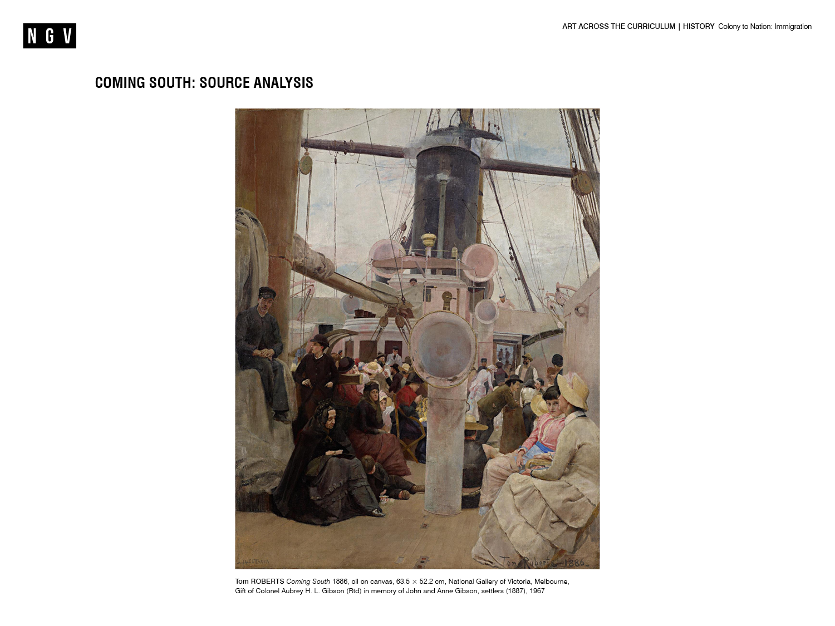

Slide 4
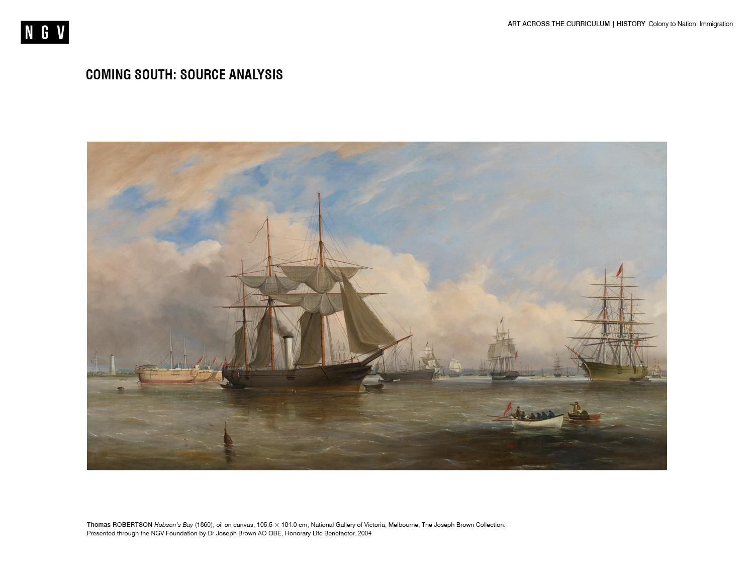

Slide 5
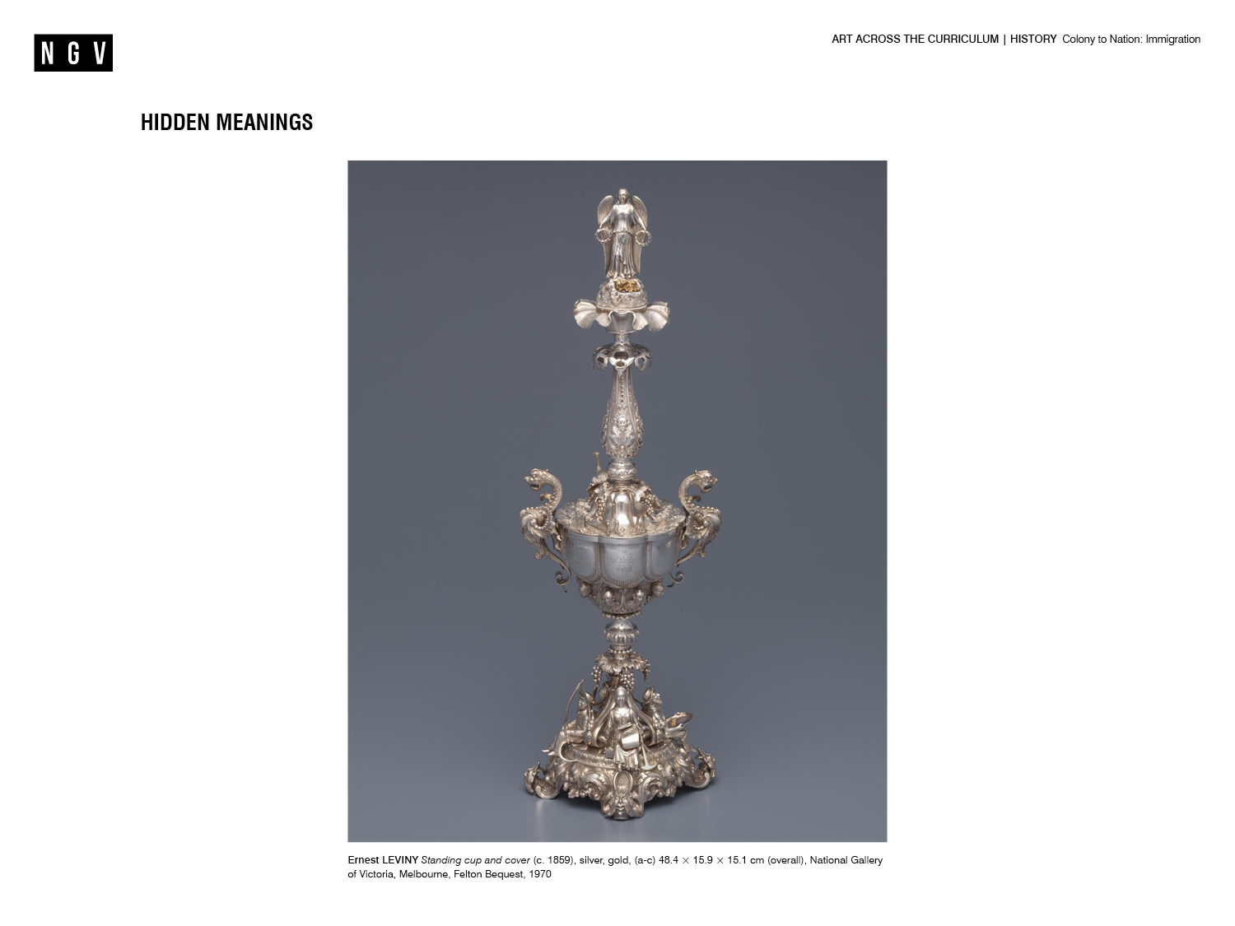

Slide 6
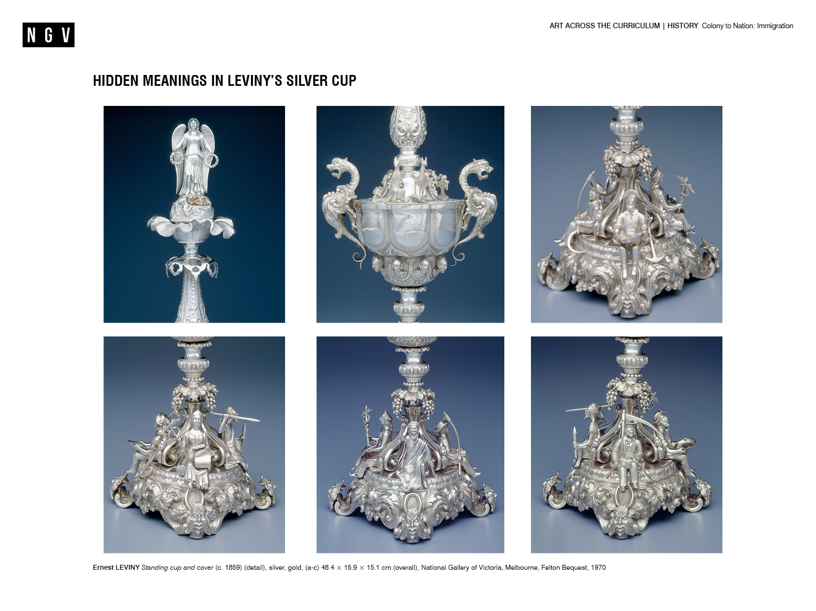

Slide 7
