Slide 1
Notes:
The following slides have been designed for use in conjunction with NGV Education resource ‘Art and English: Writing about war inspired by Pablo Picasso's Weeping Woman, 1937’ available at http://www.ngv.vic.gov.au/school_resource/writing-about-war-inspired-by-pablo-picasso/

Slide 2
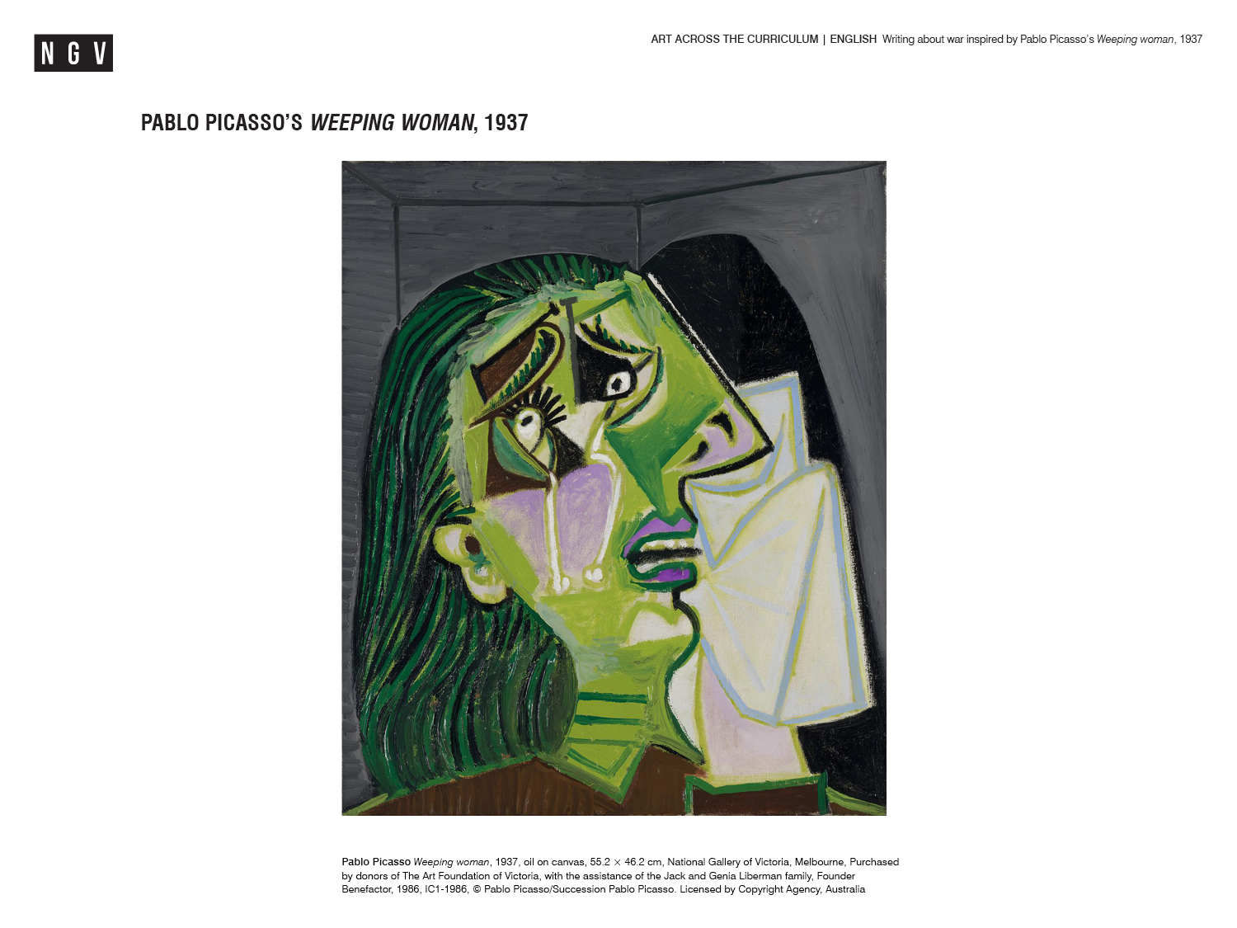

Slide 4
