Slide 1
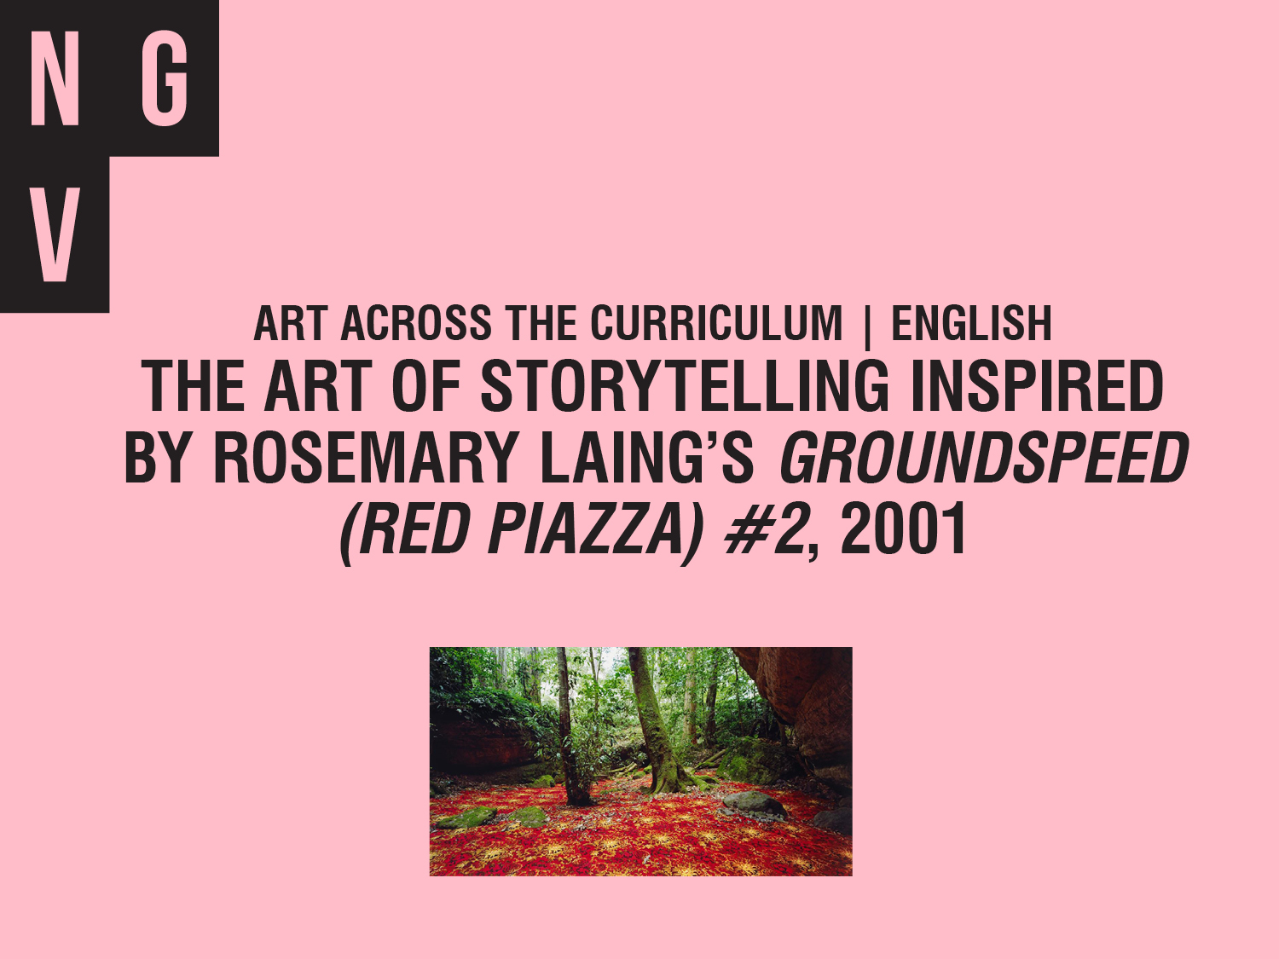
Notes:
The following slides have been designed for use in conjunction with NGV Education resource ‘Art and English: The art of storytelling inspired by Rosemary Laing's groundspeed (red piazza) #2, 2001’ available at https://www.ngv.vic.gov.au/school_resource/the-art-of-storytelling-inspired-by-rosemary-laing/

Slide 2
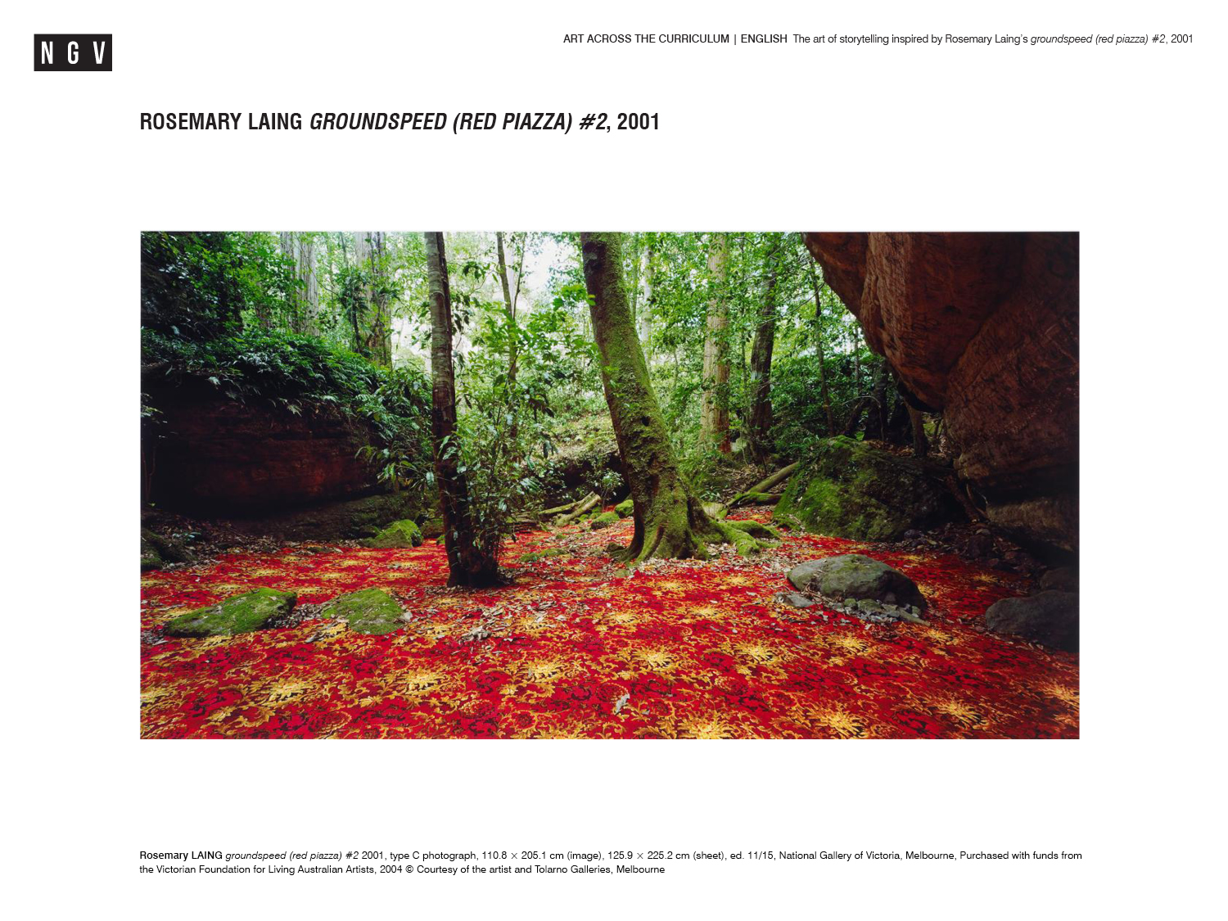

Slide 3
