Slide 1

Notes:
The following slides have been designed for use in conjunction with NGV Education resource ‘Big Weather’ available at https://www.ngv.vic.gov.au/school_resource/big-weather/

Slide 2
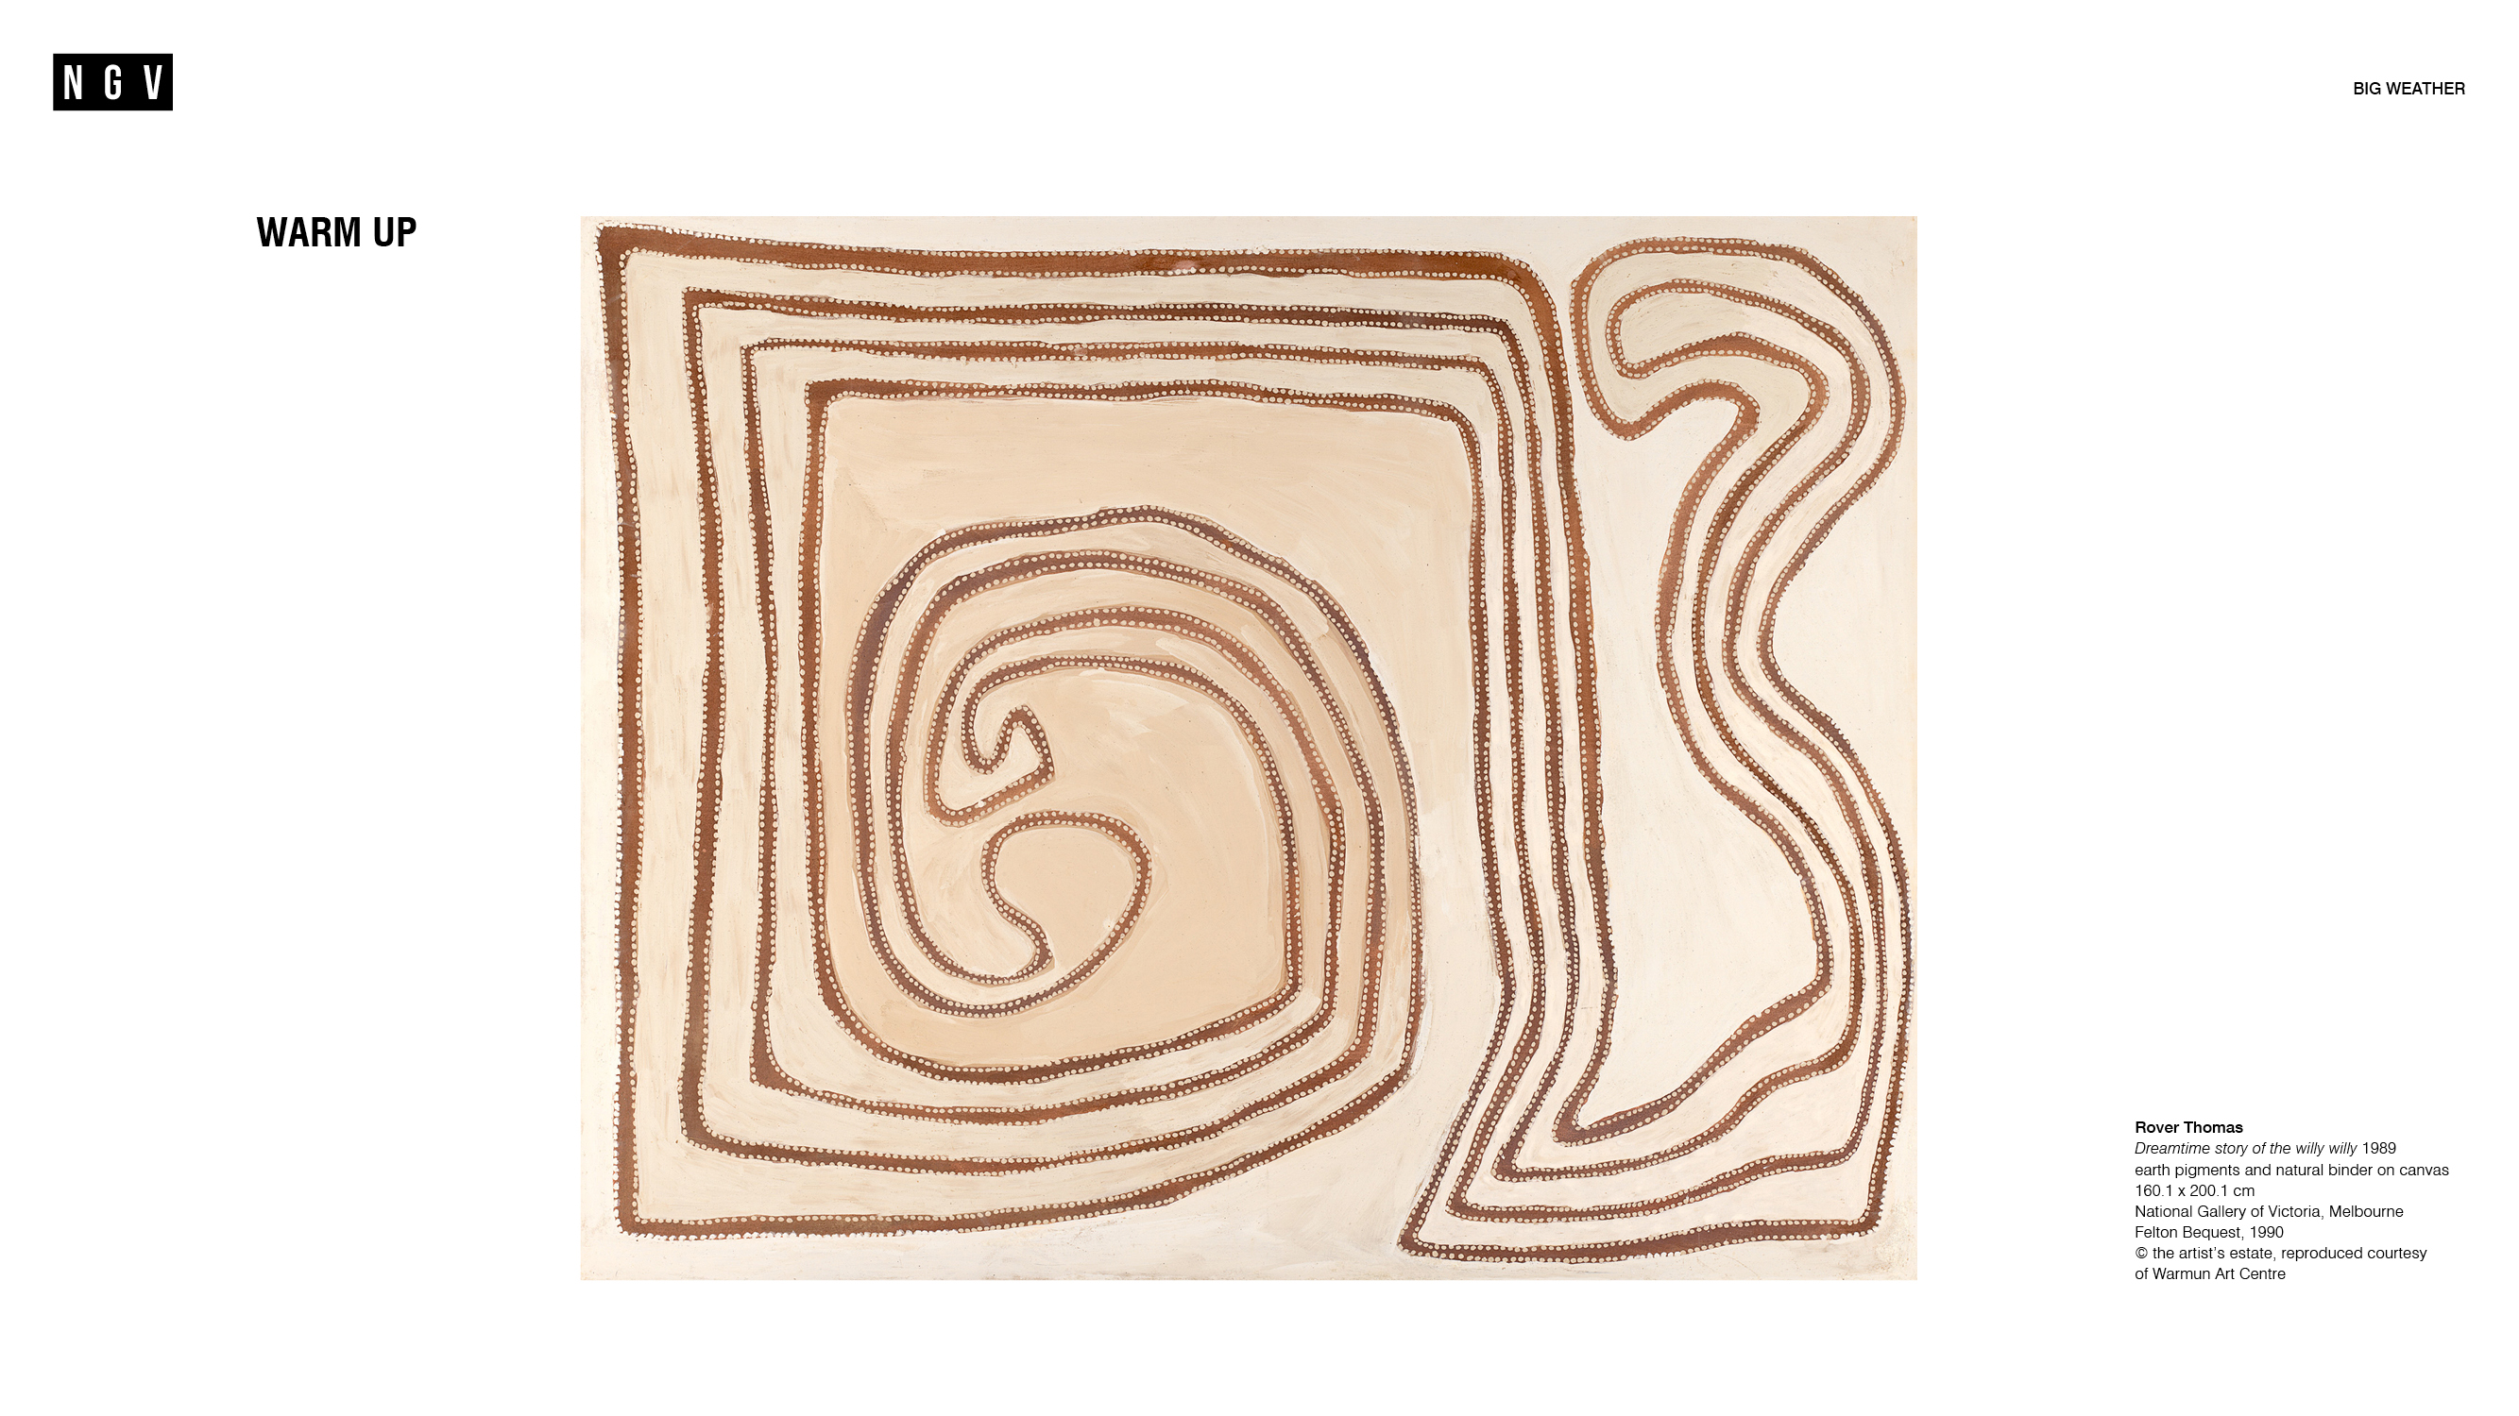

Slide 3
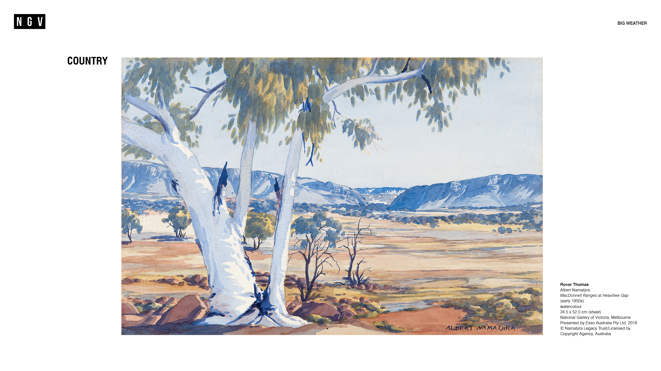

Slide 4
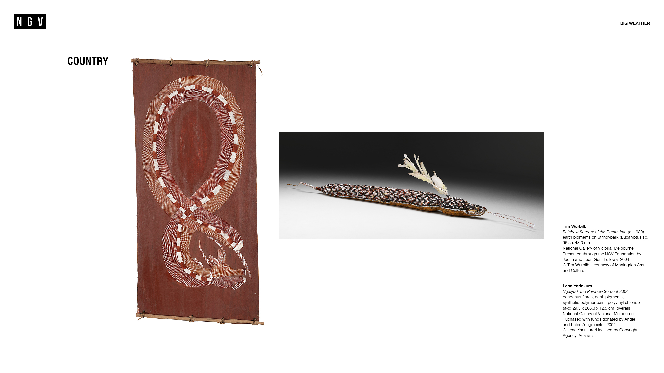

Slide 5
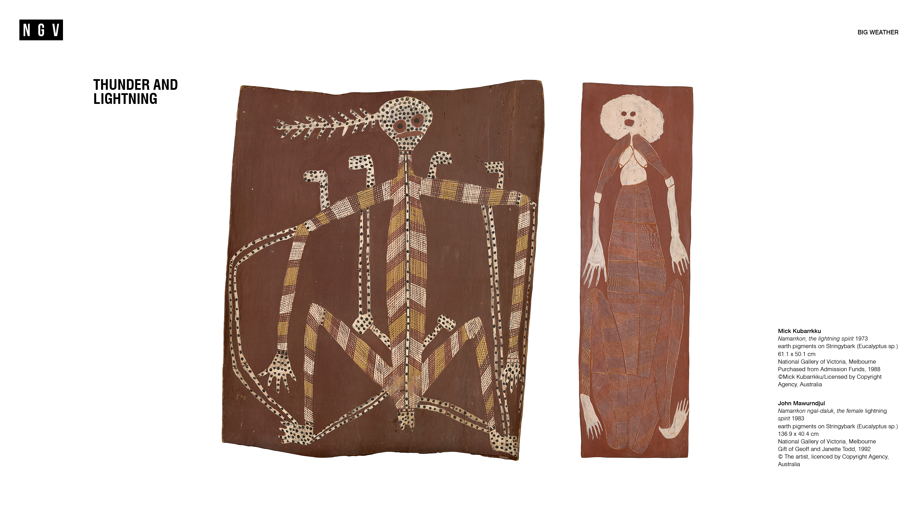

Slide 6
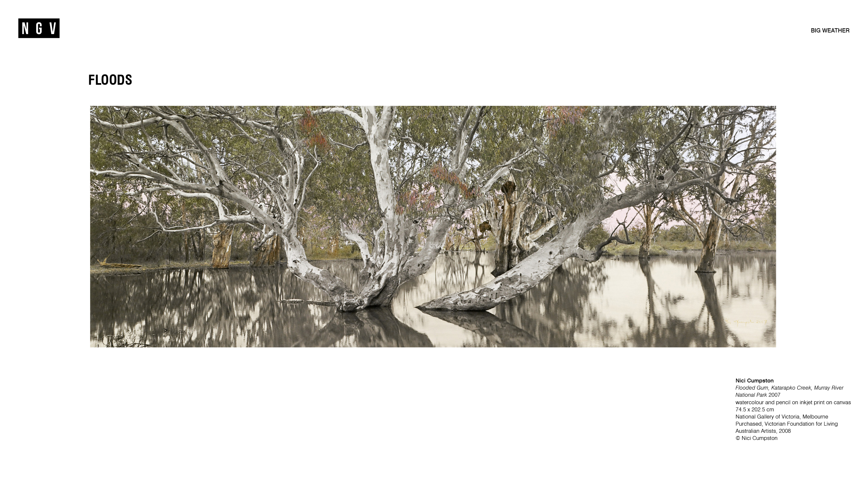

Slide 7
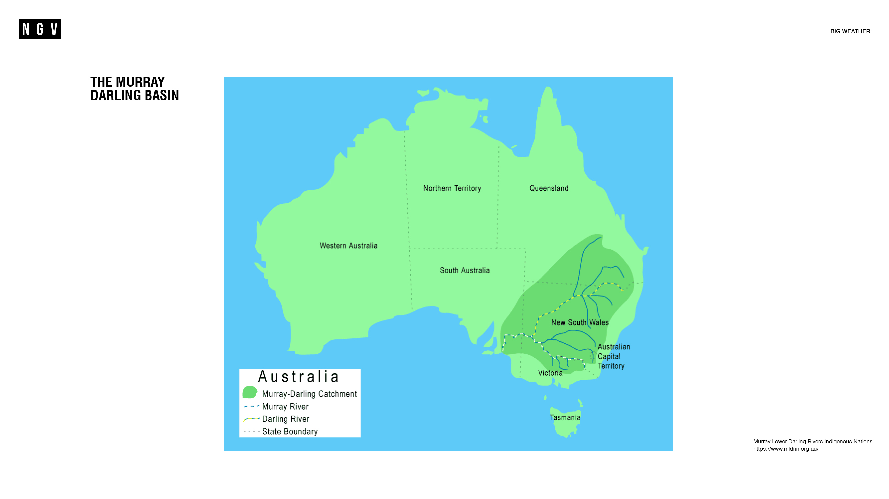

Slide 8
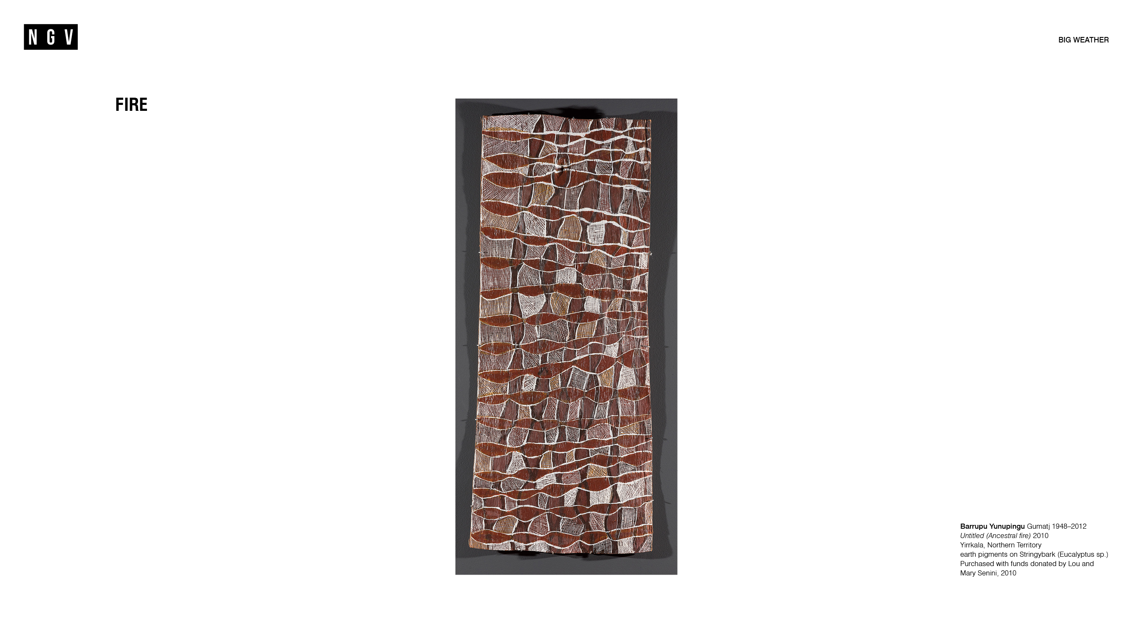

Slide 9
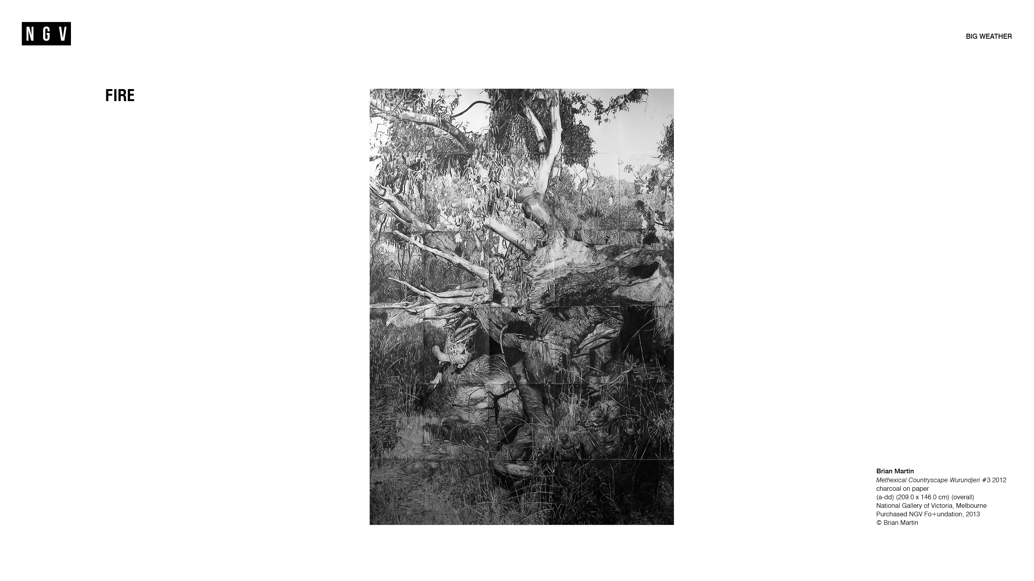

Slide 10
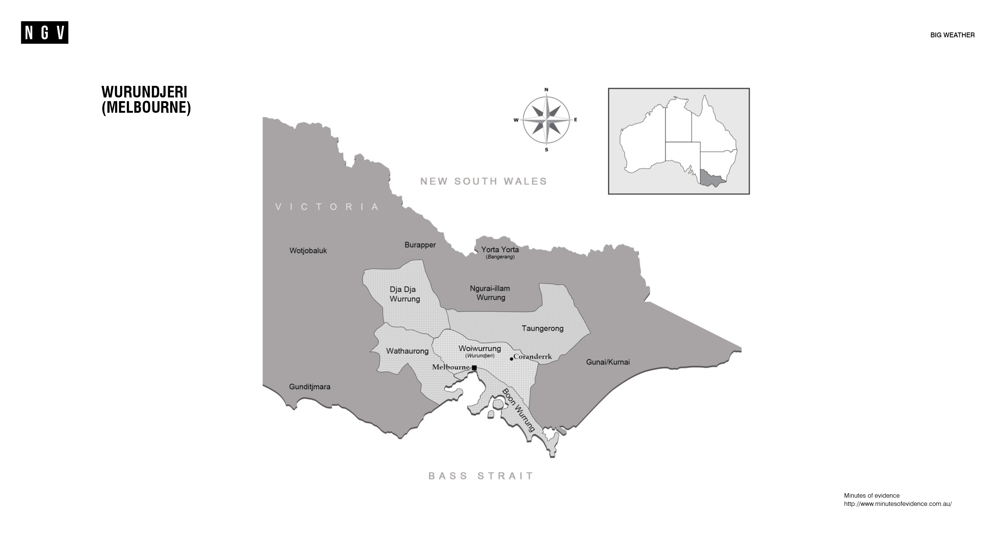

Slide 11


Slide 12


Slide 13
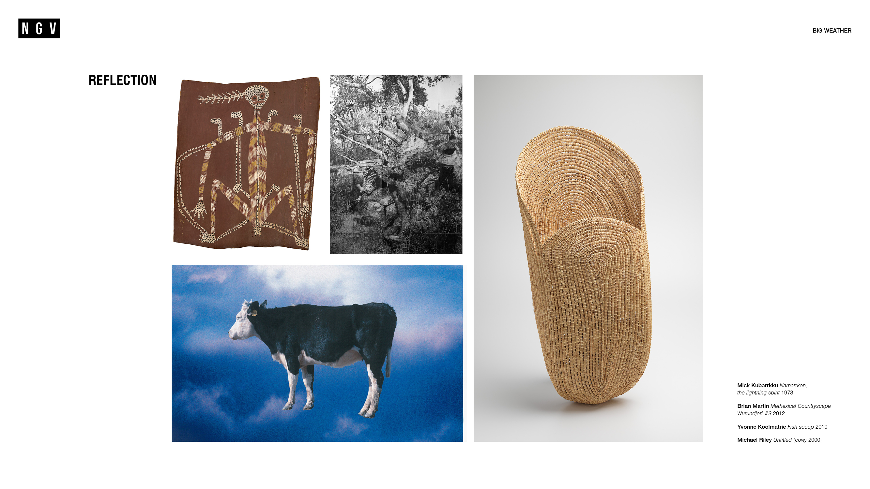

Slide 14


