Slide 1
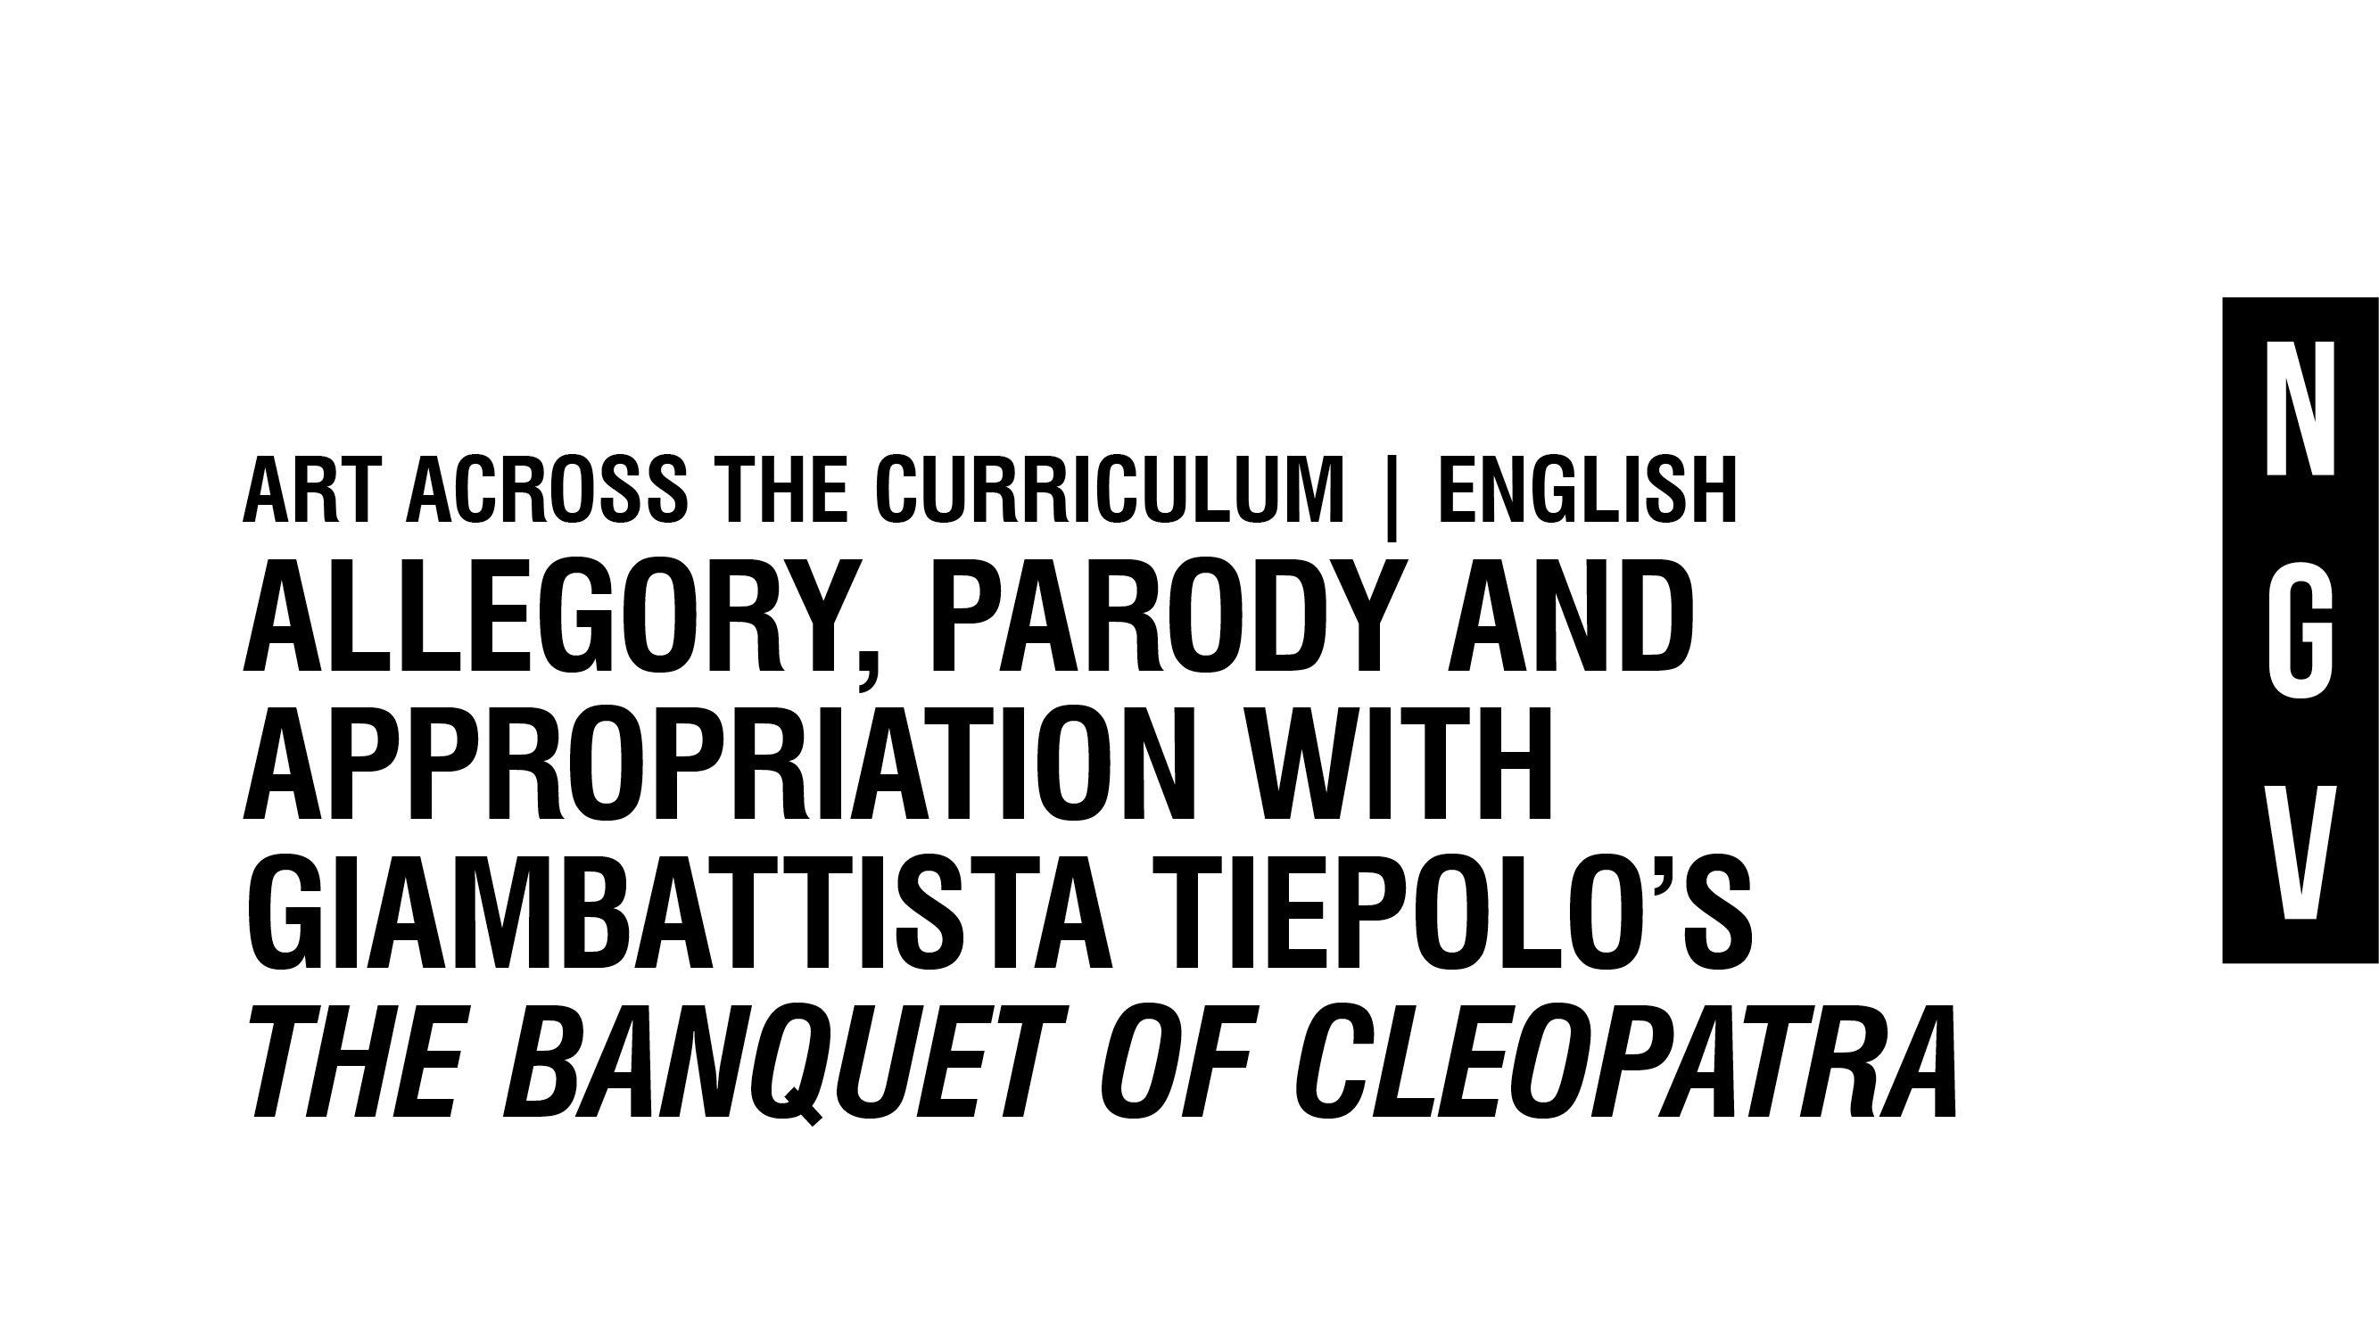
Notes:
Visit http://www.ngv.vic.gov.au/school_resource/allegory-parody-and-appropriation-with-the-banquet-of-cleopatra/ for information and activities to support these slides

Slide 2
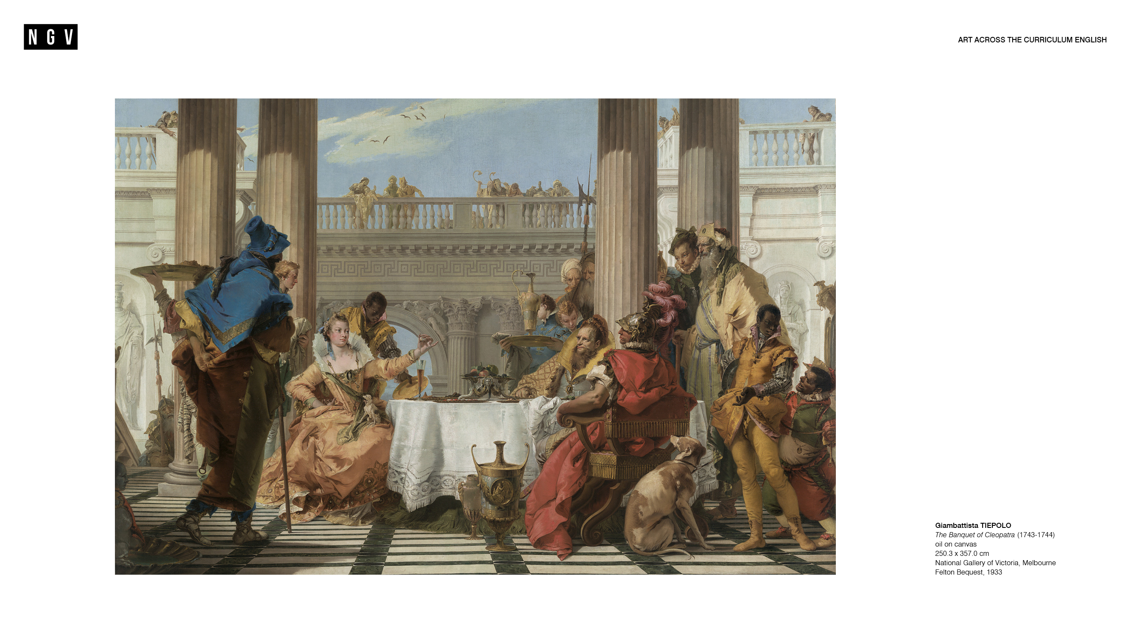

Slide 3
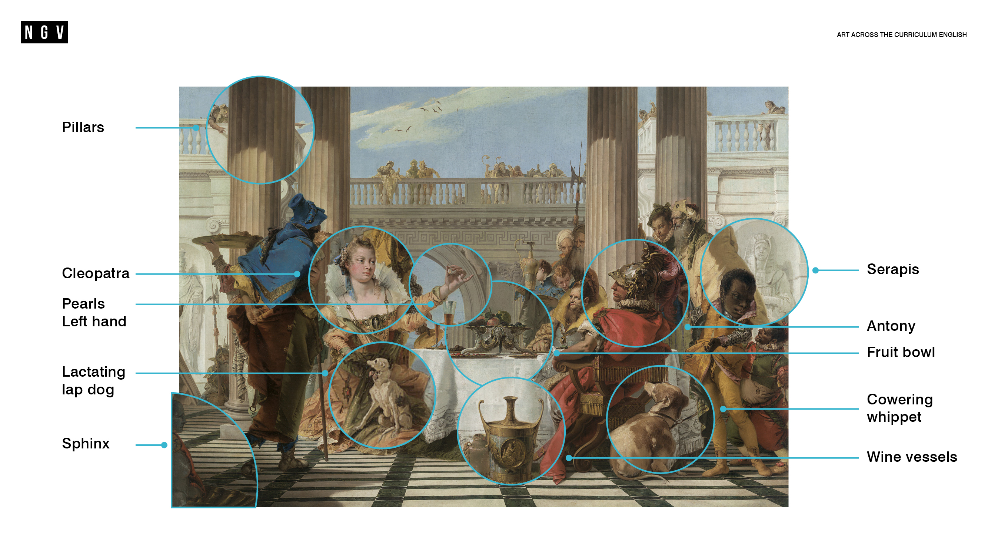

Slide 4
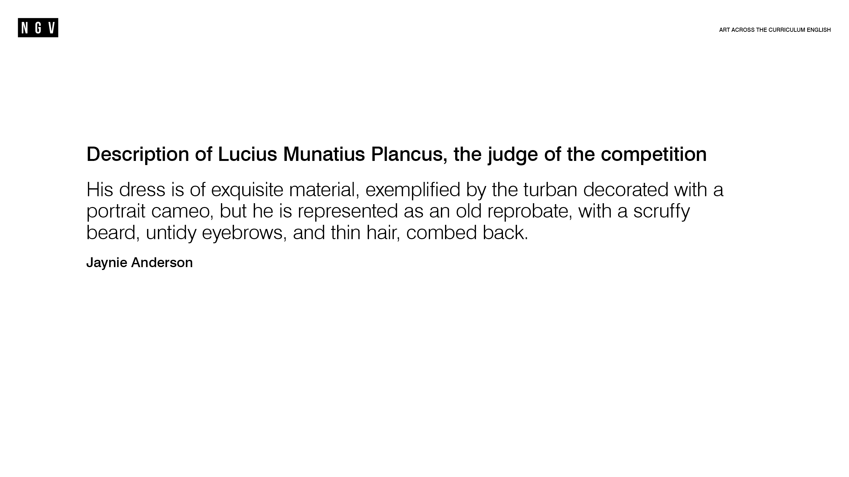

Slide 5
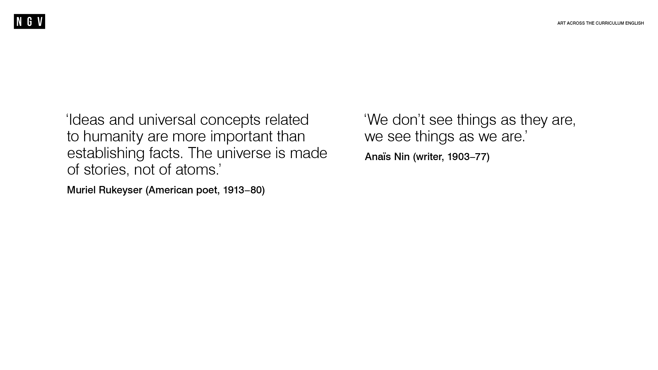

Slide 6
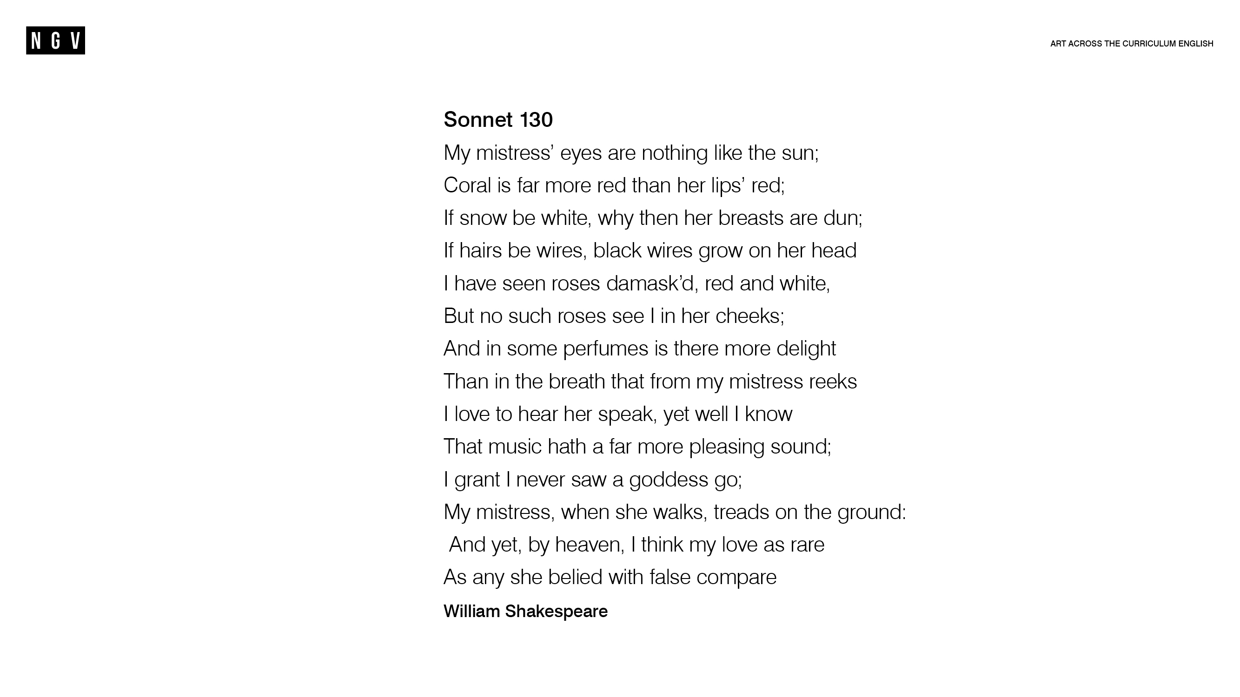

Slide 7
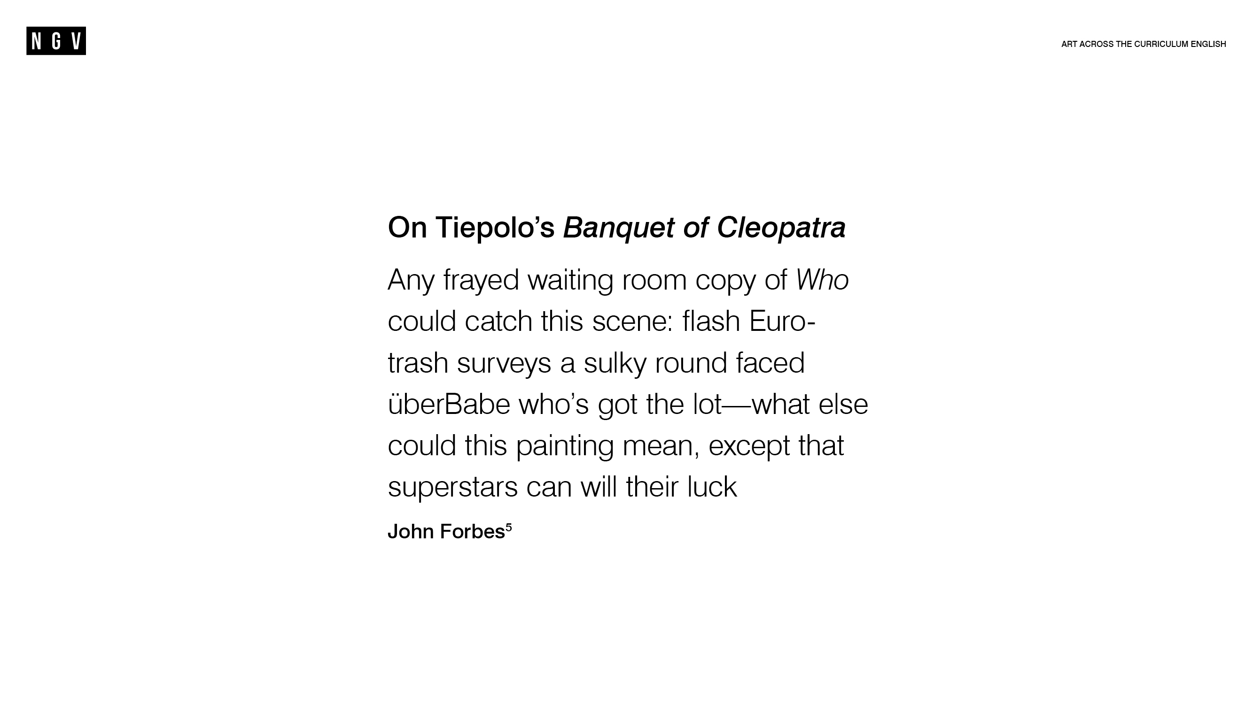

Slide 8
