Slide 1
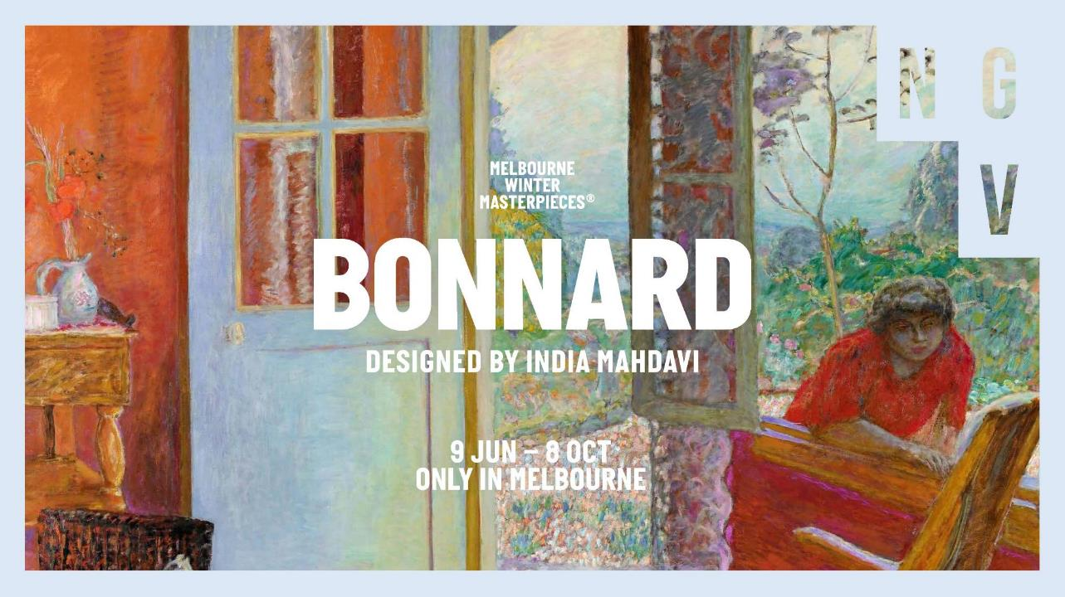
Notes:
Introduction to the Resource for Primary Students
This slide pack provides students and teachers with key information about the 2023 exhibition Pierre Bonnard: Inspired by India Mahdavi at the National Gallery of Victoria. It can be used before or after visiting the exhibition to scaffold and support student learning and extend their understanding of the works.
Introduction to Pierre Bonnard
The exhibition Pierre Bonnard: designed by India Mahdavi presents more than 100 works of art by French artist Pierre Bonnard, made from the late nineteenth century to the first half of the twentieth century.
The exhibition includes paintings, drawings, photographs, folding screens and early cinema and comes mostly from the collection of the Musée d’Orsay, Paris, with loans from other art collections in France and beyond.
The exhibition’s scenography (exhibition staging) was designed by India Mahdavi, a Paris-based designer who has been named as one of the world’s 100 most influential architect/ designers by Architectural Digest.
Learning Objectives
Analyse and interpret themes, concepts and ideas in Bonnard’s work and discuss how they are expressed.
Identify and discuss important influences on Bonnard’s style and choices in art making.
Explore Bonnard’s use of materials, techniques and processes to realise his intentions in his artworks.
Identify and connect specific features of Bonnard’s work to a wider historical, cultural and social context.
Identify key elements in the exhibition design by India Mahdavi. Discuss how they draw on the work of Pierre Bonnard and how they impact the experience of the exhibition.

Slide 2
Notes:
Meet the Artist
Discussion prompts
This painting is one of Pierre Bonnard's self-portraits. What does it tell us about him? What makes you say that?
Introduction to Pierre Bonnard
Pierre Bonnard is an artist known for his colourful celebrations of everyday life: homely scenes of rooms with views through windows and doors, vibrant paintings of landscapes, and his pictures of his lifelong companion, Marthe de Méligny.
Biography
Pierre Bonnard was born on the outskirts of Paris, France, on 3 October in 1867.
Bonnard’s father wanted him to become a lawyer, but Bonnard really wanted to be an artist. He studied law at the Sorbonne University, but also studied art throughout his early twenties.
With his partner Marthe, Bonnard travelled throughout France. You can see many of the places they lived in his paintings, especially the streets of Paris and the views of the south of France.

Slide 3
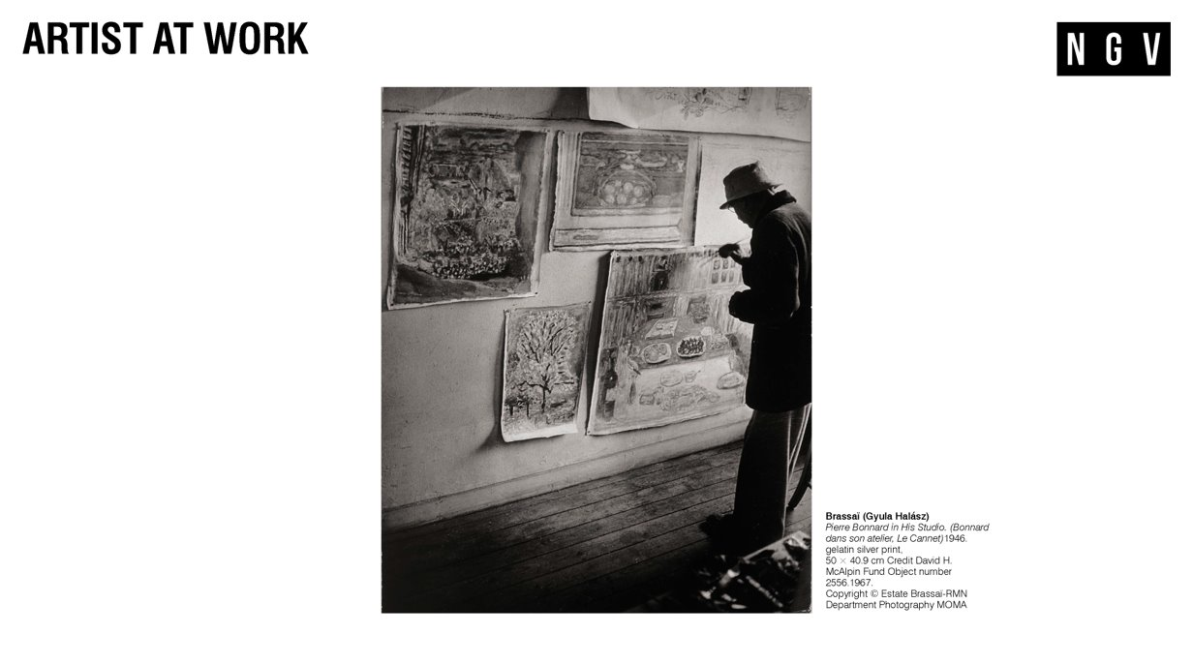
Notes:
Painting Technique
Bonnard worked on his paintings for long stretches of time and didn’t always ‘finish’ them in the traditional sense. He would always sign his work, but rarely include the date (which would show when the work was completed). Sometimes, he would make alterations to finished works, often adding details like a smear of colour, sometimes years later – even if he had sold them to someone else!
On one occasion he was said to have persuaded his lifelong friend Édouard Vuillard to distract an attendant in the Luxembourg Museum so he could retouch one of his paintings while it was on the wall!
Discussion prompts
Can you paint a scene from memory? How might a scene painted from memory differ from a painting based on direct observation of the same scene?
Further investigation
Try carrying a sketchbook to record your observations in sketches and notes for a day or two. Compare your observations with those of your friends.

Slide 4
Notes:
The Nabi Artists
While he was at art school, Bonnard met other young artists including Maurice Denis, Paul Sérusier, Ker-Xavier Roussel, Paul Ranson, Félix Vallotton and Édouard Vuillard. They formed a group and called themselves Les Nabis, after the Hebrew word 'navi' which means ‘prophet’. Like prophets in the bible, they had a vision for the future. The Nabi artists wanted to make art and decoration a part of everyday life. They wanted art to be central in industries like interior design, fashion and advertising. They loved big, bold colours and simple forms.
Influences
The Nabis were strongly influenced by an artist named Paul Gauguin, who also liked to use exaggerated colours and simple shapes in his paintings. They were also inspired by Japanese prints like the one on the right. Bonnard was very inspired by Japanese art, and integrated compositional elements – like the use of broad areas of colour or pattern – into his own work.
Discussion prompts
Look at the painting by Bonnard and compare it to the Japanese print. What similarities and differences can you see (think about colour, shape, pattern and space)?
How does Bonnard’s painting reflect the Nabi artists’ ideas about colour and form?
The Nabi artists were interested in interior design and decorative art. How do you think Bonnard would feel about India Mahdavi turning parts of his paintings into wallpapers?

Slide 5
Notes:
The Theatre of the Everyday
Bonnard loved to observe daily life in Paris: he called it the ‘theatre of the everyday’.
Every day, he would go for a walk, taking in his surroundings and sketching as he went.
Memories, Drawing and Composition
Although Bonnard’s work is of scenes from real life, his paintings often feel dreamlike and exaggerated. Bonnard famously painted from memory and not directly from life. ‘Before I start painting, I reflect, I dream,’ Bonnard explained.
To help his memory he took photographs and made drawings to record his observations, sometimes writing notes that he would refer to later to compose his pieces.
From 1927 to 1946, he made sketches in his pocket diary almost every day. He captured drawings of animals, still lifes, people and landscapes (alongside shopping lists, telephone numbers and other everyday details) many of which you can see in his paintings.
Discussion prompts
Describe how Bonnard uses colour, shape, space and tone in these paintings to represent everyday scenes? Do you notice anything unusual about the way he has used these different elements? Explain your answer.
How does Bonnard capture a sense of energy and movement in these scenes?
Further investigation
What would a painting of everyday life look like now? Try photographing a busy street or park and compare your picture to Bonnard's paintings. How does your composition compare with Bonnard's work?

Slide 6
Notes:
Pierre and Marthe
Bonnard’s lifelong companion, Marthe de Méligny, appeared in his work more than any other person. Bonnard first saw Marthe alighting a city tram. Struck by her appearance and manner, he approached her to model for him.
Marthe’s life is depicted in loving detail across Bonnard’s work. Over almost fifty years he drew, photographed and painted her – sleeping, eating, spending time with their animals, tending to their garden, lying on her bed, dressing, standing, sitting, crouching and most often, bathing.
Marthe suffered from a variety of health issues that resulted in her taking frequent baths as part of her treatment – up to three a day.
She also often needed a change of air (a common remedy for illness at the time) prompting their many travels around France.
Marthe also became an artist. After taking drawing lessons in the 1920s, she held her first exhibition of drawings in 1924 under the name of Marthe Solange. She made around 700 paintings and drawings, which were discovered after her death.
Discussion prompts
How does Le corsage rouge (Marthe Bonnard) differ from more traditional portraits you might be familiar with? Think about what Marthe is doing, and the setting for this image. Does it give us any clues about what Marthe was like?
Which people in your life do you spend the most time with? What would you paint them doing in a portrait?
What setting and pose would you choose for a self-portrait?

Slide 7
Notes:
Animals
Bonnard loved animals and made many images that included them. He drew and painted cats, dogs, cows and horses, but mostly cats and dogs, and most often with people. In fact, there are over 30 depictions of dogs in this exhibition! In the first picture, the white cat stretches itself impossibly tall, in the central picture two dogs snuffle for food on an empty street, and in the final picture Bonnard’s sister Andrée sits at the table, holding her cat.
Discussion prompts
Which of the animals in these three paintings would you most like to meet? What is it about the way that Bonnard has painted this animal makes it interesting to you?
If you had to paint a picture of your pet, or any animal you like, what pose would you choose? Would they be sitting at the table or doing another activity?
Bonnard often exaggerated or made changes to the appearance of the animals he painted. Where can you see he has done this in these images, and why do you think he did this?

Slide 8
Notes:
Interiors and Still Life
Bonnard liked to paint interior scenes and still lifes: including things happening around a table, and things on the table (still life) in a room at home. He liked to focus on the little details and personal moments of everyday life, rather than grand or symbolic subjects.
Bonnard's approach to composition in these paintings is a little unusual. Can you see how in each painting on this slide, the tabletop looks like it is tilted towards us, creating a large space for the objects on the table? Bonnard also puts us in the scene by cutting off the bottom of the table, so it appears close to us – almost as though we are sitting at the table! Around the table, life happens: people are sitting, eating or moving about. They blend into the background’s colour, pattern and movement.
Discussion prompts
How does Bonnard make the people and background equally important in these paintings?
What kinds of colours has Bonnard chosen for these paintings (warm, cool, bright, pale)? How do these colours make you feel about the scene?
Think about where your eyes focus in the paintings. Do they move around or go straight to one thing? Has Bonnard done anything that encourages your eyes to look at specific parts of the image?

Slide 9
Notes:
Inside Looking Out
Bonnard liked to create artworks showing the view of the outside world from inside a room, looking through a window or door.
He used objects and furniture in the room to suggest human activity and included humans and animals that are not always obvious at first glance when we look at a painting.
Dining room in the Country shows the dining room of a country house in Vernonnet that Bonnard bought in 1912. The dining room was on the ground floor; and through the door we can see the Seine Valley.
Both paintings feature Marthe, who often travelled with Bonnard. The window was made in an apartment they rented in 1925 in Le Cannet, a town near the Mediterranean, that had a warm climate (which suited Marthe’s health). On the table by the window is a book titled Marie, which might reference the book published in 1898 and illustrated by Bonnard, with Marthe as the model for the illustrations.
Discussion prompts
How does Bonnard define the different spaces – inside and outside – in the works? Think about his use of colour, texture and tone.
Compare the paintings pictured, looking at key lines and the way your eyes are encouraged to move in certain directions. How are they similar or different?
Further Investigation
The longer we look at a Bonnard painting, the more we see! Set a time for one minute and focus on absorbing every element of one of these paintings. What new details do you notice when you look longer? Why do you think these details are not immediately obvious?

Slide 10
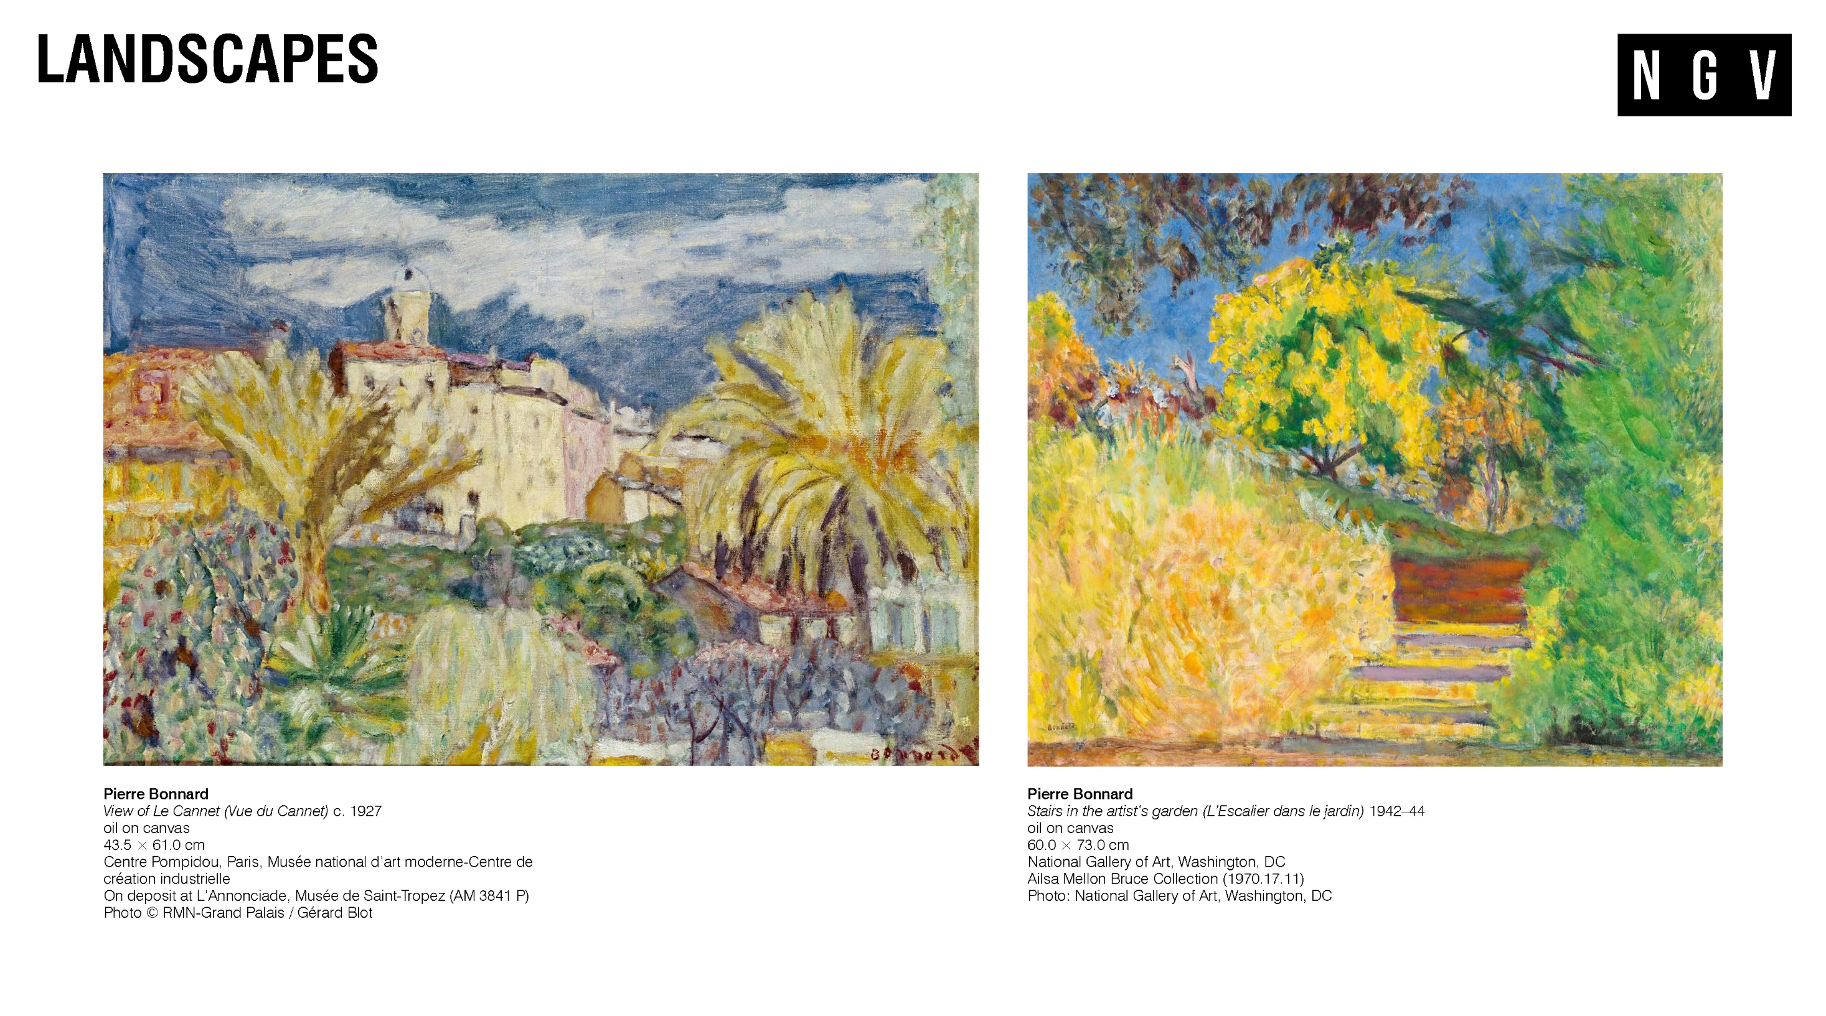
Notes:
Landscapes
Bonnard bought a little villa in Le Cannet in 1926. He called it Le Bosquet after the grove of trees that surrounded it. As Bonnard got older, he increasingly avoided the busyness of Paris and instead stayed in the countryside. In the last ten years of his life, and especially when he was in Le Cannet, Bonnard painted landscapes more than any other theme.
As shown in The window, at Le Cannet, his landscapes became an explosion of colour and texture, making different elements of the landscape appear to dissolve into each other.
Discussion prompts
List some describing words for the colours and textures you see in these paintings. What mood or feeling do these create in each painting?
Where can you see different elements of the landscape appearing to dissolve into each other?
What are the landscapes or places that are special to you? What colours and textures would you use to create a painting of these and why?

Slide 11
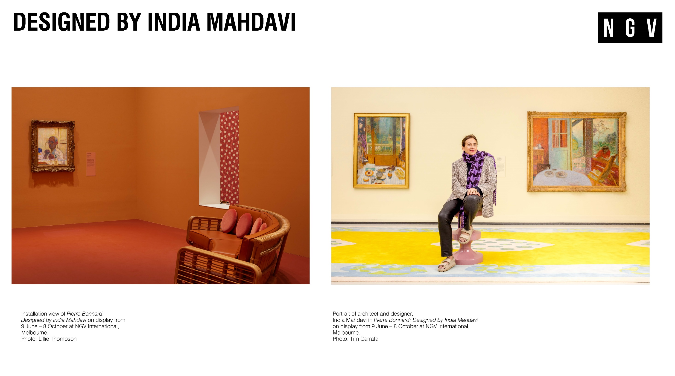
Notes:
Designed by India Mahdavi
India Mahdavi is an architect and designer, most famous for her use of bold colour, texture and pattern to craft distinctive interiors. She was commissioned by the National Gallery of Victoria to develop a series of immersive environments in which to display Bonnard’s works.
Mahdavi studied architecture in France and then industrial design, graphic design, and furniture design in New York. She worked for prominent interior designer Christian Liagre in Paris before founding her own studio in 2000. Her studio produces furniture and objects, as well as interiors for clients that include restaurants, hotels, boutiques and retail spaces.
In developing the exhibition design, Mahdavi drew inspiration from different moments in Bonnard’s life and career, from his early work with the highly decorative Nabi artists, to his engagement with the worlds of music and theatre, to his love of the domestic interior. Through this engagement with Bonnard’s practice, Mahdavi transformed the NGV’s galleries into interiors for Bonnard’s art, with furniture, lighting and wallpapers based on elements of her favourite paintings.
‘Monsieur Bonnard and I share the same passion: colour.’ said India Mahdavi. ‘I love his subjective perception of colour – the way he transforms the intimacy of everyday life into something sublime – how he invites us into his home, to look through a bathroom door, or to look out through the window onto the sunset in Le Cannet.’ (16)
Discussion prompts
Detail how Mahdavi draws on elements of Bonnard’s work for her scenography.
Mahdavi responds to colour with all her senses. She says mint green is a colour that makes her thirsty and says the colour of her childhood is strawberry milkshake. What associations do certain colours have for you? Does Bonnard's colour palette evoke certain feelings?
Further Investigation
Choose an element of Bonnard’s painting and use it as inspiration to design a piece of furniture or a pattern for fabric or wallpaper.

Slide 12
Notes:
References
(1) National Gallery of Victoria, 'Exclusive World Premiere Pierre Bonnard Exhibition in Melbourne', NGV, Victorian Government, https://www.ngv.vic.gov.au/media_release/exclusive-world-premiere-pierre-bonnard-exhibition-in-melbourne/, accessed June 2, 2023.

