Slide 1
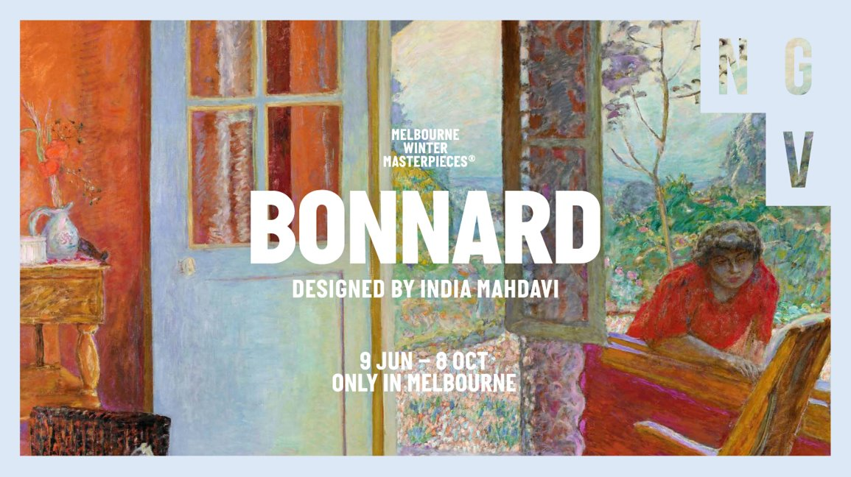
Notes:
Introduction to the Resource for Secondary Students
This slide pack provides students and teachers with key information about the 2023 exhibition Pierre Bonnard: Designed by India Mahdavi at the National Gallery of Victoria. It includes images, information and discussion prompts that can be used before or after visiting the exhibition to scaffold and support student learning related to the exhibition.
Teachers are encouraged to adapt the content to the level and interests of their students.
About the exhibition
The exhibition Pierre Bonnard: Designed by India Mahdavi presents more than 100 works of art by French artist Pierre Bonnard (1867–1947), made from the late nineteenth century to the first half of the twentieth century.
The exhibition features works by Bonnard and his fellow artists, including paintings, drawings, photographs, folding screens and early cinema. Most of these works have been drawn from the collection of the Musée d’Orsay, Paris, as well as loans from other art collections in France and beyond.
The exhibition’s scenography (exhibition staging) was designed by India Mahdavi, an internationally celebrated Paris-based architect and designer.
Learning Objectives
Analyse and interpret themes, concepts and ideas in Bonnard’s work and discuss how they are expressed.
Identify and discuss important influences on Bonnard’s style and choices in art making.
Discuss Bonnard’s use of materials, techniques, technologies and processes to realise his intentions in his artworks.
Identify and connect specific features of Bonnard’s work to a wider historical, cultural and social context.
Identify key elements in the exhibition design by India Mahdavi. Discuss how they draw on the work of Pierre Bonnard and how they impact the experience of the exhibition.

Slide 2
Notes:
Meet Pierre Bonnard
Discussion prompts
What do you know about Pierre Bonnard? What can you infer about his art style, techniques and interests from the exhibition masthead and promotional material?
Critic Roger Allard wrote ‘Bonnard only paints Happiness.’ (1) What this suggest to you about the artist's work?
What information do Bonnard’s self-portraits and the photographs of him on display in the exhibition give us about the artist? What would you like to know about Pierre Bonnard?
Pierre Bonnard is known for his colourful celebrations of everyday life, his paintings of intimate domestic scenes and interiors with views through windows and doors, and his pictures of his lifelong companion and muse Marthe.
Biography
Pierre Bonnard was born on the outskirts of Paris, France, on 3 October in 1867. He was the middle child of three, with an older brother, Charles, and a younger sister, Andrée, and his family often appears in his paintings. Bonnard’s father encouraged his son to pursue a legal profession, and he studied law at the Sorbonne University in Paris from 1885 to 1888.
However, Bonnard also enrolled at the École des Beaux Arts (School of Fine Arts) and took art lessons at a privately run art academy, the Académie Julian. He first exhibited his works at the Salon des Indépendants (Salon of Independent Artists) in 1891.
While he spent a lot of time in Paris throughout his life, Bonnard also frequently travelled with his wife Marthe. In 1912 he bought a country house in Vernonnet in Normandy, and the pair ultimately moved to Le Cannet in the South of France. The vibrant natural beauty and domestic everyday life enjoyed by the artist in these locations all feature prominently in his work.

Slide 3
Notes:
The artist at work
Memories, drawing and composition
Although Bonnard’s work was always based on reality, his scenes had the sense of being vivid, fleeting recollections. Bonnard famously painted from memory and not directly from life. ‘Before I start painting, I reflect, I dream,’ Bonnard explained. (2)
At the beginning of his career, Bonnard took photographs to help his memory and made drawings to record observations, writing notes that he would refer to later to compose his pieces. He included comments on the weather, so that he would later be able to think his way back to the respective light and colours distinguishing the scene. ‘I draw continuously,’ he said. ‘And after drawing comes composition which must be balanced.’ (3)
From 1927 to 1946, he made sketches in his pocket diary almost every day. He captured drawings of animals, still lifes, people and landscapes - alongside shopping lists, telephone numbers and other everyday details. He would play through the same motif again and again, developing new ideas from it.
Painting Technique
Unlike other artists who painted on stretched canvases at an easel, Pierre Bonnard preferred to work on canvases cut from a roll and pinned or nailed to the wall at various heights. He would often work on several canvases at once, or even have several compositions on one large canvas that he would later cut. The final size of each painting was decided when the canvas was stretched.
Bonnard did not always “finish” his paintings, in the traditional sense. He would always sign but rarely date his work and would make alterations to finished works, often adding details like a smear of colour, sometimes years later - even after they had been sold and were owned by someone else. On one occasion he was said to have persuaded his lifelong friend Édouard Vuillard to distract the attendant in the Luxembourg Museum so he could retouch one of his paintings on the wall.
Discussion prompts
How might Bonnard working on multiple paintings concurrently impact his work?
Select a work by Bonnard from the exhibition and analyse how he has used colour and shape to create "balance" in his compositions.

Slide 4
Notes:
The Nabis
While he was studying at the Académie Julian, Bonnard met several young artists including Maurice Denis, Paul Sérusier, Ker-Xavier Roussel, Paul Ranson, Félix Vallotton, and Édouard Vuillard. They formed a group and called themselves Les Nabis, after the Hebrew word ‘navi’ meaning ‘prophet’. Like a prophet in the bible, they had a vision for the future. For the Nabi artists, they aimed to herald a new age of art and design: one where art wase relevant in every sphere of modern life – including interior design, furniture, commercial illustration and advertising.
The Nabi artists were strongly influenced by the art of Paul Gauguin. They admired his use of exaggerated hues and simplified forms. They were also inspired by the Japanese prints that had been fashionable in Paris from the middle of the nineteenth century.
Bonnard was particularly taken with Japanese prints and integrated compositional elements into his work, including flattened perspectives, broad areas of colour or pattern, and the use of line to suggest volume and the use of empty space.
Discussion prompts
What similarities and differences do you see in the images pictured? How do the artists use colour, shape, pattern and/or space?
Considering the Nabis’ interest in interior design and decorative art, how might Bonnard feel about India Mahdavi drawing details from his paintings and transforming them into wallpapers?
Further Investigation
Compare and contrast the works above with a Japanese print (such as A parlour in a foreign mercantile firm in Yokohama (1861) by Utagawa Satahide from the Gallery's permanent collection). Can you see how the print inspired or informed the paintings here?

Slide 5
Notes:
Graphic Design
After graduating from his law studies, Bonnard balanced working in a government record office with making art. However, that changed when he won a commission to design a poster for French Champagne in 1889.
His lithographic print (depicting a woman enjoying an overflowing glass of champagne with the handwritten words France Champagne above her) earned him 100 francs. The success and popularity of his graphic design impelled him to devote himself full time to an artistic career, with his family’s blessing.
Much of Bonnard’s early work was executed on paper– including prints, drawings and illustrations: he created over 250 lithographs between 1889 and 1902. He illustrated music, books and journals, including a publication called La Revue Blanche, an avantgarde arts journal.
With his designs for prints and advertising graphics, Bonnard had already achieved fame and financial success by the end of the 1890s, and he staged his first solo exhibition at the Parisian Galerie Durand-Ruel in January 1896.
Discussion prompts
What feelings, ideas or associations does Bonnard’s design for France Champagne create? How does he do this?
How does this design compare to contemporary advertising?
Look at Bonnard’s use of letterform in both images – How does it work with the image? How is it similar/ different in both images?

Slide 6
Notes:
Theatre of the Everyday
Bonnard loved to watch Parisian life, which he referred to as the ‘theatre of the everyday’. He would walk each day, observing his surroundings, sketching as he went.
French journalist, art critic, historian, and novelist Gustave Geffroy wrote:
No-one is quicker than Bonnard to seize the look of our Parisian streets, the silhouettes of a passer-by and the patch of colour which stands out in the Metropolitan mist. [He] seizes on all the momentary phenomena of the street, even the most fugitive glances are caught and set down. (4)
Bonnard’s representations in drawings, paintings and prints capture the lively street scenes, everyday interactions and social exchanges of turn of the century Paris, a time known as the Belle Époque (literally Beautiful Age). The Belle Époque – the period between the end of the Franco-Prussian War in 1871 and the start of the first world war in 1917 – was characterised by stability and economic prosperity, and artistic and cultural refinement for the middle and upper classes.
Discussion prompts
How does Bonnard use colour, shape, space and tone in each painting?
From what point of view is each image captured?
How does Bonnard capture a sense of energy and movement in his compositions?
In what ways might social media be another form of the ‘theatre of the everyday’? Can you think of any images from platforms like Instagram that look like Bonnard’s paintings?

Slide 7
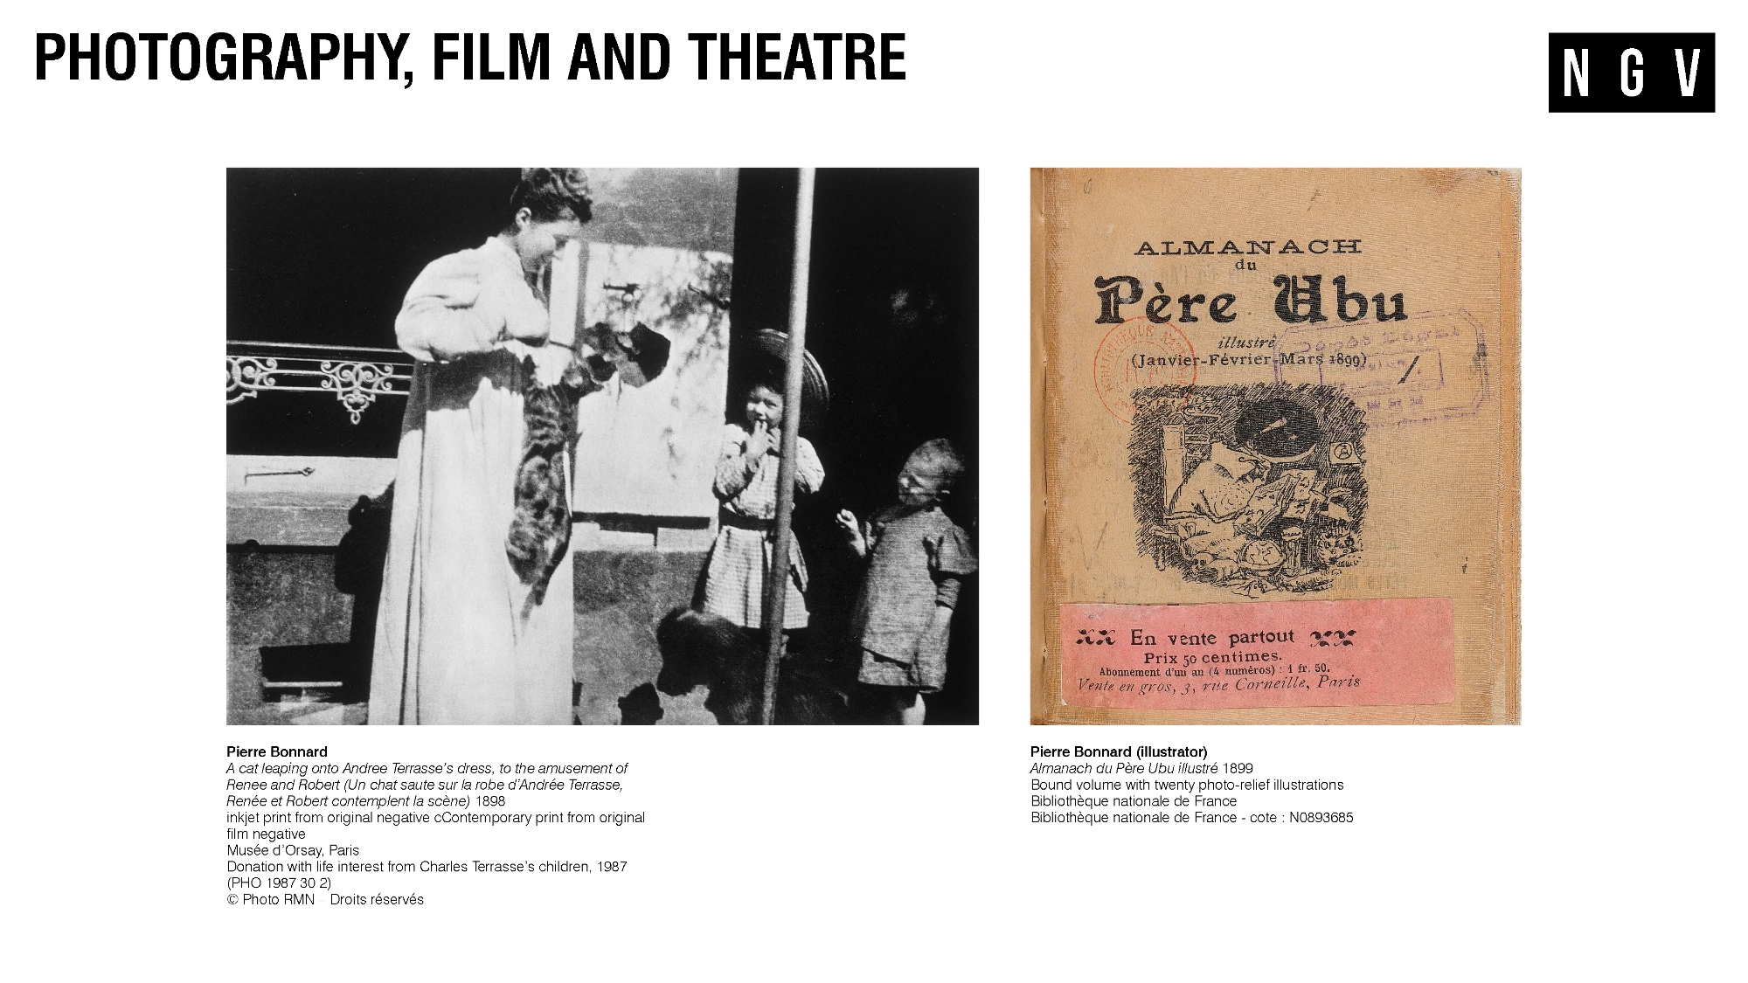
Notes:
Photography and Filmmaking
The turn of the twentieth century was a time of great innovation and invention, including the popularisation of the pocket camera, cinema and new types of theatre.
Bonnard embraced these new technologies. In 1895 Kodak produced their first Pocket Kodak camera, which Bonnard bought the very next year.
Bonnard used his Kodak to capture images of his family, including pictures of his sister’s family (as shown here) and his partner Marthe. He used these photographs to inspire paintings, although by the 1920s he mostly relied on his memories and sketches to conceive of his artworks.
Through his brother-in-law, Bonnard met the Lumière brothers, who were early pioneers in cinema. They held the world’s first pub­lic movie screening on December 28, 1895, at the Grand Café in Paris.
Their debut film, La sortie des ouvriers de l’usine Lumière (Workers Leaving the Lumière Factory) was a 50-­second film that showed workers leaving the Lumière factory and can be seen in the exhibition alongside other examples of their work.
Theatre
Bonnard became involved in theatre and filmmaking through his sister Andrée (a musician) who was married to a composer named Claude Terrasse. Terrasse created a puppet theatre in the workshop next to his apartment and Bonnard worked with him making puppets as well as set designs and programs for theatre. In 1986, Bonnard made set designs and masks for Ubu Roi or King Ubu, a controversial political play by Alfred Jarry. The plot centred around the main character Ubu – an obese, absurd, amoral character who killed the king of Poland and then went on to perform bizarre acts that were aimed to disrupt the social order and upset the status quo. The play outraged audiences at the time but went on to epitomise avantgarde theatre.
Discussion prompts
What new technologies have been invented in your lifetime? How are artists using them to create innovative and new art forms?
Further Investigation
Ubu Roi was a highly subversive and controversial play when it was first performed. Research the play’s narrative and analyse whether it would be considered controversial today.

Slide 8
Notes:
Pierre and Marthe
Marthe de Méligny was Bonnard’s muse and lifelong companion, appearing in his work more than any other person. Bonnard first saw Marthe alighting a city tram and struck by her appearance and manner, approached her to model for him.
Marthe’s life is depicted in loving detail across Bonnard's work. Over almost fifty years he drew, photographed and painted her – eating, sleeping, spending time with their animals, tending to their garden, lying on her bed, dressing, standing, sitting, crouching and most often, bathing.
She suffered from a variety of health issues that resulted in her taking frequent baths as part of her treatment – sometimes up to three a day. She also often needed a change of air (a common remedy for illness at the time) prompting their many travels around France.
Marthe also became an artist. After taking drawing lessons with writer and artist Louise Hervieu in the 1920s she held her first exhibition of drawings in 1924 under the name of Marthe Solange. When Marthe died of a heart attack in 1942, Bonnard, was devastated. ‘You can imagine my grief and solitude,’ he wrote to his friend Matisse. (5)
Discussion prompts
What kinds of colours has Bonnard chosen for the paintings on this slide (warm, cool, bright, pale)? How do they make you feel about the person depicted?
Bonnard’s self-portraits aren’t always very flattering. What pose would you choose for a self-portrait? What would you want the self-portrait to tell the viewer about you?

Slide 9
Notes:
Bathers and The Nude
Bonnard’s work was dominated by women – often Marthe, but also other models – depicted in a moment of intimacy or in quiet, unguarded personal reflection, bathing or dressing.
Bonnard painted from memory and didn’t usually ask his models to pose. This is why they are often in these transitional poses, like the ones in these paintings. In many of his paintings of nudes, there is a strong sense of movement. Bonnard juxtaposed high intensity, complementary hues, using the after-effect of bright colours to confound and dazzle the viewer’s gaze.
The use of densely repeated arrays of pattern also had the effect of creating movement in a scene.
Discussion prompts
How does Bonnard use complementary colours and contrasting pattern in both paintings?
How does Bonnard suggest a feeling of movement in these images? For example, consider how Bonnard’s choice of colour and texture direct the viewer’s eye around the paintings.

Slide 10
Notes:
Interiors and Still Life
Bonnard produced many intimate still life and domestic scenes. He and fellow Nabi artist Édouard Vuillard were referred to as Intimists. Intimists used the domestic interior as subject matter to convey the quiet warmth and comfort, the relaxed intimacy, of domestic life. Pattern and colour were also used by these artists to imbue domestic scenes with emotional and symbolic qualities.
Bonnard's approach to composition in these paintings is a little unusual: The tilted-up table surfaces are ‘empty spaces’ brought to life with coloured and patterned cloths and by the objects scattered on them. Around the table, life happens: people sit, eat, and move about, but they are often cropped and blend into background. The viewer is challenged to define the space: what is surface, what is object, what is background?
Discussion Prompts
What is the focal point in each painting? How does Bonnard create this focal point using colour, light or other devices?
How is Bonnard’s painting different from a photograph of the real scene? How does Bonnard make these images feel intimate or homely?
Further Investigation
Print these images and draw the main lines of the paintings to analyse Bonnard’s composition. How does Bonnard use shape and colour to construct these lines?

Slide 11
Notes:
A room with a view
Bonnard often featured compositions with a room that framed a view to the world outside. Casually placed objects and furniture in his paintings suggest a human presence. On closer inspection, a person or animal, initially obscured in the detail of the room or landscape, emerges.
Dining room in the Country shows the dining room of Ma Roulotte, a country house in Vernonnet on the banks of the river Seine that Bonnard bought in 1912. The dining room of Ma Roulotte was on the ground floor; a veranda on the top floor overlooked the Seine Valley. Ma Roulotte was near the home of Impressionist painter Claude Monet (at Giverny), whom Bonnard visited regularly.
Both paintings feature Marthe, who often travelled with Bonnard. The window was made in an apartment they rented in 1925 in Le Cannet, a village north of Cannes on the Mediterranean, with a warm climate that suited Marthe’s health. On the table by the window is a book titled Marie, referencing a book which was published in 1898 and illustrated by Bonnard, with Marthe (whose original name was Maria) as the model for the illustrations.
Discussion prompts
How does Bonnard define the different spaces – inside and outside – in the works? Think about his use of colour, texture and tone.
Compare the composition of both works pictured, looking at key structural lines. How are they similar/ different?
Further Investigation
Bonnard rewards the viewer with details that appear the longer we look. Set a timer for two minutes and focus on absorbing every element of one of these paintings. What hidden details emerge as you look longer, and why are they hidden at first glance?

Slide 12
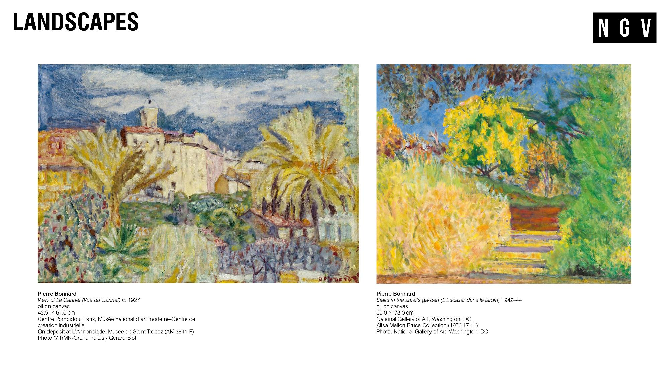
Notes:
Landscapes
Bonnard bought a little villa in Le Cannet in 1926. He called it called Le Bosquet after the grove of trees that surrounded it. His nephew Antoine Terrasse described it as:
“a little house with pink walls all white on the inside. The garden, where bushes and flowers grow at will slants down to the street. At distance one can see the red roofs of Le Cannet, the mountains, the sea. The studio, on the second floor is small. In it there are a stool, a chair, a narrow divan, one or two little tables, tubes of colour and the bottles of turpentine, the brushes and rags.”(6)
From 1933 onward, Bonnard increasingly avoided the hustle and bustle of Paris. When the Nazis occupied France in 1940, he left the city once and for all and withdrew to Le Cannet, where he continued working until his death in 1947.
In the last ten years of his life, Bonnard painted landscapes more than any other theme. At Le Cannet, those landscapes became an explosion of exuberant colour. In the images pictured (both painted at Le Cannet) animated hues and jostling textures accentuate every part of a scene to create a lively tapestry in which the separate elements of the landscape dissolve into each other and almost into abstraction.
Bonnard shared a close friendship with artist Henri Matisse which lasted for over forty years. The two artists lived a distance of just thirty kilometres apart on the Côte d’Azur, and the pair saw each other often. Both had moved from the Paris to the Mediterranean; both shared a preference for the same range of subjects: interiors, still life, landscapes and the female nude; and both believed in the importance of reality as the basis of their works rather than abstraction.
Discussion prompts
What similarities and differences do you see in the images pictured?
How does Bonnard’s choice of colour, texture direct the viewer’s eye around the image?
What do you notice about Bonnard’s use of space, depth, perspective?

Slide 13
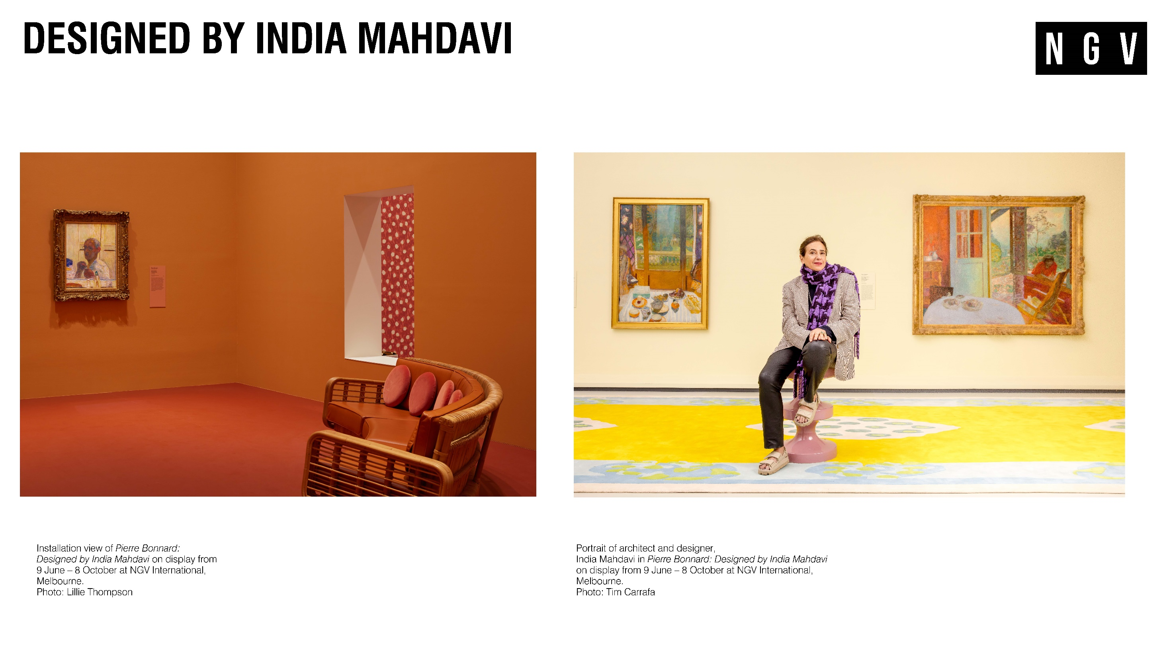
Notes:
Designed by India Mahdavi
India Mahdavi is an architect and designer, most famous for her use of bold colour, texture and pattern to craft distinctive interiors. She was commissioned by the National Gallery of Victoria to develop a series of immersive environments in which to display Bonnard’s works.
Mahdavi studied architecture in France and then industrial design, graphic design, and furniture design in New York. She worked for prominent interior designer Christian Liagre in Paris before founding her own studio in 2000. Her studio produces furniture and objects, as well as interiors for clients that include restaurants, hotels, boutiques and retail spaces.
In developing the exhibition design, Mahdavi drew inspiration from different moments in Bonnard’s life and career, from his early work with the highly decorative Nabi artists, to his engagement with the worlds of music and theatre, to his love of the domestic interior. Through this engagement with Bonnard’s practice, Mahdavi transformed the NGV’s galleries into interiors for Bonnard’s art, with furniture, lighting and wallpapers based on elements of her favourite paintings.
‘Monsieur Bonnard and I share the same passion: colour.’ said India Mahdavi. ‘I love his subjective perception of colour – the way he transforms the intimacy of everyday life into something sublime – how he invites us into his home, to look through a bathroom door, or to look out through the window onto the sunset in Le Cannet.’ (7)
Discussion prompts
Detail how Mahdavi draws on elements of Bonnard’s work for her scenography.
Mahdavi responds to colour with all her senses. She says mint green is a colour that makes her thirsty and says the colour of her childhood is strawberry milkshake. What associations do certain colours have for you? Does Bonnard's colour palette evoke certain feelings?
Further Investigation
Choose an element of Bonnard’s painting and use it as inspiration to design a piece of furniture or a pattern for fabric or wallpaper.

Slide 14

Notes:
References
(1) Gale, Matthew, The CC Land Exhibition. London: Tate, 2019, p17
(2) Sarah Whitfield and John Elderfield Bonnard. New York: Harry N Abrahams, 1998, p9.
(3) Gale, p12.
(4) Suzanne Pagé "Introduction" in Bonnard: The Work of Art: Suspending Time ed. Suzanne Pagé. London: Lund Humphries, 2006. P21.
(5) Pierre Bonnard to Henri Matisse, early February 1942, in: Bonnard/Matisse: Letters Between Friends, New York: H.N. Abrams, 1992, p. 101.
(6) Gale, p39.
(7) National Gallery of Victoria, 'Exclusive World Premiere Pierre Bonnard Exhibition in Melbourne', NGV, Victorian Government, https://www.ngv.vic.gov.au/media_release/exclusive-world-premiere-pierre-bonnard-exhibition-in-melbourne/, accessed June 2, 2023.

