Slide 1
Notes:
Introduction to the Resource
This slide pack offers key information and discussion prompts about the 2024 Melbourne Winter Masterpieces® exhibition Pharaoh at the National Gallery of Victoria. Use it to enrich your visit, either before or after, and enhance student learning.
Teachers are encouraged to adapt the content to the level and interests of their students. These slides are designed for students Levels 3–6. Each contains key background information, as well as activities and discussion questios.
Learning Objectives
Identify ancient Egyptian objects and examine how they communicate ideas from the past.
Analyse and discuss what artefacts reveal about ancient Egyptian beliefs and values.
Identify and interpret the different symbols used by pharaohs to demonstrate their power and divine right to rule.

Slide 2

Notes:
Pharaoh is a major exhibition presented by the National Gallery of Victoria (NGV) in partnership with the British Museum. The exhibition celebrates three thousand years of Egyptian art and culture and includes more that 500 objects from the British Museum’s collection including monumental sculptures, exquisite jewellery, papyri, coffins and more.
About the exhibition
The exhibition is divided into seven thematic sections that explore the pharaoh’s roles and duties. These include:
Egypt, land of the pharaohs
Born of the gods
The king as high priest
The royal family and jewellery
Ruling Egypt
Egypt and the world beyond
An eternal life
Importantly, the exhibition highlights the role of visual culture in establishing and maintaining notions of power, authority and divinity among the rulers of ancient Egypt.
Note to teachers: This exhibition does not contain human remains.

Slide 3
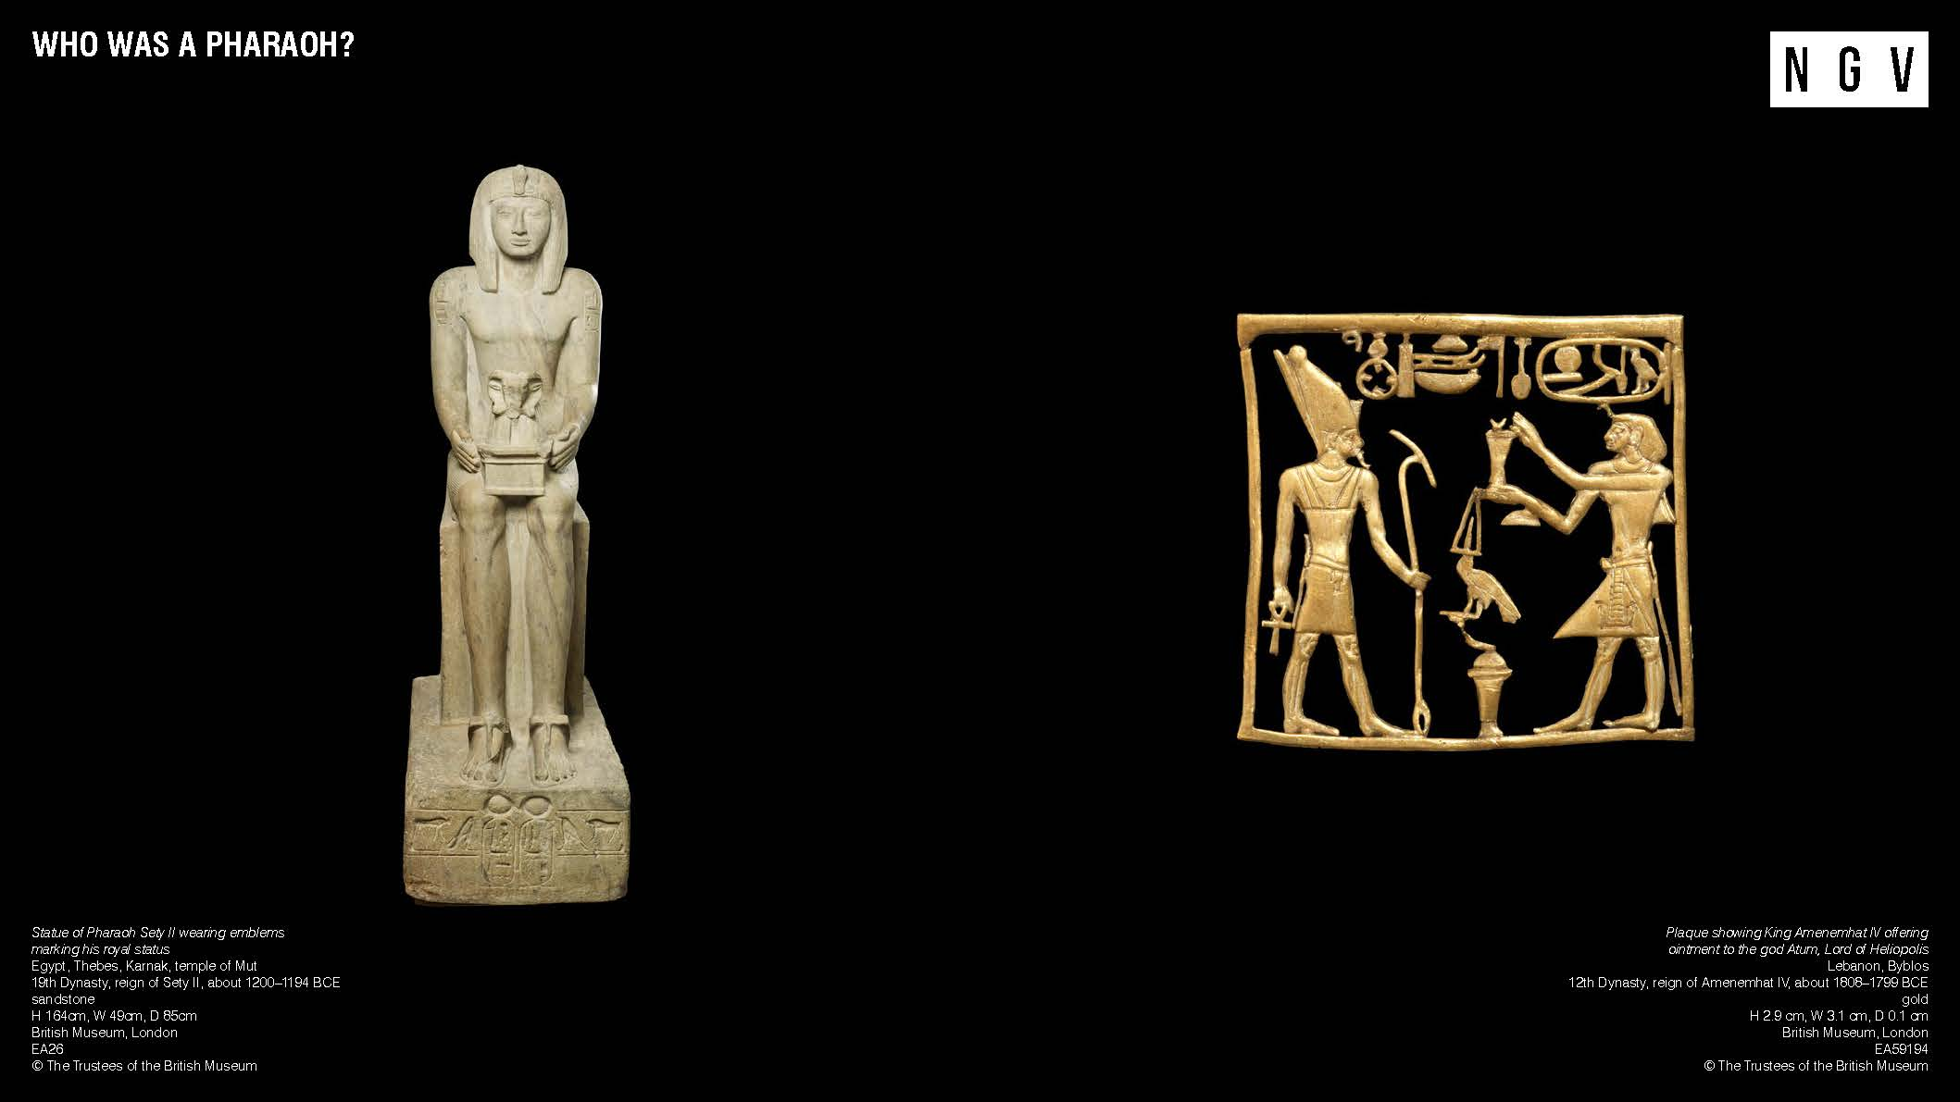
Notes:
Who was a Pharaoh?
A pharaoh was king of ancient Egypt. Usually pharaohs were men, but sometimes women were pharaohs too! The pharaoh was ruler of the entire land, responsible for creating laws, maintaining order, fighting wars, and making sure the gods were happy. People thought of the pharaoh as a real-life god on earth. In Egyptian art, you will notice various crowns and symbols representing the pharaoh.
For example, the plaque on the right shows two people: the god Atum on the left, and King Amenemhat IV on the right. Atum was believed to be a creator and the original god on earth. Here, he is dressed like a pharaoh and is wearing the double crown, which symbolised the joining of Upper and Lower Egypt. He is carrying an ‘ankh’ amulet in one hand, (which represents eternal life) and his other hand is holding a ‘was’ sceptre, (symbolising royal power).
Activities and questions for students
Look at the objects on this slide. Find and draw the following symbols:
A crown or headdress — pharaohs wore many different types of crowns and headdresses.
An upright cobra. This symbol is called an uraeus, and it symbolised royal power.
Look closely at the golden plaque.
Why do you think the god Atum might be dressed like a pharaoh?
Why do you think the King Amenemhat IV is shown with the god Atum, making an offering to him?
What other symbolic objects can you find on this gold plaque?
Look at the statue on the left, Statue of Pharaoh Sety II wearing emblems marking his royal status.
What words or phrases can you think of to describe the pharaoh’s physical characteristics? How would you describe his facial expression, his posture and his pose?
What ideas do you have about the kind of a ruler this pharaoh might have been, based on the way he is represented?
If you were a ruler of Egypt, what objects would you include in an image or statue of yourself and why?

Slide 4
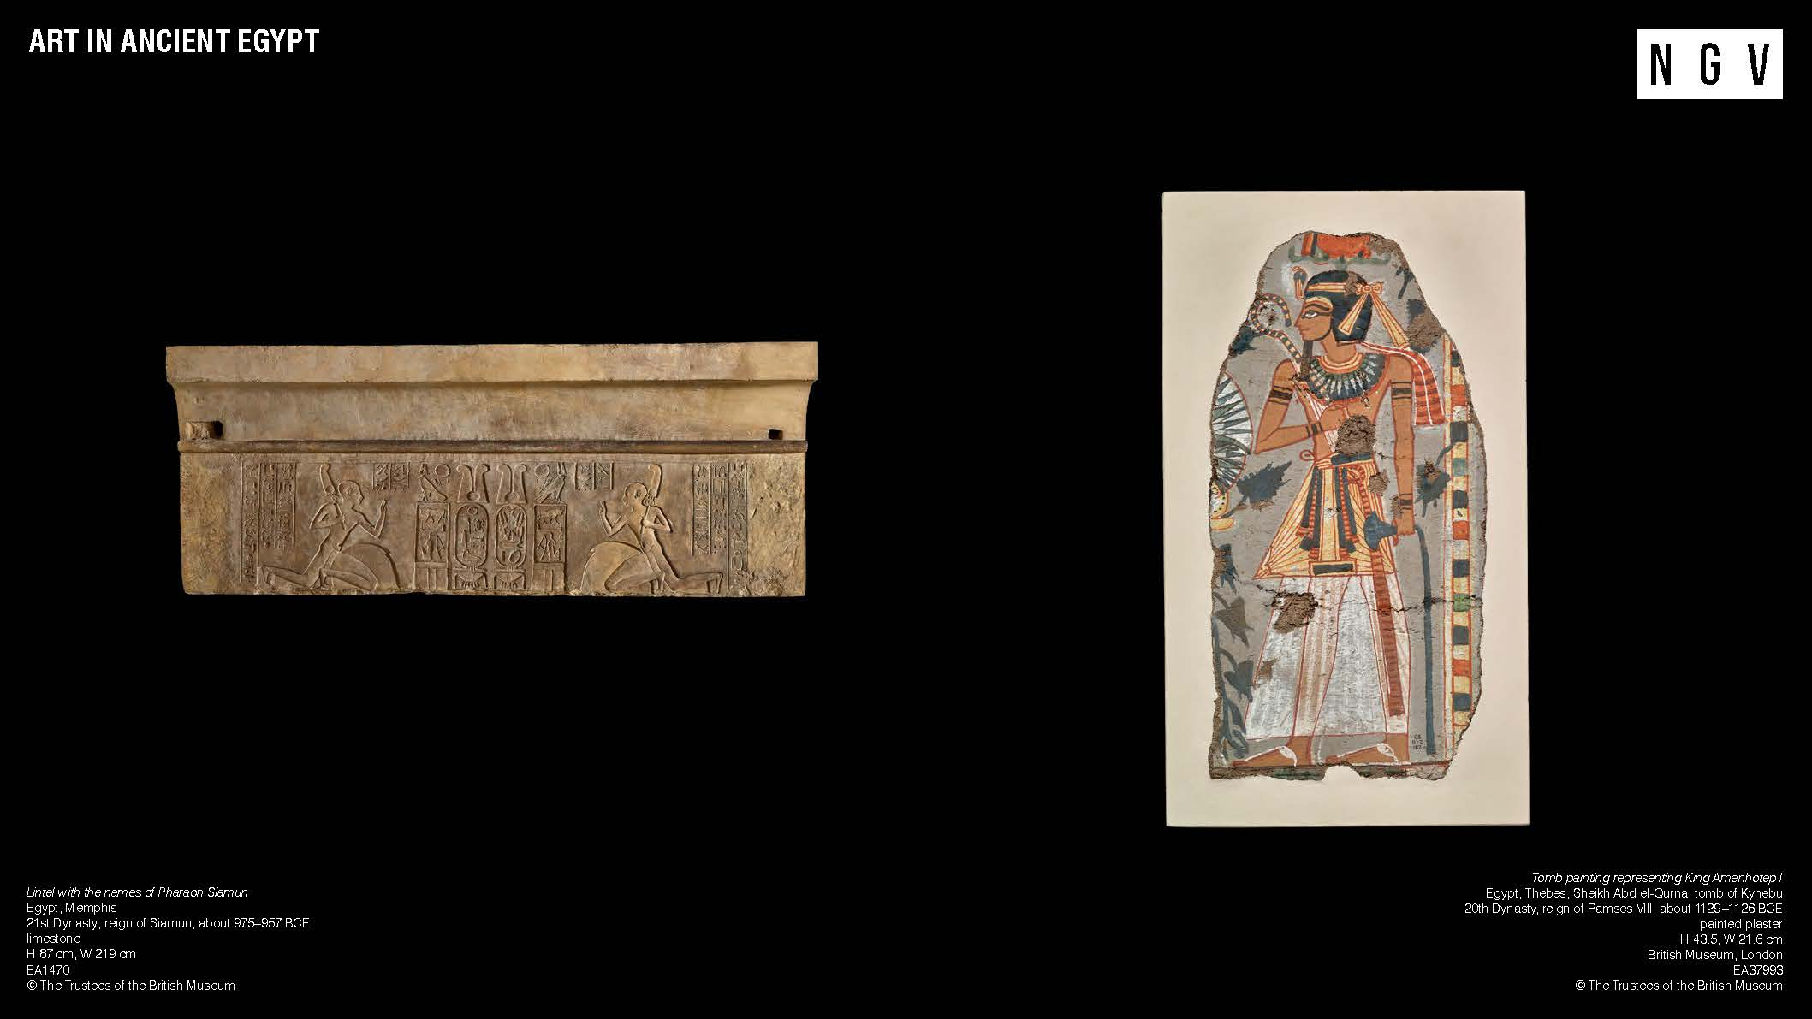
Notes:
Art in Ancient Egypt
The ancient Egyptians were incredibly skilled artists. They carved sculptures from stone and wood, painted vibrant scenes, and created beautiful jewellery and clothing. You might also notice that ancient Egyptians used lots of colours to paint their temple and tomb walls, all made from natural sources like rocks, minerals and plants.
When it was time to paint or carve figures on a wall, scribes and artists mostly followed the same guidelines and rules. Straight lines were drawn up and down and sideways to make a grid. The grid helped the artists place the figures in the right places and use correct proportions of the figure – nothing too big or too small! The finished images of people and gods were not intended to look realistic; they functioned more like a diagram or an illustration in a book.
Activities and questions for students
Look at the image on the right. Write down some observations about:
The pose of the pharaoh
The use of colour
The objects you can see being carried or worn by the pharaoh
Look at the image on the left. This object is called a lintel and would have formed the top of a door or entryway in a temple.
What do you think the kneeling figures might be doing
What other imagery or symbols can you find?
Can you guess how the artists made sure that this was balanced and symmetrical?

Slide 5
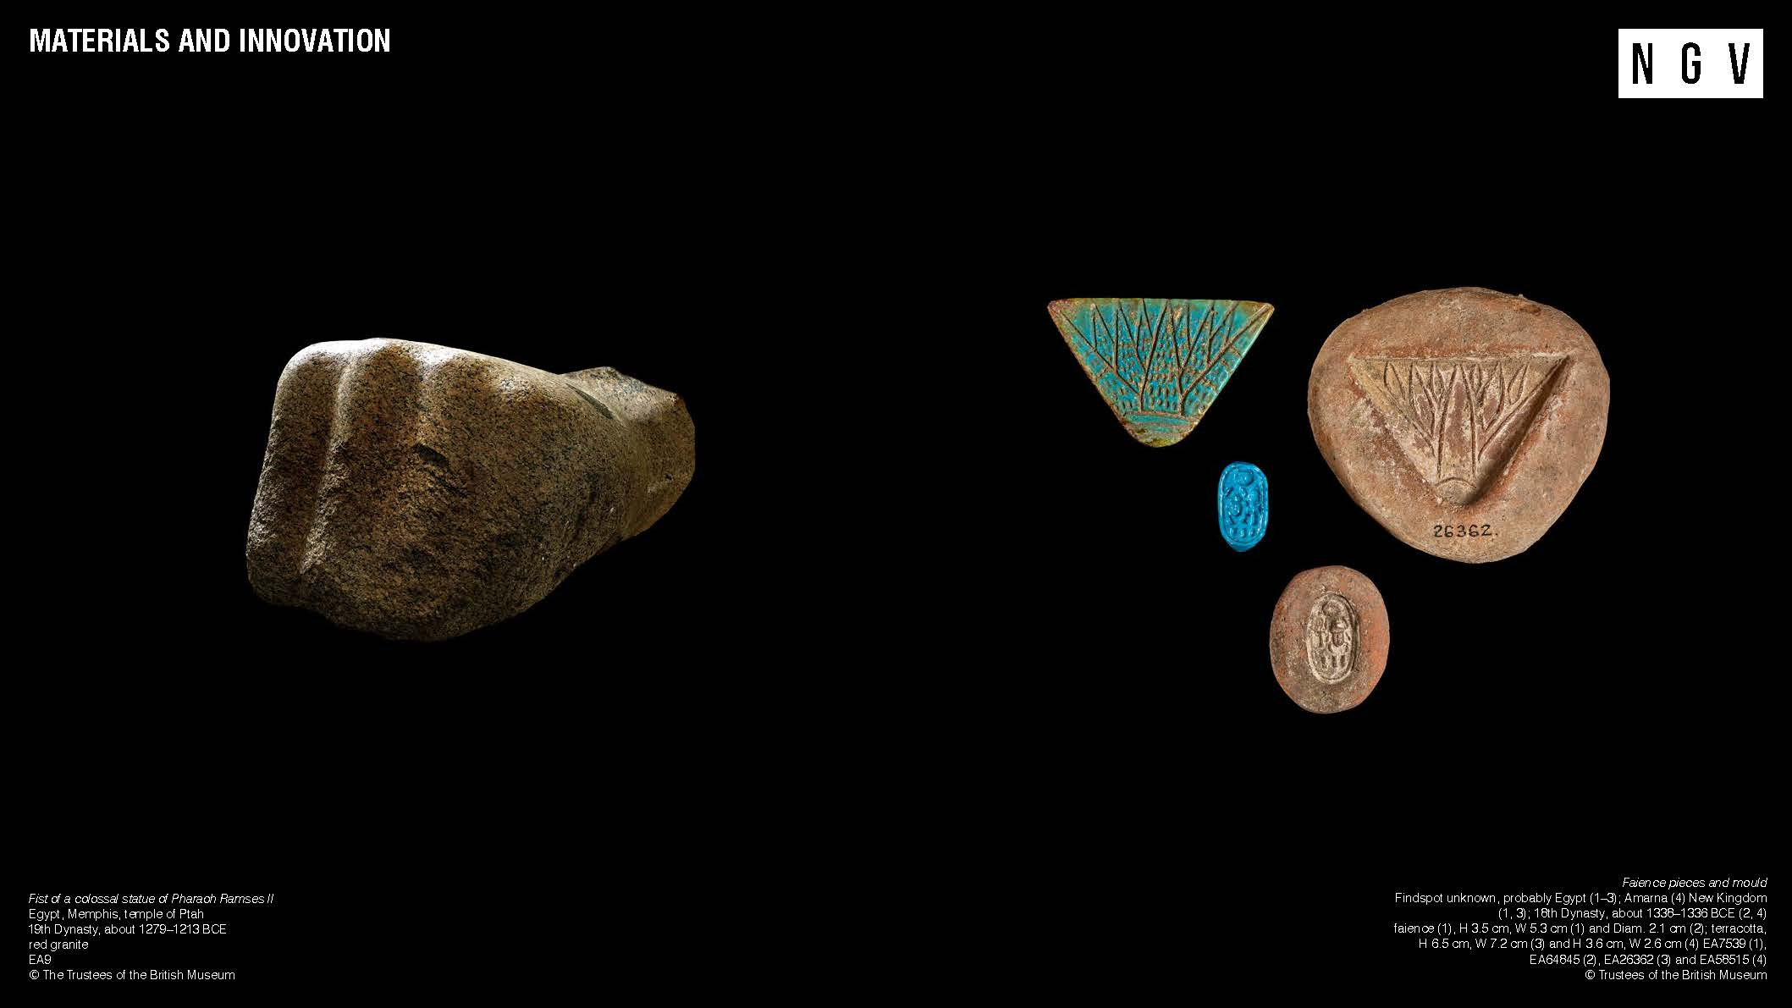
Notes:
Materials and Innovation
In the exhibition, there are objects made from lots of different materials, including bronze, gold, stone, gems and even a special type of glazed ceramic called faience. Some of these materials were found close by, but others came from faraway places, like Afghanistan and other parts of Africa. This shows how clever ancient Egyptians were at finding and using different things to make their amazing creations.
The ancient Egyptians were also brilliant inventors. They developed tools to help them do tasks like constructing enormous pyramids, devising methods to measure time, and establishing systems for record-keeping.
The enormous fist on the right originally came from a statue of Ramses II, one of the most famous pharaohs from ancient Egypt. The fist is made from granite, a very hard and durable type of stone, and would have needed lots of very skilled craftspeople to carve such a large statue. Two of the objects on the far right are moulds, and next to them are the faience pieces they made.
Activities and Questions for Students
Look at each of the objects on the slide. What questions do you have about the objects?
Look at the fist on the left- it is almost a metre tall, and nearly 1.5 metres wide! Imagine how tall the original statue might have been. Do you think it was seated or standing?
What are some challenges the ancient Egyptians may have faced when creating this enormous statue? Think about how heavy the statue would be, how it might be transported, as well as difficult it is to carve stone.
What might the moulded objects have been used for? Do they remind you of anything you’ve seen before?

Slide 6
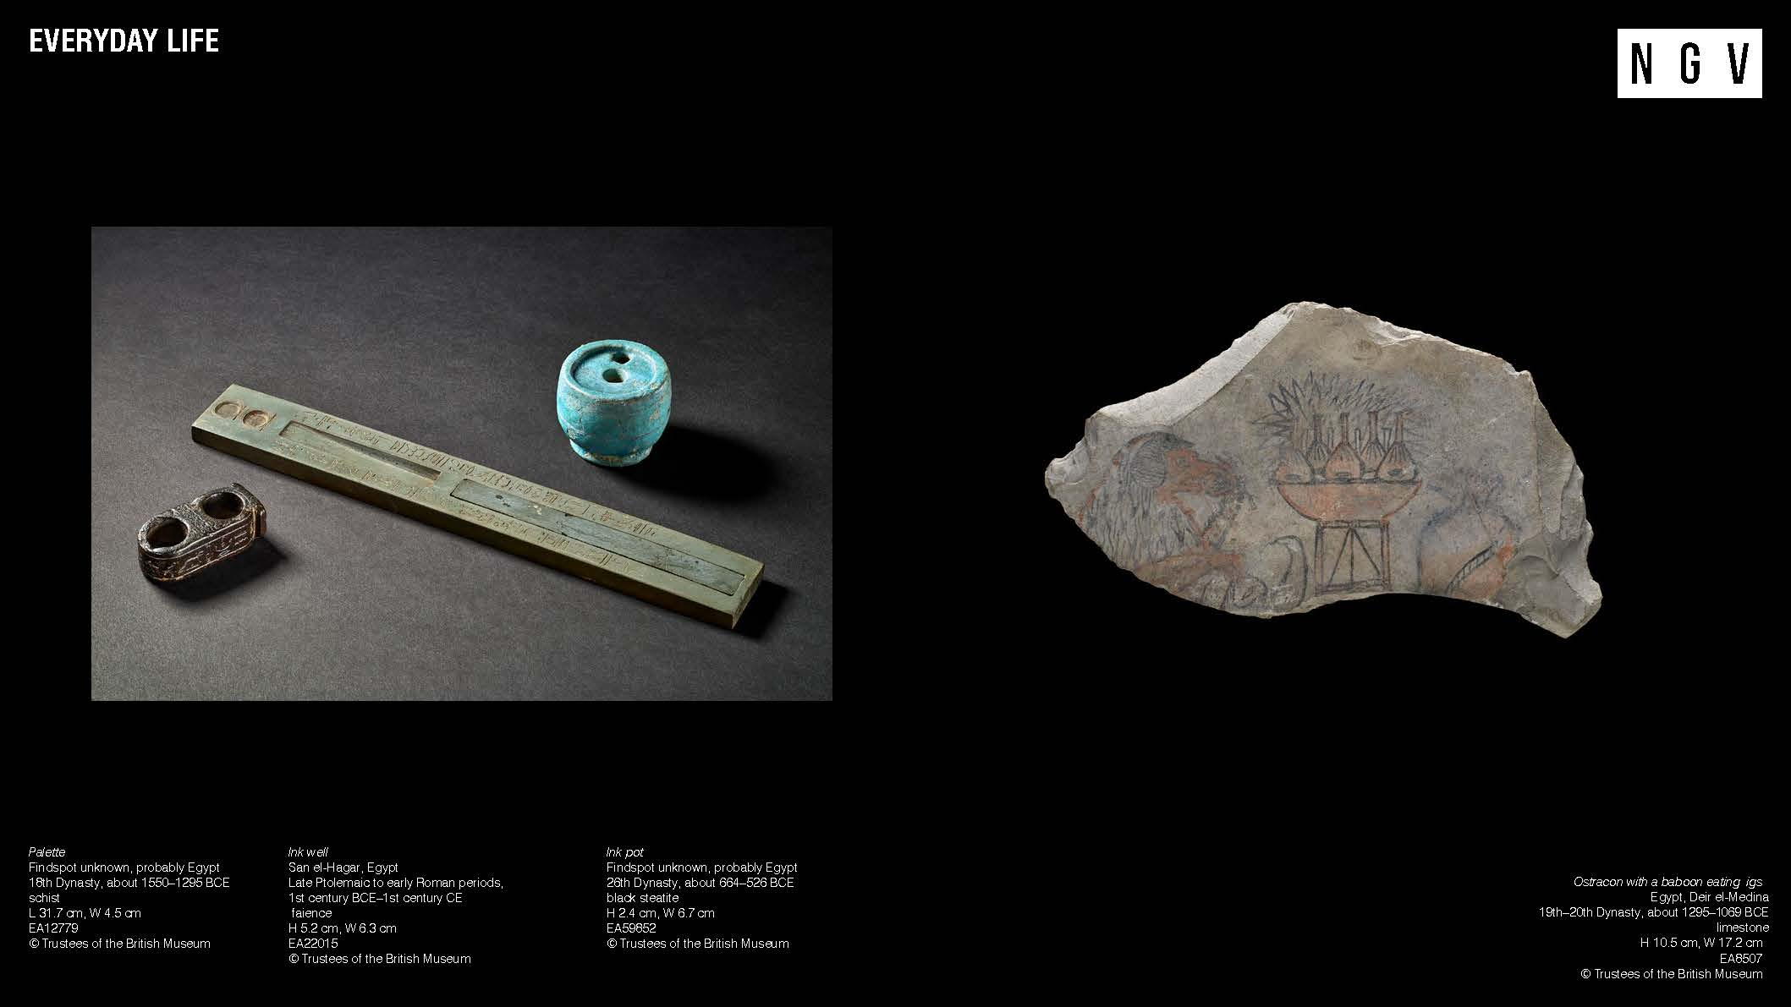
Notes:
Everyday Life
While we know a lot about the life of the pharaohs, we don’t know as much about everyday people in ancient Egypt. This is what makes the objects on this slide special: they were used by normal people like you or me! Look closely at the objects shown on this slide. Do they remind you of objects you have seen or used in your everyday life? One of the reasons we don’t know very much about everyday people in ancient Egypt is because many ancient Egyptians couldn’t read or write. The people who could were called ‘scribes’, and they had a very important job: to make a record of ancient Egyptian life. Scribes wrote about everything from historical records and religious myths to the sale of a donkey or how pyramid building was going. You can see a set of scribe’s tools on the left, almost like an ancient pencil case!
The object on the right is called an ‘ostracon’. Ostraca (i.e. more than one ostracon) are broken pieces of pottery or stone that were used to record information, details and events occurring in the lives of the workers. Ostraca were like ancient Egyptian sticky notes. They were cheap and found everywhere, making them easy for scribes, craftsmen, and everyday people to use.
Activities and questions for students
What do you think they are made of and how do you think they were used in ancient Egypt?
When learning about everyday life in ancient Egypt, why might it be important to understand about what regular people did, and not just the kings and gods?
Look closely at the ostracon. Describe what you see on the piece of stone.
Imagine who might have created this object. Who do you think were and what was their role or job in ancient Egypt?
Ostraca were often used because they were cheap and easy to find. What materials could you use in your everyday life to create quick drawings or notes, like the ancient Egyptians did?

Slide 7
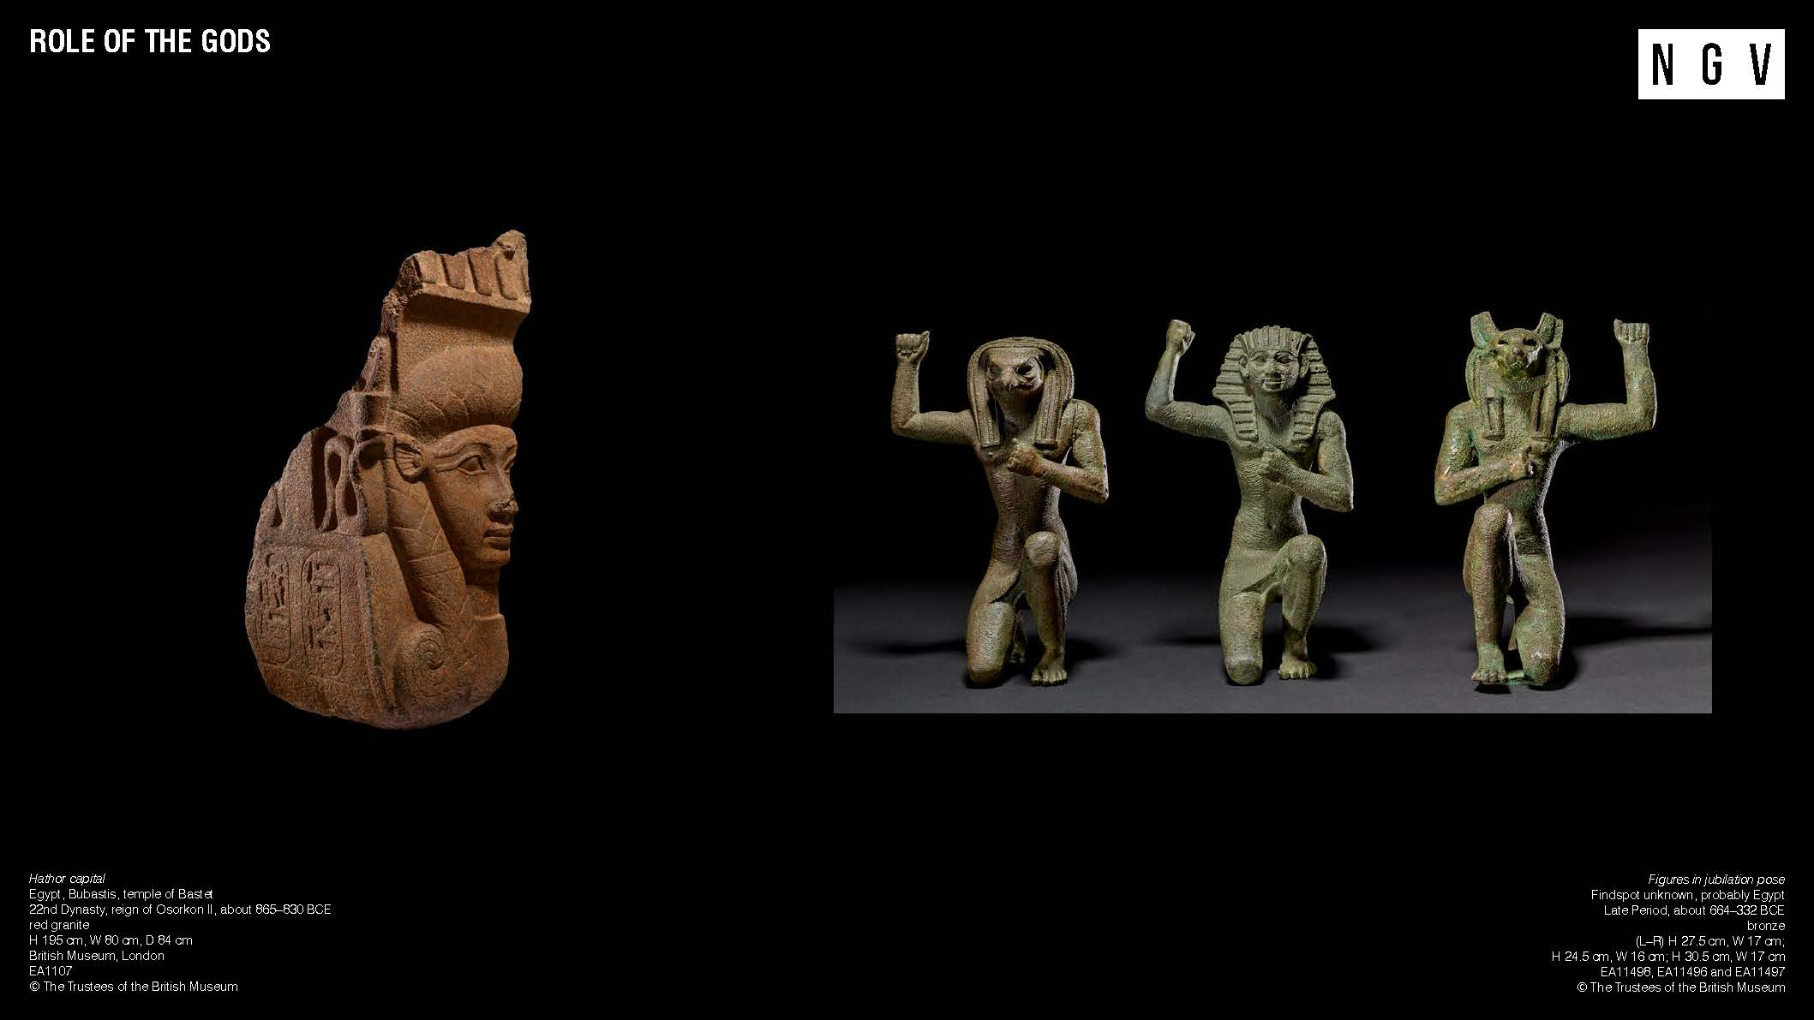
Notes:
Role of the Gods
The ancient Egyptians worshipped over a thousand of gods and goddesses. The gods were often shown as humans with animal features and were believed to have special powers. Some created the world; some controlled the daylight and others were healers and protectors. There were even a few gods who were dangerous!
The pharaoh took care of the gods by building temples and performing special rituals every day. These rituals were very important: it was believed that if the gods were looked after they would make sure Egypt was safe and successful. Only the pharaoh was meant to perform these rituals, but since they couldn't be everywhere at once, they would also let certain priests do them.
As well as the pharaoh, the objects on the right shows two gods, Horus of Pe (with a jackal head) and Horus of Nekhen (with a falcon head). Together, these three figures might have been on a sacred boat called a barque, used to carry statues of gods in parades outside temples during special ceremonies.
Ancient Egyptian temples and halls were filled with tall columns, often decorated with many different symbols. The object on the left was originally part of one of those columns, and it depicts the goddess Hathor. Hathor was often shown as a cow goddess with a sun disk between her horns or as a woman with cow ears. She was also connected with motherhood and believed to be a source of nourishment and protection for the ancient Egyptians.
Activities and questions for students
Look closely at the objects on the slide. Share what you notice about the way their bodies are posing, and any other symbols or marks you can see.
One of the objects shows a pharaoh. Which one do you think it is? What clues did you see that helped you figure it out?
Both Horus of Pe and Horus of Nekhen were thought to be the spirits of the ancient cities, guarding the king during important ceremonies. What can you see that shows their role is to protect?
What features can you see on the temple column fragment that could help us know it represents the goddess Hathor (i.e., her ears)?
The fragment is made from a large piece of red granite. What do you think the rest of the column looked like before it was damaged? Draw your idea.

Slide 8
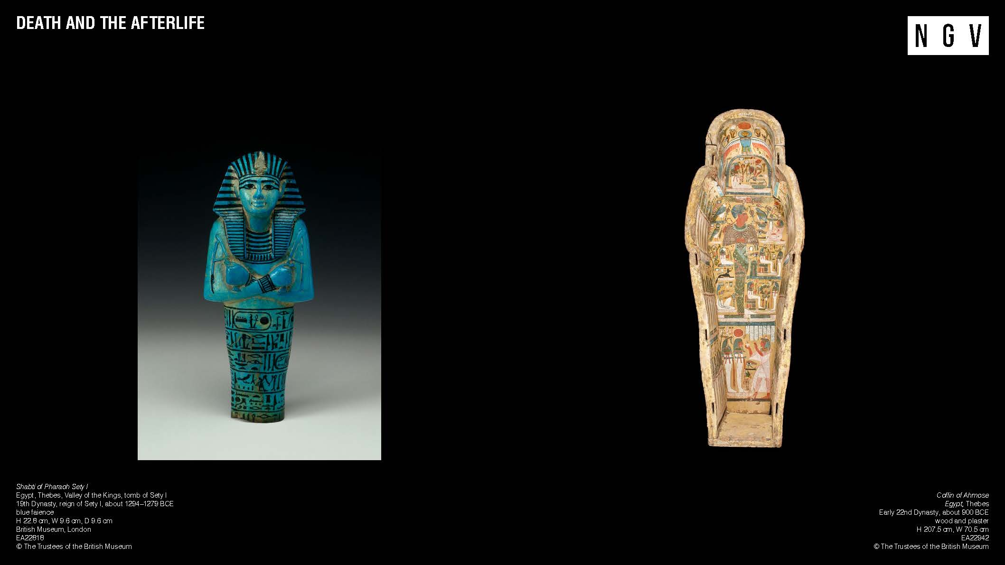
Notes:
Death and the Afterlife
Ancient Egyptians believed in life after death, also called the afterlife. When a person died in ancient Egypt, their journey to the afterlife involved their two spirits: the ka (essence) and ba (personality). These two spirits magically joined together in the afterlife to form the akh, or perfect being. To ensure a happy afterlife, the akh needed its human body. To preserve the body, the ancient Egyptians followed a detailed process called mummification. This elaborate procedure showed their dedication to preparing the deceased for the eternal journey ahead. The ancient Egyptians constructed large tombs to honour their dead pharaohs. They filled these tombs with everything they believed the pharaoh would require in the afterlife, such as food, furniture and jewellery.
The little figure on the left is called a shabti, or ushabti. These small figures carried baskets and held tools and were usually made of wood, faience or clay and sometimes even hippo teeth! Shabtis were placed in the tomb and were designed to work in the afterlife, so their owner didn’t have to. Some tombs were filled with hundreds of shabtis, as many as 401: one for every day of the year, plus an overseer for every group of ten!
To offer greater protection within the tomb, a mummified body could be placed within sets of coffins. On the right, you can see the base of an outer coffin belonging to a person named Ahmose, who was a temple doorkeeper. Coffins were decorated with hieroglyphs and spells, which were intended to serve as guides and protection for the deceased in the afterlife. Additionally, the top of the coffin was often painted to look like the deceased wearing a wig and jewelerry, so they looked their best for all eternity. Ahmose emphasised his close connection with a pharaoh by featuring the royal image at the base of his coffin.
Activities and questions for students
Imagine you were an ancient Egyptian king or queen. What kinds of things would you want to put in your tomb to make sure you have everything you need for eternity?
Notice the tools the shabti is carrying. Why do you think it was important for these objects to be included as part of the figure?
What other imagery do you notice on the coffin base? Discuss how the conventions of Egyptian art, for example guidelines about composition and poses, have been applied here.

Slide 9
Notes:
Be sure to check out the Ancient Egypt for Kids when you visit Pharaoh! In this free exhibition just for kids, you’ll discover a variety of engaging activities, like writing your own name in hieroglyphs, building pyramids, and games and technology that delve into the world of ancient Egypt. You’ll also get to see ancient Egyptian artefacts from the NGV’s Collection on display!

Slide 10
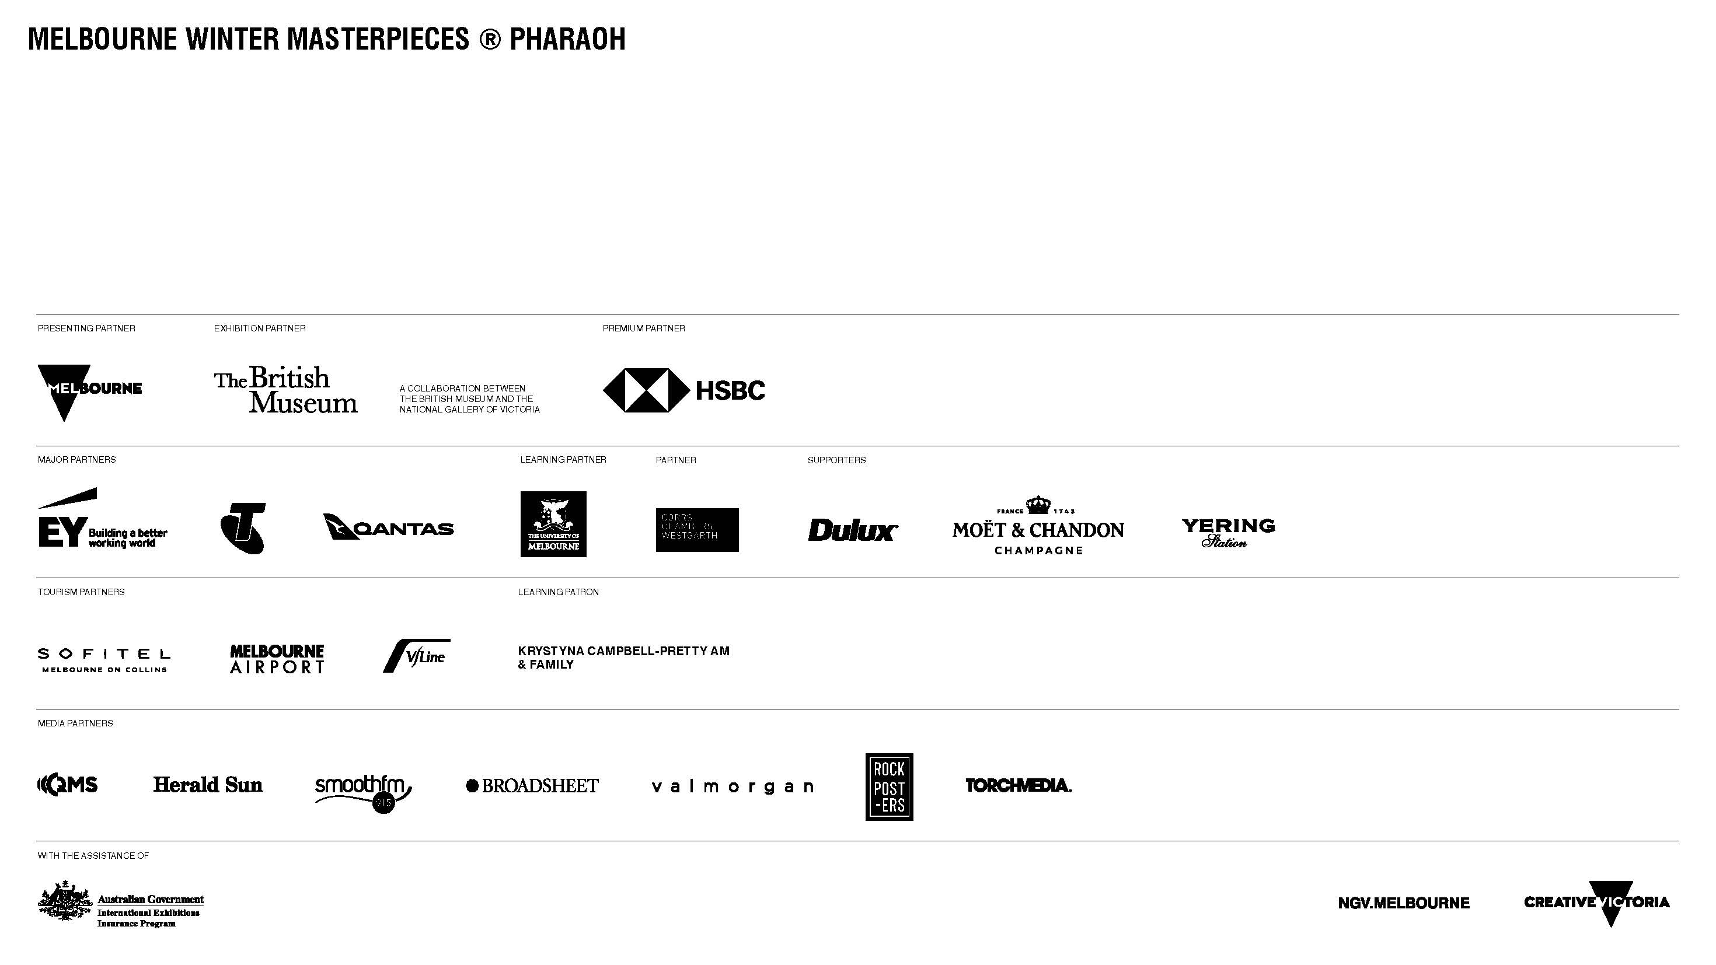
Notes:
Resources
Keep up to date with all programs, resources and events running during the Pharaoh exhibition on the NGV's Exhibition Page
Explore the Collection at the British Museum
Timeline of Ancient Egypt from the British Museum
Ancient Egypt for Ages 7 – 11 from the British Museum
Draw like an Egyptian- Activity for Levels 4-6

Slide 11
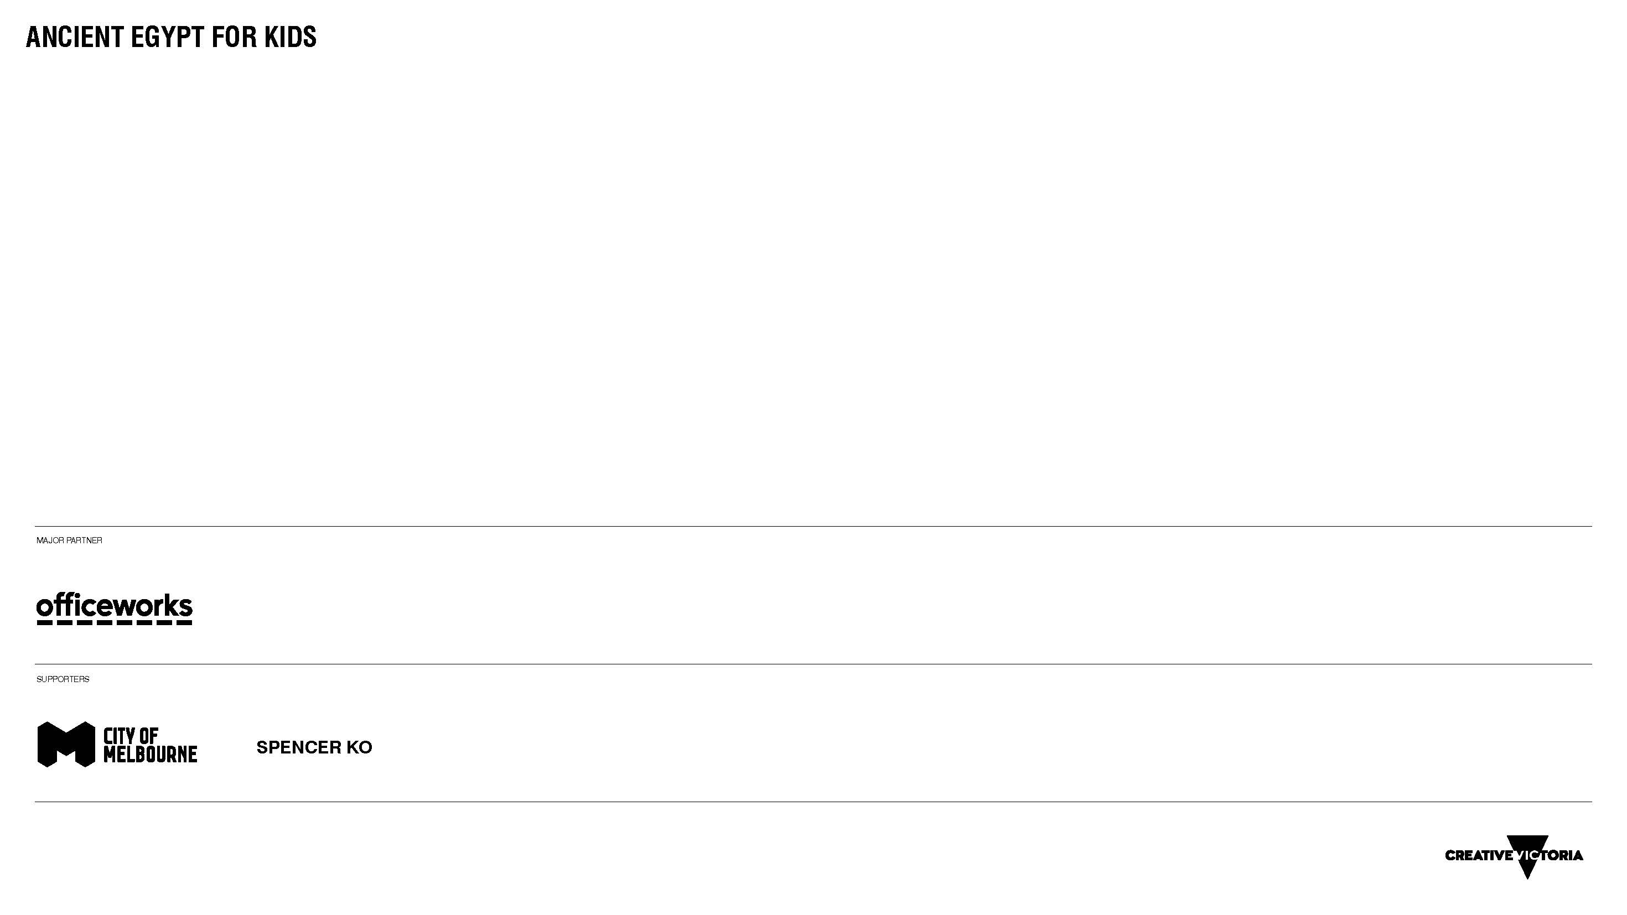

Slide 12


