Slide 1
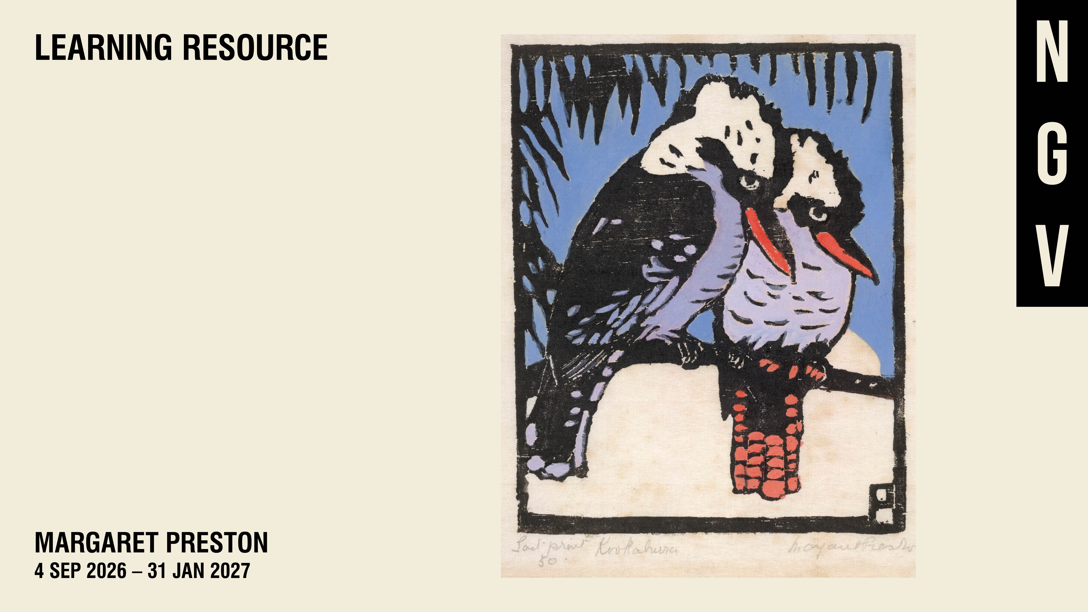

Slide 2
Notes:
INTRODUCTION TO THE RESOURCE
Designed for Levels 5-8, this resource includes introductory information and discussion prompts for a selection of NGV Collection artworks featured in the exhibition MARGARET PRESTON (4 September 2026 – 31 January 2027) at the National Gallery of Victoria. It may be used before or after your visit, or as an independent resource to support student learning and engagement with Preston's art and legacy.
Learning Objectives
Identify and describe art elements and principles in a selection of NGV Collection artworks.
Discuss how artists use the art elements and principles, as well as materials and techniques to communicate ideas and meaning.
Consider how artworks reflect the social, cultural and historical contexts in which they are made and how interpretation can shift across time.
About the exhibition
Step inside the vibrant world of one of Australia’s most influential painters. Margaret Preston is the first major exhibition on the artist in over 20 years, featuring more than 250 of her paintings, prints and ceramics. The exhibition showcases Preston’s mastery of a wide range of artistic styles, as shown in her captivating still life, floral and landscape paintings. The exhibition also features contemporary responses to Preston’s works, highlighting her lasting impact as an icon of twentieth century Australian art.

Slide 3
Notes:
WHO IS MARGARET PRESTON?
Celebrated for her bold floral still lifes and modern woodblock prints, Australian artist Margaret Preston (1875–1963) was a central figure in the development of modernism in Australia.
Preston studied in Adelaide, Sydney and Melbourne, before travelling extensively across England and Europe. Building on styles she encountered on her travels, including Post-Impressionism, European Primitivism and Japanese ukiyo-e, Preston began to develop her own unique visual language.
On her return to Australia in 1919, Preston also began to champion the idea of a national art and culture. In her enthusiasm, she increasingly looked to the cultural material of First Peoples, whose designs she perceived as untouched by European taste.
Although Preston was progressive in recognizing the aesthetic value of the objects and motifs she incorporated, her approach did not consider their significance to the communities from which she appropriated. As such, Preston’s work continues to generate debate, emphasizing her important contribution to Australian art of the twentieth century.
PRESTON AND PRINTMAKING
The mid-1920s marked the beginning of an extended period of printmaking that would come to define Preston’s practice. These early prints combined the medium of Japanese woodblock printing with, at times, designs appropriated from First Nations cultural material. Having studied the process of woodblock printing overseas, Preston was considered a well-respected authority on the subject by Sydney’s artistic community.
Wheelflower (c. 1929) is a hand-coloured woodcut print on brown hand-made paper. The woodcut depicts a blooming firewheel tree, a species that is native to coastal rainforests from northern New South Wales to Queensland.
DISCUSSION PROMPTS
Let’s investigate the Art Elements and Principles in Preston's Wheelflower (c. 1929):
Art Elements: colour, line, shape, form, tone and texture
Art Principles: emphasis (focal point), movement, rhythm, unity, variety, space, repetition (including pattern), balance, contrast, proportion, space and scale
Identify three of the most important art elements and three of the most important art principles. Create a list.
Based on your observation of how the art elements and principles have been used in this work, think of a describing word or phrase for each of the important art elements and principles you have identified?
For example: Simple shapes or bold colour, dynamic movement or striking repetition
Wheelflower (c. 1929), created almost one hundred years ago, was considered modern in the 1920s. Why might the work have been seen as modern at this time?

Slide 4
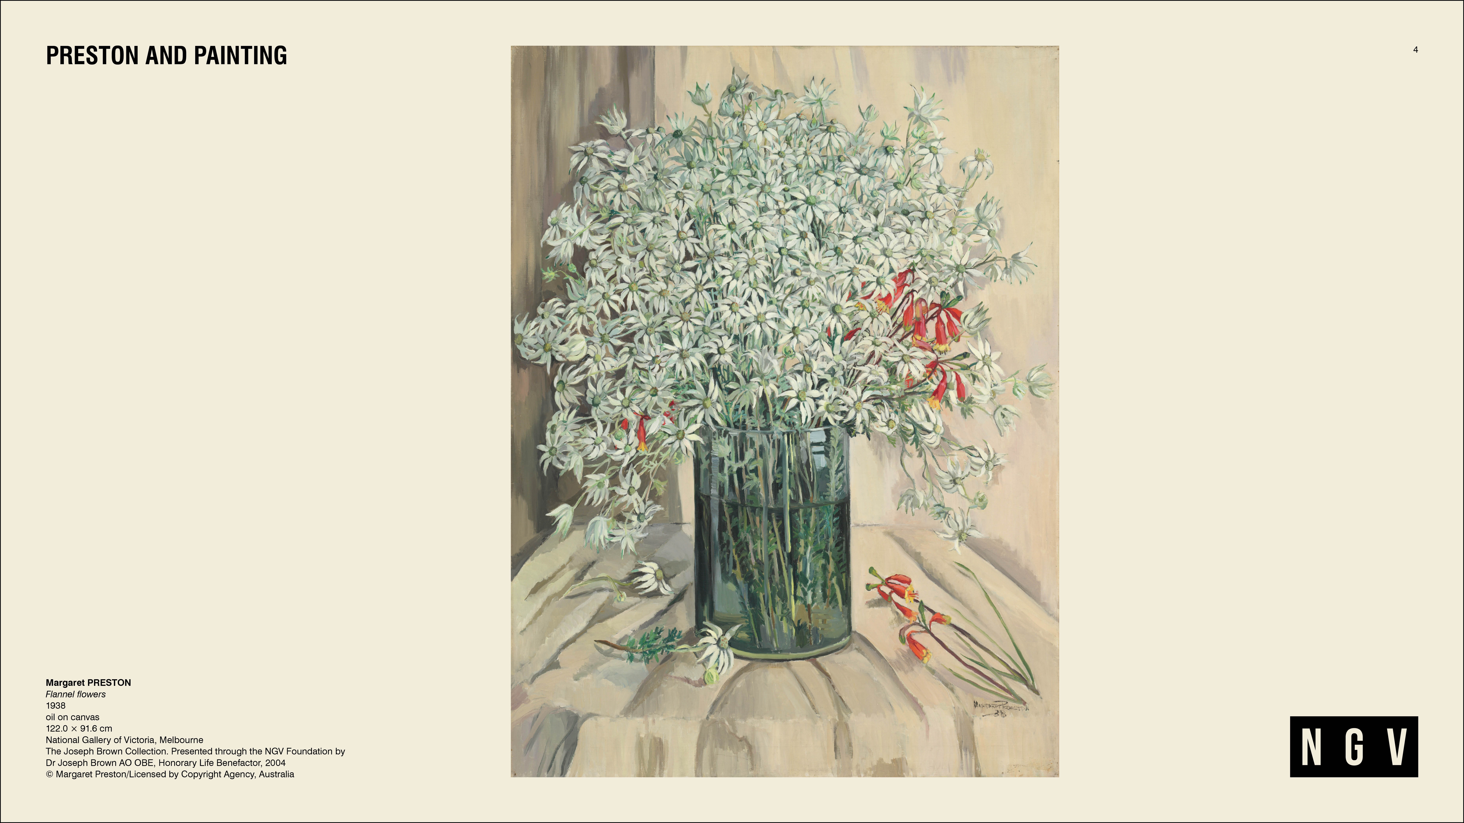
Notes:
PRESTON AND PAINTING
Preston promoted her ideas about modern art and Australian national identity, as well as her enthusiasm for First Nations cultural material through magazines such as The Home. The Home was a widely-read popular magazine that often featured Preston's art and writing. In a 1923 essay for The Home titled ‘Why I became a convert to modern art', Preston recalls painting, at the age of twelve, native Australian flannel flowers onto a set of her mother’s plates. Years later, the plant would become the subject of Flannel flowers, 1922, the earliest recording of a major painting by Preston featuring exclusively native Australian flora.
In 1938 Preston completed a series of ten large-scale paintings depicting Australian flora. Six were displayed in the Australian Pavilion at the New York World’s Fair in April 1939, and another four, including Flannel flowers 1938, were exhibited at the Golden Gate International Exposition in San Francisco later that year.
DISCUSSION PROMPTS
Identify three of the most important art elements and three of the most important art principles in Flannel Flowers, 1938. Create a list.
Based on your observation of how the art elements and principles have been used in this work, think of a describing word or phrase for each of the important art elements and principles you have identified? Can you think of more than one describing word or phrase for each?
Exhibited in San Francisco in 1939, what story do you think this work communicated about Australia?
How does Preston's use of the art elements and principles help to communicate this message?

Slide 5
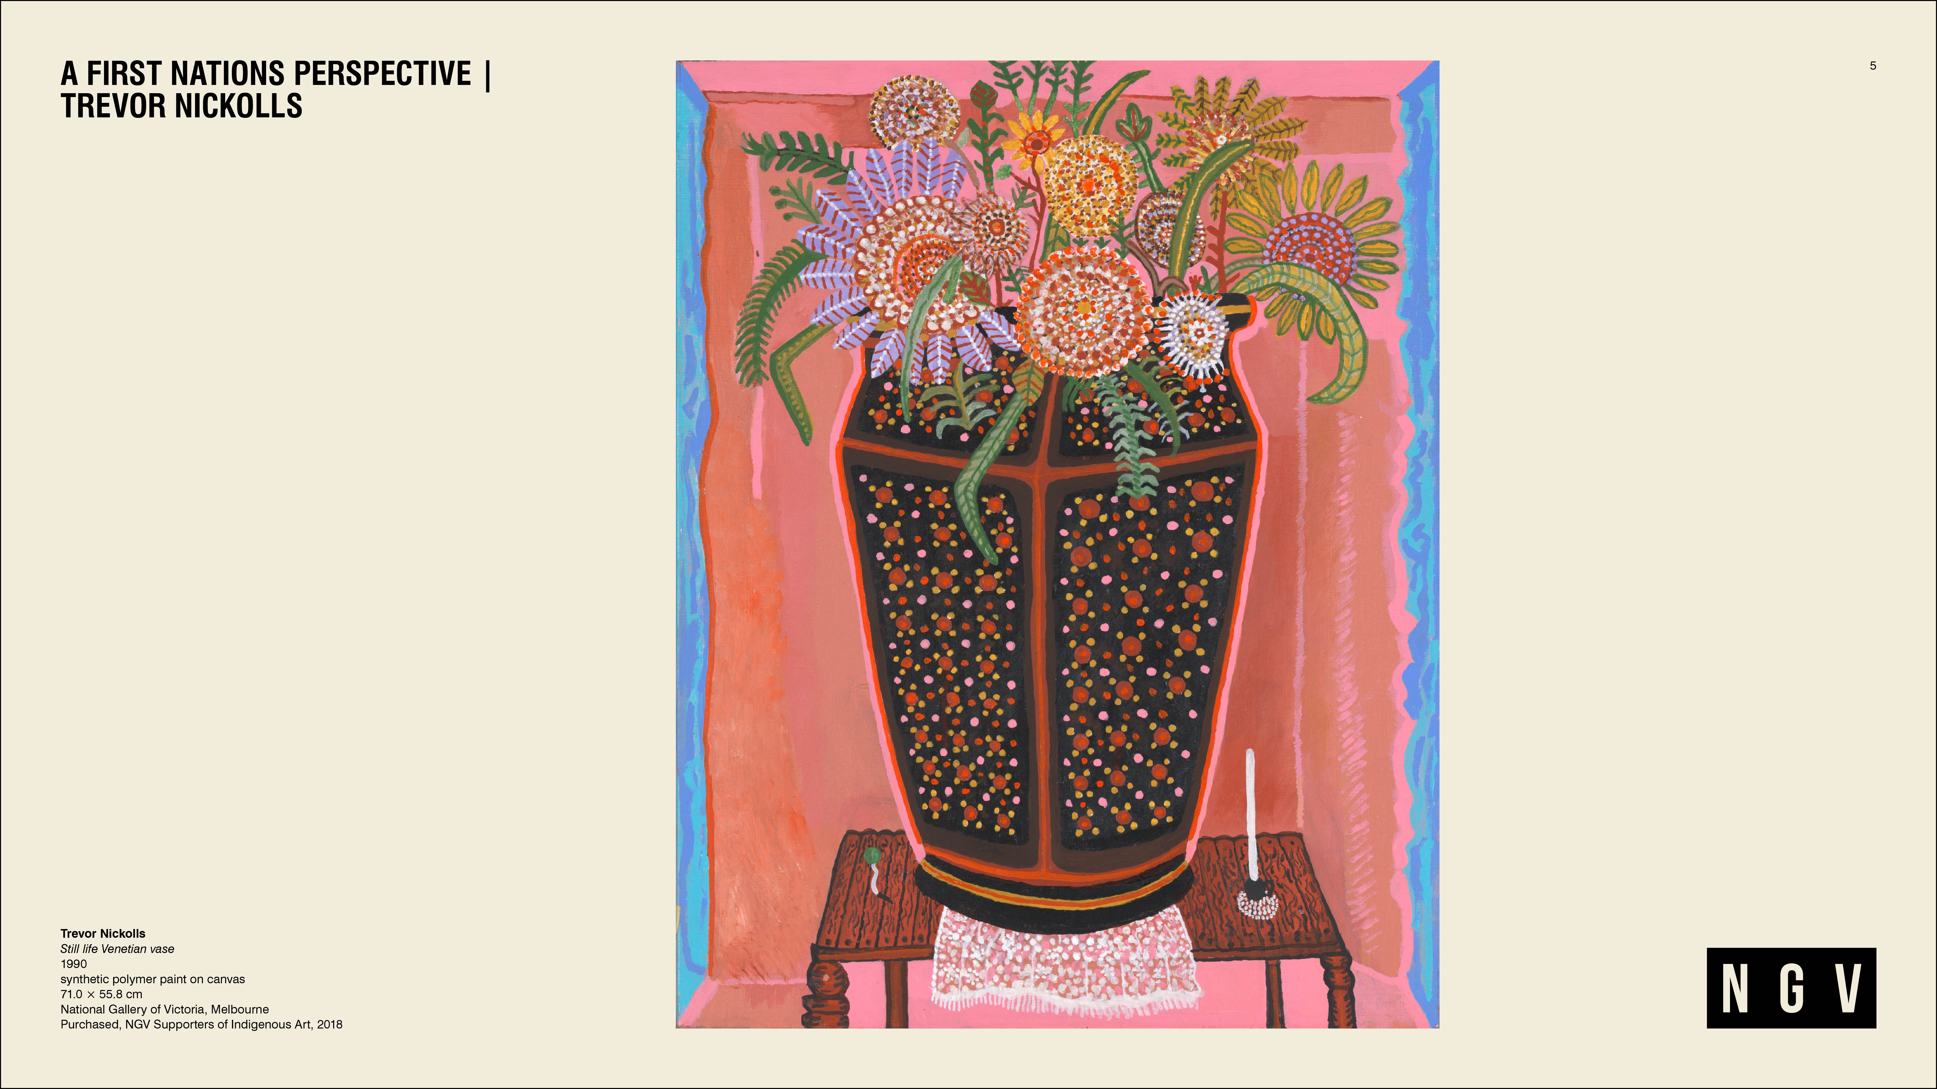
Notes:
A FIRST NATIONS PERSPECTIVE | TREVOR NICKOLLS
Many contemporary First Nations artists have repurposed, reframed and responded to Preston’s work. The first to do so was the late Ngarrindjeri artist Trevor Nickolls (1949-2012).
In Still life Venetian vase, 1990, Nickolls acknowledges how Preston encouraged non-Indigenous artists to ‘borrow’ from First Nations imagery, by including a vase decorated with stylised dot motifs and earth-toned patterns.
Nickolls was known for his colourful paintings which juxtaposed references to First Nations and Western visual culture. These references included the Western Desert dot painting technique, Arnhem Land cross-hatching or Rarrk, as well as the popular European genre of still life painting. He explored Indigenous Australian and European Australian themes which he referred to as "Dreamtime" and "Machinetime".
In 1990, Trevor Nickolls and Kimberley artist Rover Thomas became the first First Nations artists to represent Australia at the Venice Biennale. The Venice Biennale is often referred to as the Olympics of the art world. It's an international art festival held every two years that started over one hundred years ago.
DISCUSSION PROMPTS
Identify the dominant art elements and principles.
How has Nickolls used the art elements and principles in Still life Venetian vase, 1990 to communicate meaning?
What visual evidence can you find to support your answer?
What references to First Nations and Western visual culture can you find in this work?
Compare and contrast Nickolls's Still life Venetian vase 1990 with Preston's Flannel flowers 1938.
How are they similar or different?
What ideas and perspectives do they explore?
How might each work reflect the time in which it was made?

Slide 6
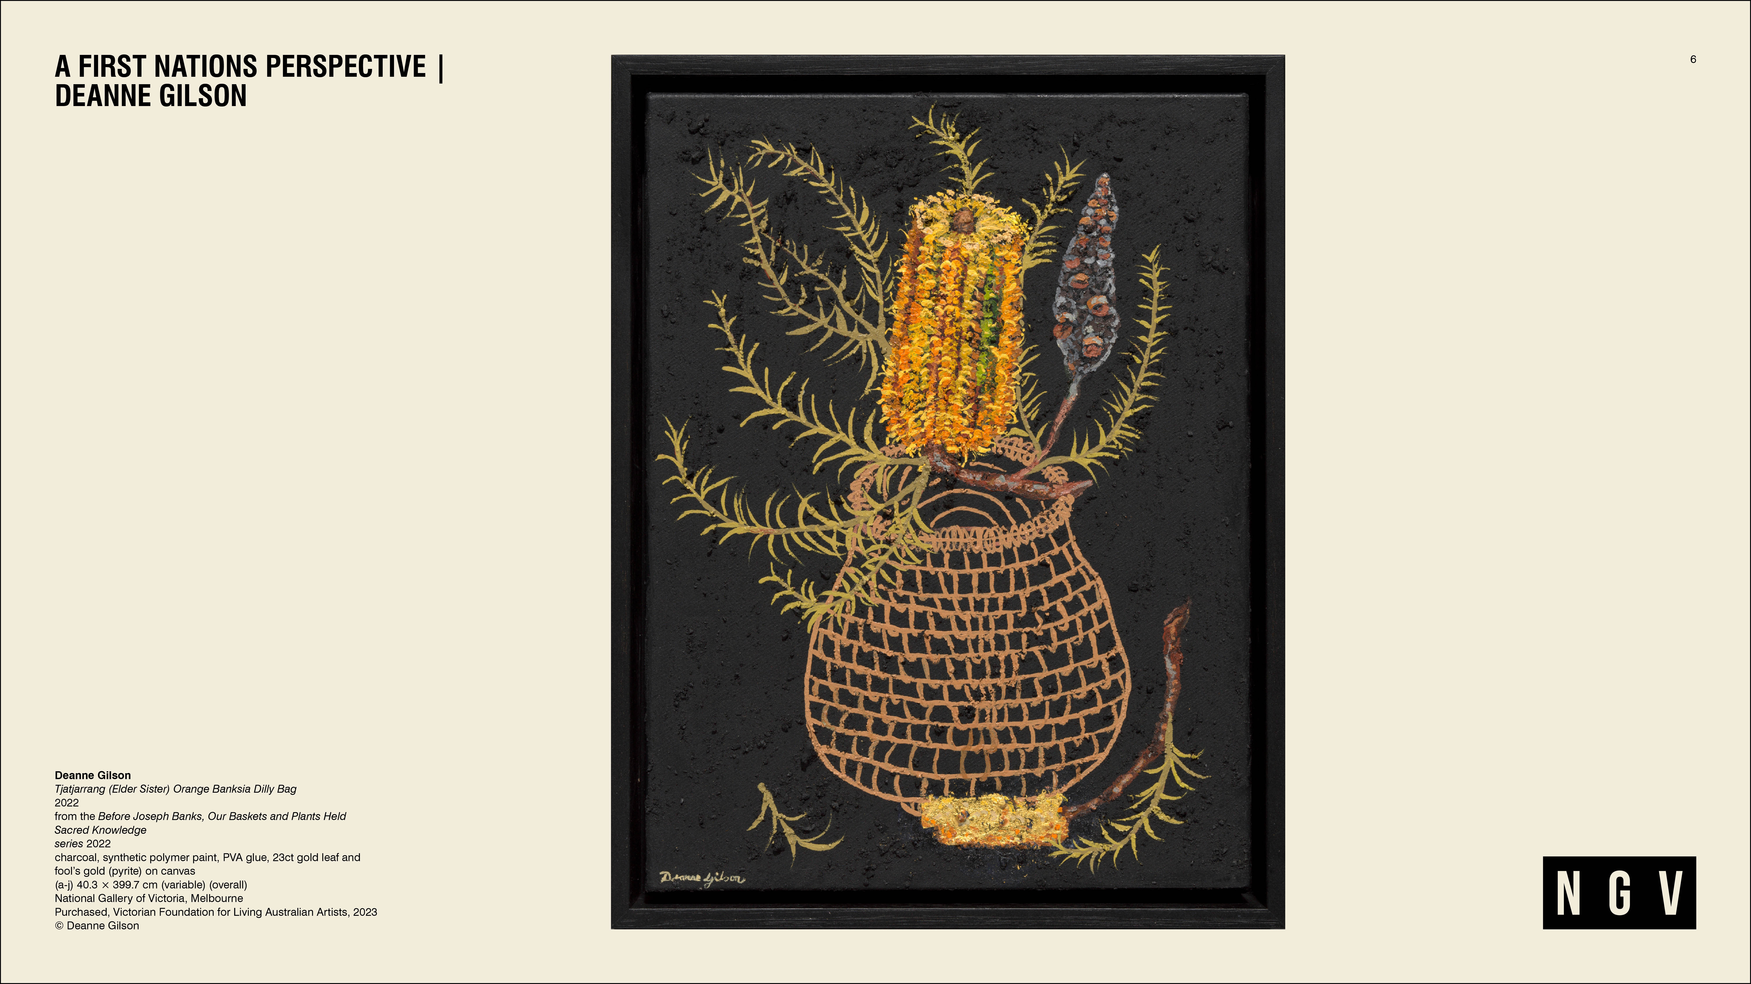
Notes:
A FIRST NATIONS PERSPECTIVE | DEANNE GILSON
While Preston’s representation of Australian native flowers is primarily concerned with aesthetics, Deanne Gilson, a proud Wadawurrung woman, addresses their inherent ancestral meaning.
Tjatjarrang (Elder Sister) Orange Banksia Dilly Bag, 2022 emphasises the deeper cultural significance of the plant and the importance of ancestral knowledge embedded in the land.
Gilson says:
‘The banksia was used to make artefacts like spears, shields and coolamons, while the seed pods were used as water strainers and fire sticks. The nectar was drunk, or used as glue for artefacts, drum making, ochre painting and to seal possum skins for wet weather.'
Painted in a mixture of charcoal, black ochre, fool’s gold (pyrite) and 23ct gold leaf on canvas this work celebrates the beauty and resourcefulness of Country and the important cultural knowledge held and transmitted by women across generations.
Tjatjarrang (Elder Sister) Orange Banksia Dilly Bag, 2022 belongs to a series of ten still-life works depicting indigenous plants in baskets that are indicative of traditional woven vessels from around Australia. This series is called Before Joseph Banks, Our Baskets and Plants Held Sacred Knowledge, 2022.
DISCUSSION PROMPTS
Gilson has used a curious mixture of materials in her work; charcoal, synthetic polymer paint, PVA glue, 23ct gold leaf and fool’s gold (pyrite) on canvas.
Where are these materials found and/or made?
How has Gilson applied these materials to the canvas?
How might these materials inform the ideas and messages of Gilson's work?
Why do you think Gilson called her series of works, of which this one belongs, Before Joseph Banks, Our Baskets and Plants Held Sacred Knowledge? If you're not sure who Joseph Banks was, see if you can find out.
How does the title of this series add to the meaning and message of her work?

Slide 7
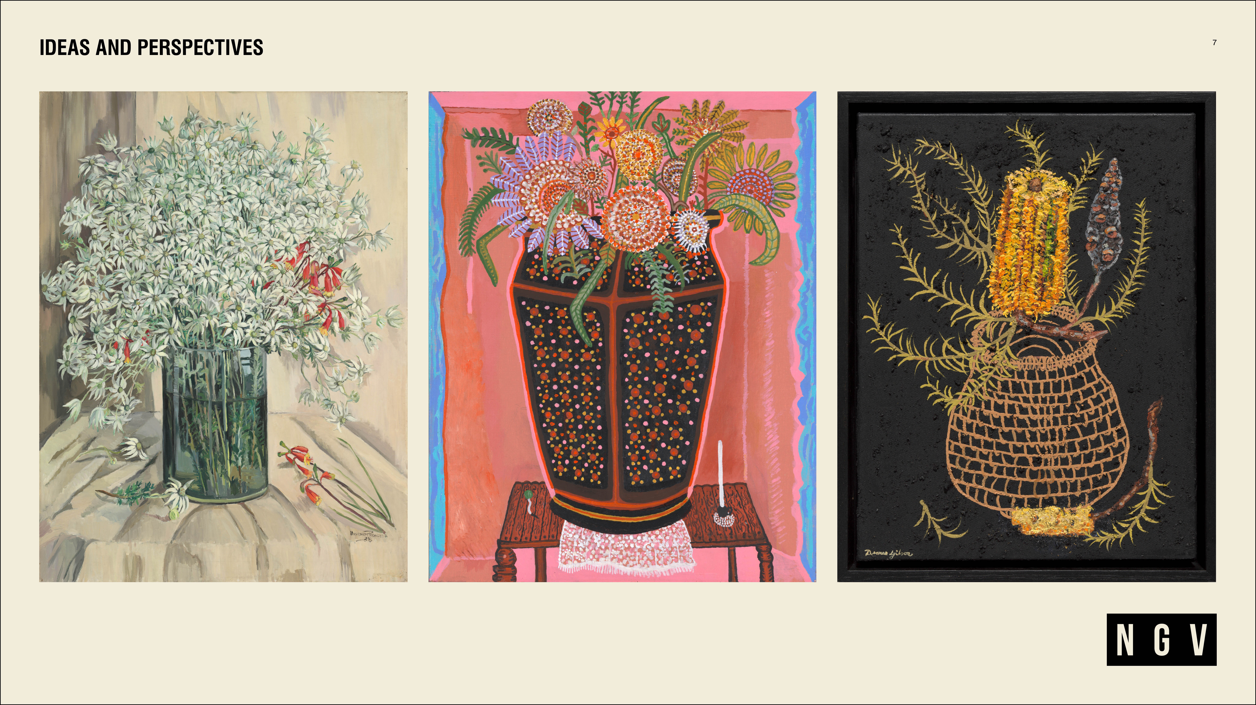
Notes:
IDEAS AND PERSPECTIVES
If you could take one of these paintings home, which one would you choose and why?
What are the similarities and differences of these three paintings? Include the art elements and principles in your response.
Preston's Flannel flowers, 1938, Nickolls' Still life Venetian vase, 1990 and Gilson's Tjatjarrang (Elder Sister) Orange Banksia Dilly Bag, 2022 were painted decades apart.
What ideas and perspectives do they each explore?
How might these ideas and perspectives reflect the time in which they were made?
Why do you think the NGV might have included Nickolls's and Gilson's work in an exhibition about Margaret Preston?
GLOSSARY
MODERNISM:
Modernism is a term often used to describe the innovative and experimental art and design styles that emerged in the early twentieth century in many places around the world. Modernism was a break from the traditional, conservative and realistic art styles and subjects that had dominated western art history for centuries. Modernist artists used materials, techniques and art elements, such as colour and form, in bold new ways for personal expression and to create artworks that reflected a rapidly changing modern world.
POST IMPRESSIONISM:
A French, late nineteenth and early twentieth century art movement that developed after Impressionism. Like the Impressionists, the Post Impressionist artists also recorded nature with an emphasis on light and colour. However, Post Impressionists subject matter was more diverse, with shapes and forms increasingly geometric; colours often more vivid and unnatural, while overall their works often had greater personal expression. Post Impressionists artists included Paul Cezanne, Vincent van Gogh and Paul Gauguin.
The uphill road, Paul CÉZANNE | NGV
EUROPEAN PRIMITIVISM:
In the late nineteenth century European artists were inspired by the tribal arts of Africa, Oceania, and Native America. It led to a new way of looking and understanding art from non-European cultures. Artists such as Picasso, Gauguin and Matisse appropriated the forms of so called "Primitive” art which used simple shapes and more abstract figures which were different from European styles of representation
Weeping woman, Pablo PICASSO | NGV
UKIYO-E:
Ukiyo-e was one of the most important styles of art in Japan from the seventeenth through to the nineteenth centuries. In Japanese, Ukiyo-e means pictures of the floating world. Its artists made woodblock prints and paintings, often reducing the subject matter to the essential elements experimenting with materials, colours and lines on a flat picture plane.
The great wave off Kanagawa, Katsushika HOKUSAI | NGV
WOODBLOCK PRINTING:
Dating back to the fifth century, Woodblock printing is a style of relief printing that is one of the oldest methods of making prints. Once a design is drawn onto a block of wood, the surface of the wood is cut away around the design. Ink or paint is then rolled onto the block of wood with only the raised areas holding the ink which is then printed on a surface such as paper. Woodblocks can be used many times, which means you are able to make multiple copies of your design.
Printing Press, Albrecht DÜRER | NGV
APPROPRIATED:
To appropriate is to take something for one's own use, often without the owner's permission. In the 1980s First Nations artists in Australia consciously engaged in our political and cultural landscape, challenging the appropriation of their cultural material. In Australia, we now have guidelines to assist in understanding the importance of cultural protocol. One example is the Australian Indigenous Design Charter – IDC
AUSTRALIAN NATIONAL IDENTITY
NATIONALIST IDEAS:
In the late nineteenth and early twentieth centuries Australian's were interested in an identity and culture which was separate from British influence. At this time, national identity was often defined by rural life, the spirit of the bush, mateship and a fair go for all. National identity is an evolving concept, shifting and changing across generations. From the 1920s, Preston advocated for First Nations culture and cultural material to be included in Nationalist ideas.
AESTHETIC:
The word aesthetic is often used in art to refer to an artwork's beauty; the artistic qualities which are visually pleasing.
MOTIF:
Motif refers to a decorative image or design, especially a repeated one forming a pattern. It often dominates and/or is a reoccurring symbol in an artwork.

Slide 8
